Slide 1
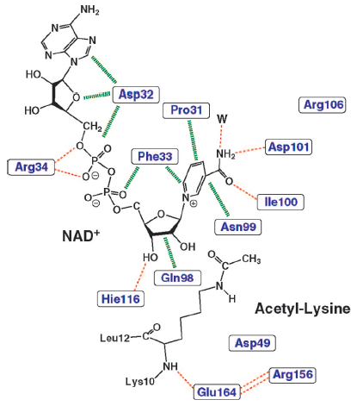
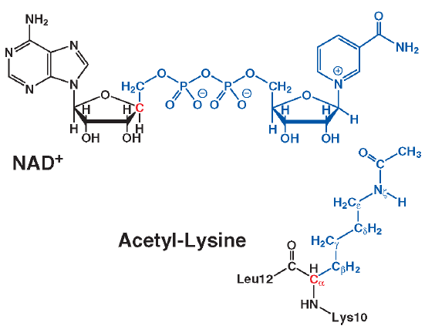
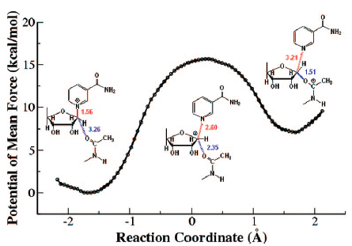
Sir2Tm
Sir2 enzymes catalyze the NAD+-dependent protein deacetylation and play critical roles in epigenetics, cell death, and lifespan regulation. In spite of a current flurry of experimental studies, the catalytic mechanism for this unique and important class of enzymes remains elusive. Employing on-the-fly Born-Oppenheimer molecular dynamics simulations with the B3LYP/6-31G(d) QM/MM potential and the umbrella sampling method, we have characterized the initial step of the Sir2Tm-catalyzed reaction, which is also the most controversial portion of its mechanism. Our results indicate that the NAM cleavage reaction employs a highly dissociative and concerted displacement mechanism: the cleavage of the glycosidic bond is facilitated by the nucleophilic participation of the acetyl-lysine, and the dissociative transition state has a significant oxocarbenium ion character. During this step of the reaction, the Sir2Tm enzyme strongly stabilizes the covalent O-alkylamidate intermediate whereas its effect on the transition state is quite minimal. In addition, functional roles of key residues and motifs have been elucidated. This work further demonstrates the feasibility and applicability of the state-of-the-art ab initio QM/MM molecular dynamics approach in simulating enzyme reactions.
Illustration of the QM/MM partition: black, MM subsystem; red, boundary carbon atoms in the QM subsystem described by improved pseudobond parameters;62 blue, all other atoms in the QM subsystem.
Potential of mean force for the Sir2Tm catalyzed nicotinamide cleavage reaction determined with B3LYP/6-31G(d) QM/MM MD simulations.
Interactions of key residues with the NAD+ and the substrate acetyl-lysine.
P. Hu, S Wang, and Y. Highly dissociative and concerted mechanism for the NAM cleavage reaction in Sir2Tm. JACS (2008) 130: 16721-16728.

Slide 2
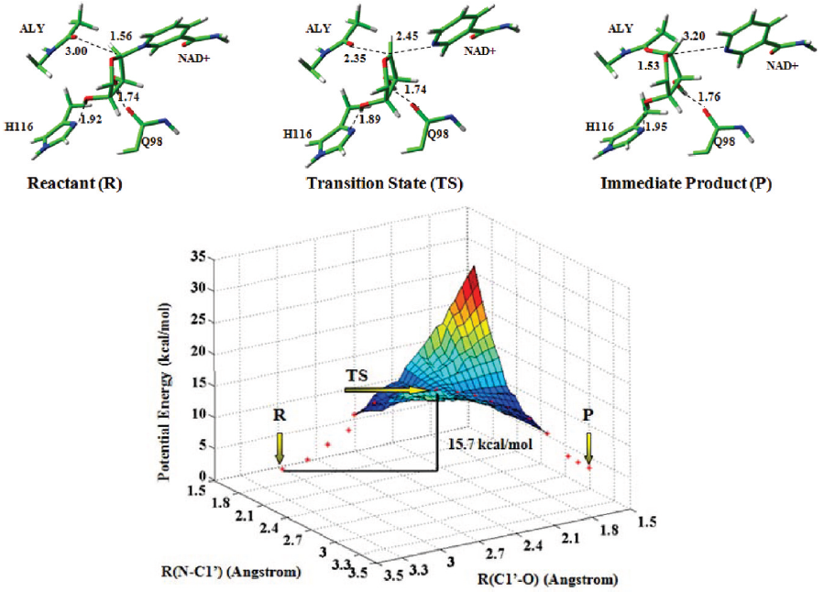
Sir2Tm
To characterize this catalytic mechanism of acetyllysine deacetylation by Sir2, we
employed a combined computational approach to carry out molecular modeling, molecular dynamics (MD)
simulations, quantum mechanics/ molecular mechanics (QM/MM) calculations on catalysis by both yeast Hst2 (homologue of SIR two 2) and bacterial Sir2TM (Sir2 homologue from Thermatoga maritima). Our threedimensional (3D) model of the complex is composed of Sir2 protein, NAD+, and acetyllysine (ALY) substrate. A 15-ns MD simulation of the complex revealed that Gln115 and His135 play a determining role in deacetylation. These two residues can act as bases to facilitate the deprotonation of 2′-OH from N-ribose. The result is in great agreement with previous mutagenesis analysis data. QM/MM calculations were further performed to study the mechanism of the first step in deacetylation in the two systems. The predicted potential energy barriers for yHst2 and Sir2TM are 12.0 and 15.7 Kcal/mol, respectively. The characteristics of the potential energy surface indicated this reaction belongs to a SN2-like mechanism.
The potential energy surface of the reaction pathway corresponding to the first step in the deacetylation of Sir2TM-ALY-NAD+ complex. The structures displayed at the top of the potential surface are the QM/MM optimized structures of the reactant (R), transition state (TS), and immediate product (P). For clarity, only the structures in the QM region have been shown.
A Liang, et al. Investigation of the catalytic mechanism of Sir2 enzyme with QM/MM approach: SN1 vs SN2? J Phys. Chem. )2010) 114: 11927-11933.

Slide 3
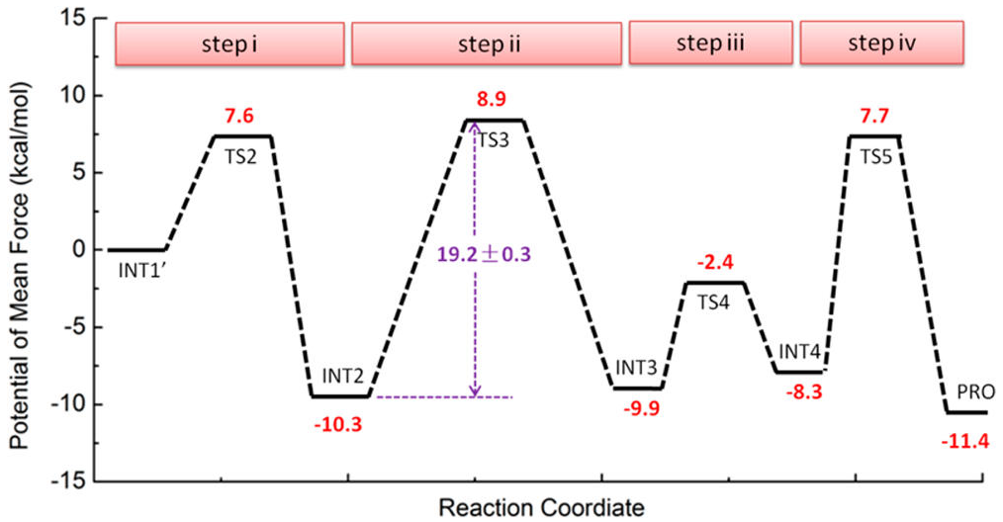
Sir2Tm
By employing Born−Oppenheimer ab initio quantum mechanics/molecular mechanics (QM/MM) molecular dynamics simulations, a state-of-the-art computational approach to study enzyme reactions, we have characterized the complete deacetylation mechanism for a sirtuin enzyme, determined its multistep free-energy reaction profile, and elucidated essential catalytic roles of the conserved dynamic cofactor binding loop. These new detailed mechanistic insights could facilitate the design of novel mechanism-based sirtuin modulators.
Alkylamidate intermediate after NAM release
Bicyclic intermediate
Tetrahedral intermediate
The protonated tetrahedral intermediate
2’-O-AADPR & deactylated
product
Step ii is rate-determining step
The calculated overall activation free energy barrier with B3LYP/6-31G(d) QM/MM simulations is
19.2 kcal mol⁻¹.
Y. Shi, Y. Zhou, S. Wang, and Y. Zhang.Sirtuin Deacetylation Mechanism and Catalytic Role of the Dynamic Cofactor Binding Loop. (2013) J Phy. Chem. 4: 491-495.
Notes:
Computational details can be found in reference named as “Supp_sirtuin deacetylation mechanism and catalytic role of the dynamic cofactor binding loop”.

Slide 4
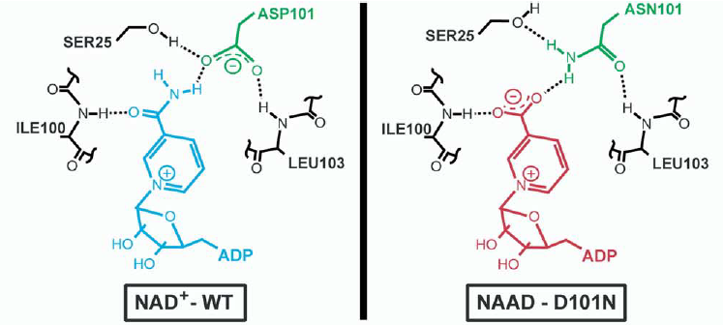
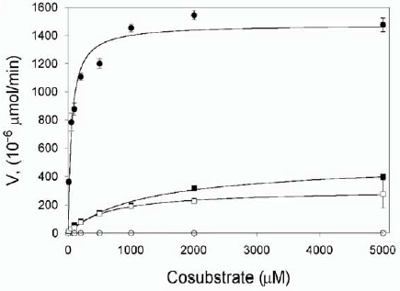
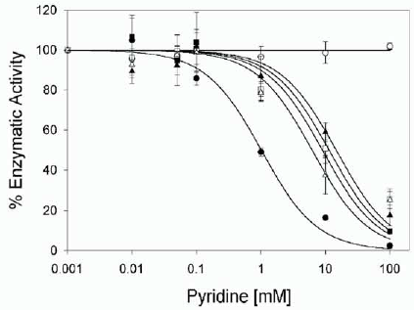
Sir2Tm
 | NAD⁺ |  | NAAD
 | Sir2Tm | Sir2TmD101N | Sir2Tm | Sir2TmD101N
K_{cat}, s⁻¹ | 0.17 ± 0.006 | (1.8 ± 0.1)x10⁻³ |  | (1.1 ± 0.1)x10⁻³
K_{M}, uM | 53 ± 11 | 1170 ± 180 |  | 617 ± 43
K_{cat}/k_{M}, s⁻¹ mM⁻¹ | 3.2 ± 0.8 | (1.5 ± 0.4)x10⁻³ |  | (1.8 ± 0.3)x10⁻³
With transition state theory, from highlighted k_{cat} value, the calculated overall activation free energy barrier is 18.6 kcal mol⁻¹.
Schematic representation of the H bond network observed between productive NAD+ (blue) and Asp101 (green, left) and the hypothetical H bond network between productive NAAD (red) and the substituted Asn101 (green, right).
Inhibition of Sir2Tm wt's NAD+-dependent deacetylation activity (circles) and the Sir2Tm-D101N mutant's NAD+-dependent (squares) and NAAD-dependent (triangles) deacetylation activities by nicotinamide (black) and nicotinic acid (white).
Initial rates of NAD+-dependent (black) and NAAD-dependent (white) deacetylation activities of the wild-type (wt) (circles) and D101N mutant (squares) Sir2Tm.
Jl Avalos, KM Bever, and C Wolberger. Mechanism of sirtuin inhibitionn by NAM: altering the NAD+ cosubstrate specificity of a Sir2 enzyme. Mol. Cell (2005) 17: 855-868.
Notes:
Methods
Measurement of deacetylation activity using a Fluorolabeled peptide
The deacetylation activity was measured by using the Fluor de Lys-SirT1 assay.
TLC detection of base exchange activities
The NAM and NA exchange reactions were carried out in 20 ul containing 50 mM sodium phosphate, (pH8.0), 0.5 mM DTT, 2mM NAD+, and 500 uM of the acetylated p53 peptide used in the crystallographic studies and NAD+ consumption assay. The reactions contained 0.1 mM of 14 C-nicotinamide (Moravek biochemicals MC1427, 53mCi/mmol) or 14C-nicotinic acid (54 mCi/mmol), with 80 ug.ml of the wt enzyme or 2.5 mg/ml of the D101N mutant. After incubation at 37oC for 3 hr, 8 ul of each reaction was spotted on a polygram SIL-G TLC plate. The plate was developed in a pre-equilibrated chamber with 80:20 ethanol:2.5M ammonium acetate. After chromatography, the plate was air dried and exposed to a phosphorimaging screen overnight. The reaction using 2.5 mg/ml of wt enzyme and 14C-nicotiniac acid showed no detectable formation of NAAD.

Slide 5
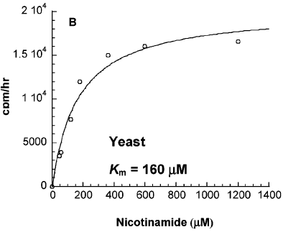
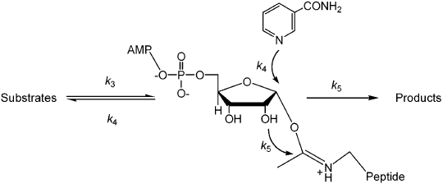
Sir2: bacterial, yeast, mouse
Reactions are initial rate measurements under conditions that saturate the enzyme [600 μM NAD and 300 μM peptide substrate, pH 7.8]. k_{cat}(deacetylation) is the rate of the deacetylation reaction for the enzyme in the absence of added NAM. k_{cat}(exchange) is determined from the saturation curves (right) for exchange. k_{inh}(deacetylation) is the residual deacetylation rate in the presence of 2 mM nicotinamide. The K_{m}(exchange) values are determined from the fits of the Michaelis-Menten equation.
The rate constants k₃-k₅ for the mouse and yeast enzymes can be obtained with modest assumptions. For these enzymes, k_{cat}(exchange) > k_{cat}(deacetylation) by a factor of at least 3. Since they share a common rate constant k₃, k₃ > k₅ and k₄ > k₅ by a factor of at least 3. Therefore, we assume k₅ = k_{cat}(deacetylation). The relation k₄/k₅=kcat(exchange)/k_{int}, where k_{int} is the residual deacetylation rate, reflects the ratio of the two competing rates that deplete the ADPR intermediate. These ratios are 220, 9.8, and 0.25 for inhibition for the mouse, yeast, and bacterial enzymes, respectively. Calculation of k₄ using k₅ determines that k₃ is rate-limiting for exchange for the mouse and yeast enzymes. Therefore, the final rate can be approximated with the relation k₃ = k_{inh} + k_{cat}(exchange). These simple assumptions allow quantitation of k_{cat}(exchange), k_{cat}(deacetylation), and the residual rate k_{inh} (Table 3). The mechanistic assumptions can also derive the relation K_{m}(exchange) ) K_{i}. This equality is analogous to that calculated and demonstrated for the ADPribosyl cyclase CD38 (24). The calculated rates assuming saturating conditions and equilibrium binding for peptide and NAD⁺ agree to within 20% with the experimental values.
Note: k₄/k₅ =k_{cat}(exchange)/k_{inh}(deacetylation) ; k₃ = k_{cat}(exchange) + k_{inh}(deacetylation); k₅ =k_{cat}(deacetylation); k₄ is computed from the determined k₄/k₅ ratio and the value of k₅; K_{eq} = k₃ /k₄.
A.A. Sauve, et al. Sir2 regulation by nicotinamide results from switching between base exchange and deacetylation chemistry. Biochemistry 42 (2003) 9249–9256.
Notes:
Methods
SIR2-Exchange and Deacetylation Assays. Reaction mixtures of 50 υl of 50 mM potassium phosphate (pH 7.8) containing 300 uM KKGQSTSRHK(KAc)LMFKTEG peptide and 600 uM NAD⁺ containing selected micromolar concentrations of [carbonyl-¹⁴C]nicotinamide at 60 uCi/umol (0, 10, 20, 30, 45, 60, 80, 90, 125, 250, 360, 600, and 1200) were reacted with 1 uM Sir2 enzyme added as a 1 ul addition of concentrated enzyme. After 2 h, 10 ul aliquots were removed at 0, 30, 60, 90, and 120 min. Each aliquot was combined with 50 uL of 50 mM ammonium acetate (pH 5.0) to quench and assayed by HPLC for deacetylation products and NAD⁺. The chromatograms (260 nm) were obtained using 50 mM ammonium acetate (pH 5.0) as the eluant on a semipreparative Waters C-18 column (flow rate of 2.0 mL/min). Peaks for ADPR and 3’-O-acetyl-ADPR were quantified by integration. The peak for NAD⁺ was collected and the radiation counted. Plots of rate versus nicotinamide concentration were fit using the curve V = k_{cat}[S]/([S] + Km) with the curve-fitting feature of Kaleidagraph. Plots of deacetylation rate versus nicotinamide concentration were fit to the equations described in the text. Experiments with 2 mM nicotinamide established the effects of this concentration on the deacetylation and exchange activity of the Sir2 enzyme.
Inhibition of Deacetylation with Nicotinamide Isosteres. Reactions were as described above, but mixtures for base reactions contained 5 mM pyrazinamide, isonicotinamide, thionicotinamide, or benzamide. Reactions were carried out (2 h for AF2 and yeast enzymes and 3 h for mouse enzyme) at 37 °C and quenched by addition of 80 uL of 50 mM
ammonium acetate (pH 5.0). Product formation was quantified by HPLC. Thionicotinamide-NAD⁺ was synthesized by CD38. Rates were compared with controls lacking added
base.

Slide 6
NAM exchange reaction
J. Landry, et al. The silencing protein SIR2 and its homologes are NAD-dependent protein deacetylases. PNAS (2000) 97: 5807-5811.
Exchange reactions for CobB, HST2, or Sir2 were performed in 20-μlvolumes with 5 mM NAD (Sigma N-1511), ≈50 ng of enzyme, 0.1 mM [¹⁴C]nicotinamide (Sigma N-2142, 53.1 mCi/mmol), 50mM sodium phosphate (pH 7.2), and 0.5 mM DTT. Chicken erythrocyte histones were used at a concentration of 0.2 mg/ml. H4 or H3 peptides, when present, were at a concentration of 25 μM. The H4 peptide corresponded to the first 28 amino acids of H4, and the H3 peptide corresponded to the first 20 amino acids of H3. Peptides were acetylated as described below. Exchange reactions were incubated at 37°C for 60 min. After incubation, 8 ml of each reaction was spotted to Whatman HPKF Silica Gel 60 A TLC plates. The plates were developed in a pre-equilibrated chamber with 80:20 ethanol:2.5 M ammonium acetate. After chromatography, the plates were air dried and exposed to film (Kodak X-Omat AR) for 36–48 h.
M.D. ackson, et al. Mechanism of NAM inhibition and transglycosidation by Sir2 histone/protein deacetylases. J Bio. Chem. (2003) 278: 50985 – 50998.
General exchange reactions for HST2, HST2 mutant H135A, hSIRT2, and ySir2 were performed in 50-ul volumes containing 500 uM NAD, 300 uM acetylated H3 peptide, 1 mM DTT, and buffer (PBS, pH 7.3, 37 °C, or 50 mM Tris-Cl, pH 7.5, 37 °C, as noted), 0.2 uM enzyme, and nicotinamide concentrations ranging from 3 uM to 1 mM containing [carbonyl-¹⁴C]nicotinamide (Sigma N-2142, 52.8 mCi/mmol). Reactions were initiated via addition of enzyme, incubated at 37 °C for 5–8 min, and quenched with neat trifluoroacetic acid (to a final concentration of 1%). Linearity of rates was confirmed by measuring exchange over time courses up to 30 min. After quenching, 5 ul of each reaction was spotted to Whatman aluminum backed Silica Gel TLC plates (Fisher) and placed in a development tank pre-equilibrated with 80:20 ethanol, 2.5 M ammonium acetate for 1 h. Plates were air-dried and exposed to a PhosphorImaging screen (Bio-Rad Molecular Imaging Screen-CS) for 24 h and then read with Bio-Rad GS-525 Molecular Imaging System and Molecular Analyst software (version 2.1.2). The percentage of nicotinamide exchanged was determined by measuring the densities of the [carbonyl-14C]nicotinamide(R_{f} 0.80) and enzymatically created ¹⁴C-labeled NAD⁺ (R_{f} 0.27). Enzymatic exchange rates were fitted to the Michaelis-Menten equation (Kaleidagraph, Synergy Software, Reading, PA).
AA Sauve, et al. Sir2 regulation by NAM results from switching between base exchange and deacetylation chemistry. Biochemistry (2003) 42: 9249 -9256.
T. McDonagh, et al. Microplate filtration assay for NAM release from NAD using a boronic acid resin. Methods (2005) 36: 346-350.

Slide 7
NAM inhibition reaction
M.D. ackson, et al. Mechanism of NAM inhibition and transglycosidation by Sir2 histone/protein deacetylases. J Bio. Chem. (2003) 50985 – 50998.
Nicotinamide inhibition reactions for both HST2 and hSIRT2 were performed in 80-l volumes with 500 uM NAD, 300 uM ³H-acetylated H3 peptide, 1 mM DTT, 50 mM Tris-Cl (pH 7.5, 37 °C), 0.5 uM enzyme, and nicotinamide concentrations ranging from 3 uM to 1 mM. Reactions were initiated by addition of enzyme, incubated at 37 °C for 5–8 min, and quenched with activated charcoal. Inhibition was determined by measuring the forward rate using the charcoal-binding assay (described below). Forward rates were fitted to
using Kaleidagraph software.
charcoal-binding assay
General enzymatic reactions contained ³H-acetylated H3 peptide substrate, NAD, and a NAD-dependent Sir2-like class III protein/histone deacetylase to form the product ³H-labeled OAADPr. To 70-ul reaction volumes was added 50 ul of charcoal slurry (1 volume of activated charcoal to 2 volumes of 2.0 M glycine buffer, pH 9.5) to terminate the reaction at the desired time points. The mixture was heated at 95 °C for 1 h and then centrifuged for 1 min at 7000xg. A total of 90 ul of the supernatant was removed and added to 50 ul of fresh charcoal slurry, centrifuged again for 1 min, and 100 ul of the supernatant removed and added to a clean tube. This was centrifuged for 5 min, and 75 ul removed and quantified by liquid scintillation counting. This assay effectively measures the amount of ³H-labeled OAADPr in the form of free acetate. Both OAADPr and acetylated H3 peptide bind to the activated charcoal. However, under these conditions the ³H-labeled acetate from OAADPr is hydrolyzed and remains in the supernatant. Activated charcoal immediately stops the enzymatic reaction at all pH and temperature values tested. Heating and high pH is necessary only to hydrolyze acetate from OAADPr (data not shown). Amides, represented by unreacted peptide, are not hydrolyzed under these conditions (data not shown).

Slide 8
Deacetylation reaction
J. Landry, et al. The silencing protein SIR2 and its homologes are NAD-dependent protein deacetylases. PNAS (2000) 97: 5807-5811.
Deacetylation reactions were carried out in a two-step process. Histonesypeptides were first acetylated with [³H]acetyl-CoA in 50-ul reactions with 75 mM TriszCl (pH 8.8), 135 mM NaCl, 0.2 mg/ml chicken erythrocyte histones, or 50 uM H4 or H3 peptide, 0.875 mCi of [³H]acetyl-CoA (Amersham TRK688, 3.80 Ci/mmol), and 40 ng of enzyme (HAT1, ESA1, or HPA2). Reactions were incubated at 37°C for 30 min and then heated at 55°C for 30 min to inactivate the histone acetyltransferase. Tests showed that this inactivated HAT1 and ESA1 but not HPA2. Acetylated histones/peptides were assayed for deacetylase activity in 25-ul reactions including 0.5 mM NAD, 50 mM sodium phosphate (pH 7.2), 0.5 mM DTT, 50 ng of enzyme to be tested, and 20 ul of a histone acetylation reaction as the substrate. Reactions were incubated at 37°C for 60 min. After incubation, the reactions were spotted to Whatman P81 cation-exchange paper and air dried. The dried papers were washed for 5 min three times with 1 M sodium carbonate (pH 9.0), followed by a wash in acetone. Papers were air dried, and
radioactivity was quantitated in a liquid scintillation counter.
Reverse-phase HPLC analysis was performed on H4 peptides, either untreated, or acetylated with HAT1 and acetyl- CoA, or acetylated by HAT1 and then treated with HST2, as described above. Reactions were centrifuged for 5 min at 16,000 x g. Supernatants (~50 ml) were added to 450 ul of 0.1% trifluoroacetic acid (TFA), and samples were resolved with a Vydac proteinypeptide C18 column. Peptides were eluted with a 30-min gradient from 0% to 80% acetonitrile plus 0.1% TFA throughout. Peptides were detected at 214 nm, and data were collected and processed by using Rainin Instruments DYNAMAX software version 1.4.

Slide 9
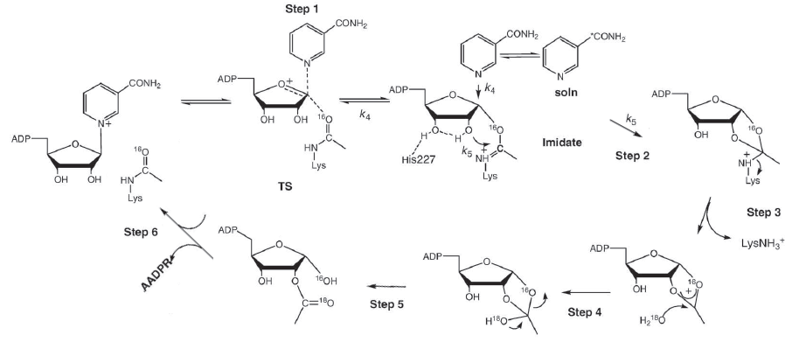

Slide 10
A variety of reports of NAD⁺ K_{m} values for sirtuins. The enzyme affinity for NAD⁺ is not of high affinity and in the range of 100-550 μM for human enzymes.
Km of human SIRT1 have been published, ranging from 132 to 550 μM.
Km, uM (for NAD⁺) | Sirtuin | Method | Ref.
132 | Human SIRT1 |  | K.T. Howitz, et al. Small molecule activators of sirtuins extend Saccharomyces cerevisiae lifespan, Nature 425 (2003) 191–196.
550 | Human SIRT1 |  | M. Kaeberlein, et al. Substrate - specific activation of sirtuins by resveratrol, J. Biol. Chem. 280 (2005) 17038–17045.
165 | human SIRT1 | p53 derived peptide substrate | AA Sauve, unpublished data
~100 | SIRT2 |  | M.T. Borra, et al.Substrate specificity and kinetic mechanism of the Sir2 family of NAD+-dependent histone/protein deacetylases, Biochemistry 43 (2004) 9877–9887.
29 | SIRT2 |  | J. Landry, et al. Role of NAD(+) in the deacetylase activity of the SIR2-like proteins, Biochem. Biophys. Res. Commun. 278 (2000) 685–690.
70 | SIRT2 |  | M.T. Borra, et al.Substrate specificity and kinetic mechanism of the Sir2 family of NAD+-dependent histone/protein deacetylases, Biochemistry 43 (2004) 9877–9887.
 | SIRT2 | K1, k-1, | S.J. Lin, er al. Calorie restriction extends yeast life span by lowering the level of NADH, Genes Dev. 18 (2004) 12–16.

