Slide 1
Activity comparison
New HPLC_100uM NAD+ 100uM FdL2 peptide |  |  |  | MS_80uM AceCS2-Kac + 6mM NAD
Enzo SIRT3, ul | [Enzo SIRT3 ], nM | % conversion of peptide sub-strate to product over time in 40min | %.min⁻¹ | % conversion of peptide substrate to product over time , %.min⁻¹
 |  |  | Enzo (102-399) | JBC (102-399) | JBC (118-399)
1.0 | 470.9 | 0.977 | 0.0244 | 1.7489 | 1.5596
2.5 | 1177.4 | 2.670 | 0.0668 | 4.3627 | 3.8908
4.0 | 1883.8 | 6.670 | 0.1668 | 6.9764 | 6.2220
 |  |  |  | y=0.0037x+0.0064 | y=0.0033x+0.0055
Because of the lack of detailed experimental info, the specific activities for reported enzymes can’t be calculated. To make a rough comparison, the percentage of conversion of acetylated peptide substrate to deacetylated product over time for Enzo SIRT3 (102-399), JBC (102-399), and JBC(118-399) under different nM Enzeym (based on PMC-AT Lab experiments) have been calculation.
JBC (102-399) and JBC (118-399) have similar % product formation
Enzo (102-399)in PMC-AT Lab using HPLC method has less product formation
Comments
The numbers can not be compared directly since the peptide substrates used were different
Value from Enzo (102-399)in PMC-AT Lab using HPLC method may be under estimated since 40min were used for calculation, earlier time point may needed.
Reason(s) may caused the disagreement between JBC and JMB paper (details in slide 2 and 3)
JBC paper use MS-based assay, the first time point was 15 min. Substrate used was AceCS2-Kac.
JMB paper use FdL-based assay, may provide earlier time points. Substrate used was FdL2-peptide.

Slide 2
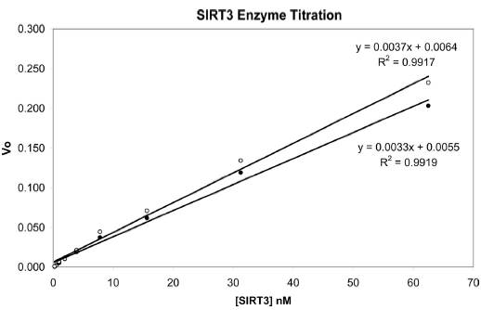
[Enzyme] = 0.24 – 62.5 nM
[NAD⁺]=6000μM
[AceCS2-KAc]=80μM
Time point + 0, 15, 30, 60, 90, 120, 150 min
Temp. = 25oC
Mass Spec based assay
When the two proteins were tested side-by-side with excess amounts of peptide substrate and NAD, they also displayed very similar activity for their deacetylase function (0.0037 for SIRT3-(102– 399) and 0.0033 for SIRT3-(118– 399) in the unit of percentage-of conversion of acetylated peptide substrate to deacetylated product over time and enzyme concentration). This is in disagreement with a recent report that SIRT3-(114– 399) has a 50-fold-higher specific activity than SIRT3-(102–399)

Slide 3
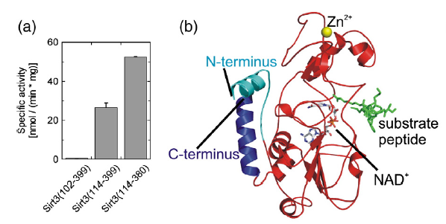
[NAD⁺]=500 μM
[FdL2 peptide]=100 μM
FdL Sirtuin assay
An N terminally shortened construct (residues 114–399) displayed a ∼50-fold-higher specific activity than residues 102–399 in the peptide-based deacetylation assay (Fig. 4a).
Removing this C-terminal part of Sirt3 resulted in a protein (residues 114–380) with further increased specific activity in the peptide assay, but only ∼2-fold compared to Sirt3(114–399) and thus ∼100-fold compared to Sirt3(102–399) (Fig. 4a).
In order to rationalize these results, we generated a three-dimensional model of Sirt3 based on the crystal structure of Sirt2 (Protein Data Bank ID 1J8F).36 When considering the complete mitochondrial form of Sirt3(102–399), Sirt2 is the most closely related Sirtuin that is structurally characterized. The Sirt3 model produced with the programMODELLER37 (Fig. 4b) covers residues 98– 399 and, thus, the complete less active form in mitochondria after the first proteolytic processing step. The part removed through the N-terminal shortening to residue 114 corresponds to α0 and a loop region in Sirt2 (Fig. 4b, cyan). The C-terminal helix α14 (Fig. 4b, blue) appears to pack against the N-terminus and to form a module with α0 and the loop to α1.

