Slide 1
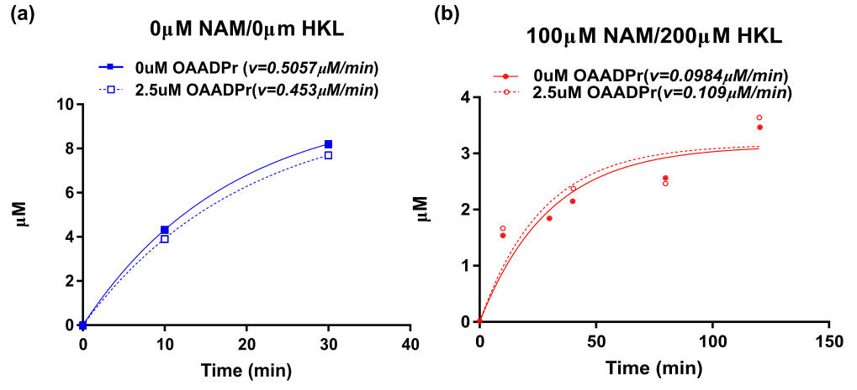
Figure 10. Investigation of OAADPr product inhibition. The deaceylation reactions were performed at [NAD⁺]=100µM, [MnSOD K122]=600µM in the presence of 2.5 µM OAADPr (a) 0µM NAM and 0µM HKL (b) 100µM NAM and 200µM HKL. The product formation was monitored by HPLC at desired time points (0, 10, 30, 40, 80, 120min). The time series were fitted in single exponential function in Prism.

