Slide 1
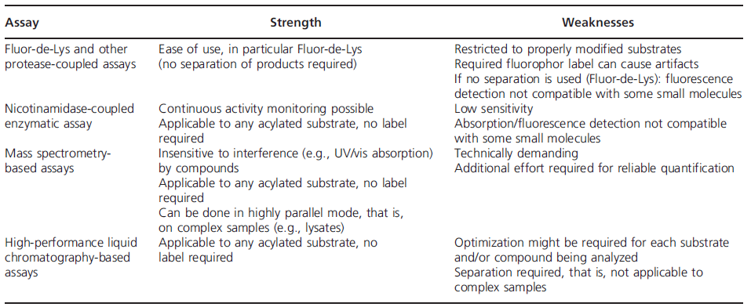
New assays and approaches for discovery
Detecting and studying protein (de)acylation – Quantitative proteomic studies
Separation of substrates and products of sirtuin reactions --- capillary electrophoresis, microchip electrophoresis, microfluidic mobility assay, polyacrylamide gel electrophoresis, HPLC, thin layer chromatography (TLC), charcoal-binding, and radioisotopes applied assay.
MS spectrometry and antibody-based sirtuin assays --- sequence-specific anti-acetyl-Lys antibodies can be used in western blots for ananlyzing specific protein acetylation sites.
Strengths and weaknesses of popular Sirtuin activity assays.
Schutkowski M, et al. New assays and approaches for discovery and design of sirtuin modulators. Expert Opinon (2014) 9:1-17.

Slide 2
GSk vs Pfizer
Milne JC, Lambert PD, Schenk S, et al. (2007) Nature 450:712-716. Dai H, Kustigian L, et al (2010) J Bio Chem. 285: 32695 - 32703
Claim 1: Resveratrol is not a direct activator of SIRT1 activity (Amgen Inc.). Building on two 2005 papers (Borra MT, Smith BC, Denu JM. (2005) Mechanism of human SIRT1 activation by resveratrol. J. Biol. Chem. 280: 17187-17195.Kaeberlein M, et al. (2005) Substrate-specific activation of sirtuins by resveratrol. J Biol Chem 280(17):17038–17045), the Amgen team said that resveratrol, the prototype SIRT1 ligand, only works in that manner when the fluorescent peptide (Fluor de Lys) was used in the assay. This is due, they found, exclusively to the fluorophore on the peptide - it's an artifact of the assay conditions. Without it, no activation was seen with protein assays in vitro, nor in cell assays. Native substrates (p53-derived peptide and PGC-1alpha) show nothing.
GSK's response: This is true. They too, found that activation of SIRT1 depends on the structure of the substrate. Without the fluorescent label, no activation is seen.
Claim 2: Not only is this true for resveratrol, it's true for SRT1720, SRT2183, and SRT 1460 (Pfizer). The Pfizer team did a similar breakdown of the assay conditions, and found (through several biophysical methods) that the fluorophore is indeed the crucial element in the activity seen in these assays. And again, since that's an artificial tag, the Fluor de Lys-based assays can have nothing to do with real in vivo activity. Native substrates (p53-derived peptide, full-length p53, and acetyl CoA synthase 1) show nothing.
GSK's response: As above, activation of SIRT1 depends on the structure of the substrate. Without the fluorescent label, no activation is seen. SRT1460 and SRT1720 do indeed bind to the fluorescent peptide, but not to the unlabeled versions. Looking over a broader range of structures, some of them interact with the fluorophore, and some don't. There's no correlation between this affinity and a compound's ability to activate SIRT1.
A screen of 5,000 compounds in this class turned up three that actually do work with nonfluorescent peptide substrates (compounds 22, 23, and 24 in the paper). None of these have been previously disclosed. They, however, that even these still don't work when the peptide substrate lacks both the fluorescent tag and a biotin tag.
What's more, when these three compounds are tested on a p53-derived 20-mer peptide substrate, they actually inhibit acetylation, instead of enhancing it. Looking closer at a range of peptide substrates, SRT1460 and other compounds can also inhibit or enhance acetylation, depending on what peptide is being used. An allosteric mechanism could explain these results. It seems more likely that there are at least two specific sites on SIRT1 that can bind these compounds - the active site and an allosteric one. Thus there are several species in equilibrium, depending on whether these sites have substrate or small molecule bound to them, and on how this binding stabilizes or destabilizes particular pathways. In the real cell, this may all be part of various protein-protein interactions.
Claim 3: SRT1720 does not lower glucose in a high-fat-fed mouse model (Pfizer). Even though exposure of the drug was as reported previously, they saw no evidence (at 30 mg/kilo) of glucose lowering or of any increased mitochondrial function. These animals showed increased food intake and weight gain. The 100 mpk dose was not well tolerated, and killed some animals.
GSK's response: not addressed.

Slide 3
Evaluation of Fluor-de-Lys assay
In 2013 PNAS paper, a continuous assay and a nonmodified peptides were applied for the measurement of IC50 of EX527 for SIRT1 and Sir2Tm. The IC50 values from continuous assay were in agreement with the FdL values.
Gertza,M; Fischera,F; Nguyena, GTT; et al. (2013) Ex-527 inhibits Sirtuins by exploiting their unique NAD⁺-dependent deacetylation mechanism. PNAS, E2772–E2781.
“Ex-527 Is a Selective Sirtuin Inhibitor and Requires NAD+ for Inhibition. A first kinetic analysis of Sirt1 inhibition by Ex-527 was done with the Fluor-de-Lys (FdL) substrate, a peptide carrying a fluorophore that potentially causes artifacts. To investigate the molecular inhibition mechanism, we first tested selectivity and kinetics using a continuous assay and nonmodified peptides derived from physiological substrates for Sirt1 (p53), Sirt3 [acetyl-CoA synthetase 2 (ACS2)], and Sirt5 [carbamoyl phosphate synthethase 1 (CPS1)]. Because inhibition was proposed to be uncompetitive with NAD+, we adjusted NAD+ concentrations according to the respective KM values to allow comparisons. The IC50 values are 0.09 ± 0.03 μM for Sirt1 and 22.4 ± 2.7 μM for Sirt3 (Fig. 1C), in agreement with the FdL values (0.1 and 49 μM, respectively_Napper AD, et al. (2005) Discovery of indoles as potent and selective inhibitors of the deacetylase SIRT1. J Med Chem 48(25):8045–8054.). Because Sirt1 crystals became available only recently, we included the bacterial homolog Sir2 from Thermotoga maritima (Sir2Tm) in our investigation. Sir2Tm was efficiently inhibited by Ex-527 (IC50 0.9 ± 0.3; Fig. 1C), and we thus used it as a representative of the potently inhibited Sirtuins for structural studies. Furthermore, Ex-527 had no pronounced effect on Sirt5-dependent deacetylation, consistent with FdL tests (Solomon JM, et al. (2006) Inhibition of SIRT1 catalytic activity increases p53 acetylation but does not alter cell survival following DNA damage. Mol Cell Biol 26(1):28–38.) , and showed no inhibition of Sirt5-dependent desuccinylation (Fig. 1D), the dominant Sirt5 activity identified recently.”
Napper AD, et al. (2005) Discovery of indoles as potent and selective inhibitors of the deacetylase SIRT1. J Med Chem 48(25):8045–8054
A fluorimetric screen of human SIRT1 led to the discovery of a series of indoles (include Ex527) as potent inhibitors that are selective for SIRT1 over other deacetylases and NAD-processing enzymes. Furthermore, these compounds meet many of our criteria for entering lead optimization in that they display a favorable ADME profile, including oral bioavailability and metabolic stability.
Solomon JM, et al. (2006) Inhibition of SIRT1 catalytic activity increases p53 acetylation but does not alter cell survival following DNA damage. Mol Cell Biol 26(1):28–38
FdL assay was applied to characterize the potent inhibitor of SIRT1. SIRT5 had no effect on deacetylation of p53 lysine 382 peptide in the Fluor de Lys assay.

Slide 4
Evaluation of Fluor-de-Lys assay Cont’d
In 2012 PLOS ONE paper, the weak inhibition caused by resveratrol on SIRT3 was detected using ELISA, which was consistent with FdL results.
Gertz M, et al. (2012) A molecular mechanism for direct sirtuin activation by resveratrol. PLoS ONE 7(11):e49761.
Resveratrol caused weak inhibition when tested on Sirt3 in an analogous ELISA for glutamate dehydrogenase (GDH) deacetylation (Figure 4G), again consistent with the FdL results. These results show that the fluorophore label is not essential for the stimulatory effect of resveratrol on Sirtuin dependent deacetylation but can be replaced by a regular polypeptide chain, and consistently, that activation can also be observed with a complete protein as a substrate.
In 2011 Bioorg. Med. Chem. Lett paper, for the first time, that certain N-acetylthiourea derivatives serve as highly potent and isozyme selective activators for the recombinant form of human histone deacetylase-8 in the assay system containing Fluor-de-Lys as a fluorescent substrate.
Singh RK et al. (2011)Histone deacetylase activators: N-acetylthioureas serve as highly potent and isozyme selective activators for human histone deacetylase-8 on a fluorescent substrate . Bioorg. Med. Chem. Lett 21: 5920-5923.
However, we realize that our demonstration of N-acetylthiourea-mediated activation of HDAC-8 primarily relies on the employment of Fluor-de-Lys as the fluorogenic substrate, and thus one can argue that the observed activation is due to potential interaction between the fluorescent moiety of the substrate and the aromatic rings of the activators as observed in the case of sirtuin-1.16,17 In case of sirtuin-1, it has been demonstrated that the putative activators bind to the enzyme only in the presence of fluorogenic substrates17,20 and the activation is manifested via lowering the Km value of the substrate. This is in marked contrast to our observation that N-acetylthioureas directly bind to HDAC-8 (in the absence of substrate or any other ligand) and their binding results in the decrease in the Km value of the substrate as well as increase in the kcat value of the enzyme. These coupled with the fact that the overall activation profile (at sub-saturating substrate concentrations) conforms to the marked co-operativity (our unpublished results) prompt us to surmise that N-acetylthiourea-mediated activation of HDAC-8 is real, and it is not an artifact of the employment of Fluor-de-Lys as the fluorogenic substrate. We are currently evaluating the mode of binding our activators to HDAC-8 and their overall mechanism of activation, and we will report these findings subsequently.

