Slide 1
Discovery of Novel Inhibitors/Activators for Sirtuins(SIRT3)
Ping LIN Xiangying GUAN
PMC Advanced Technology, LLC

Slide 2
Outline
Overview of previous efforts in inhibitor discovery
The structures of SIRT3
Computational approaches for inhibitor discovery: docking and binding free energy calculation
Docking results for various substrates/receptors
Activator discovery
Proposed research

Slide 3
Previous sirtuin inhibitor discovery
Disch, J. S. et al. Discovery of thieno[3,2-d]pyrimidine-6-carboxamides as potent inhibitors of SIRT1, SIRT2, and SIRT3. J. Med. Chem. 56, 3666–79 (2013).
Salo, H. S., Laitinen, T., Poso, A., Jarho, E. & Lahtela-kakkonen, M. Identification of novel SIRT3 inhibitor scaffolds by virtual screening. Bioorg. Med. Chem. Lett. 23, 2990–2995 (2013)
Rotili, D. et al. Discovery of Salermide-Related Sirtuin Inhibitors: Binding Mode Studies and Antiproliferative Effects in Cancer Cells Including Cancer Stem Cells. (2012)
Schlicker, C., Boanca, G., Lakshminarasimhan, M. & Steegborn, C. Structure-based development of novel sirtuin inhibitors. Aging 3, 852–72 (2011).
Cen, Y. Sirtuins inhibitors: the approach to affinity and selectivity. Biochim. Biophys. Acta 1804, 1635–1644 (2010).
Zhang, Y. et al. Identification of a small molecule SIRT2 inhibitor with selective tumor cytotoxicity. Biochem. Biophys. Res. Commun. 386, 729–33 (2009).
Uciechowska, U. et al. Thiobarbiturates as sirtuin inhibitors: virtual screening, free-energy calculations, and biological testing. ChemMedChem 3, 1965–76 (2008)
Neugebauer, R. C. et al. Structure-activity studies on splitomicin derivatives as sirtuin inhibitors and computational prediction of binding mode. J. Med. Chem. 51, 1203–13 (2008)
Napper, A. & Hixon, J. Discovery of indoles as potent and selective inhibitors of the deacetylase SIRT1. J. Med. Chem. 48, 8045–8054 (2005).

Slide 4
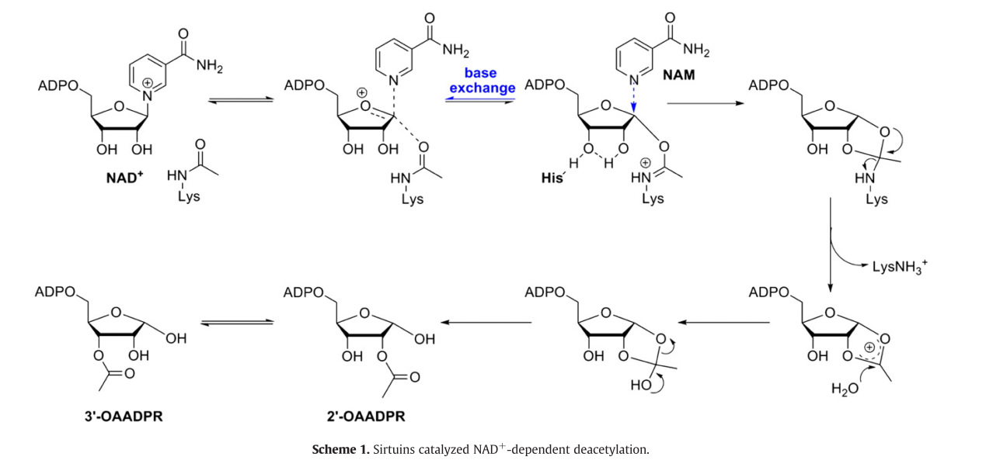
Deacetylation mechanism
Cen, Y. Sirtuins inhibitors: the approach to affinity and selectivity. Biochim. Biophys. Acta 1804, 1635–1644 (2010).

Slide 5
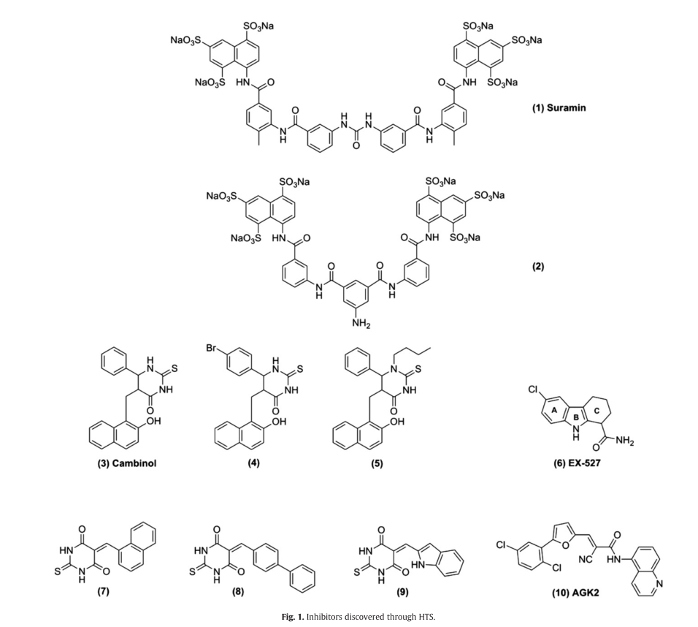
Sirtuins inhibitors discovered through HTS
Thiobarbiturates
Notes:
Must be FDA-approved

Slide 6
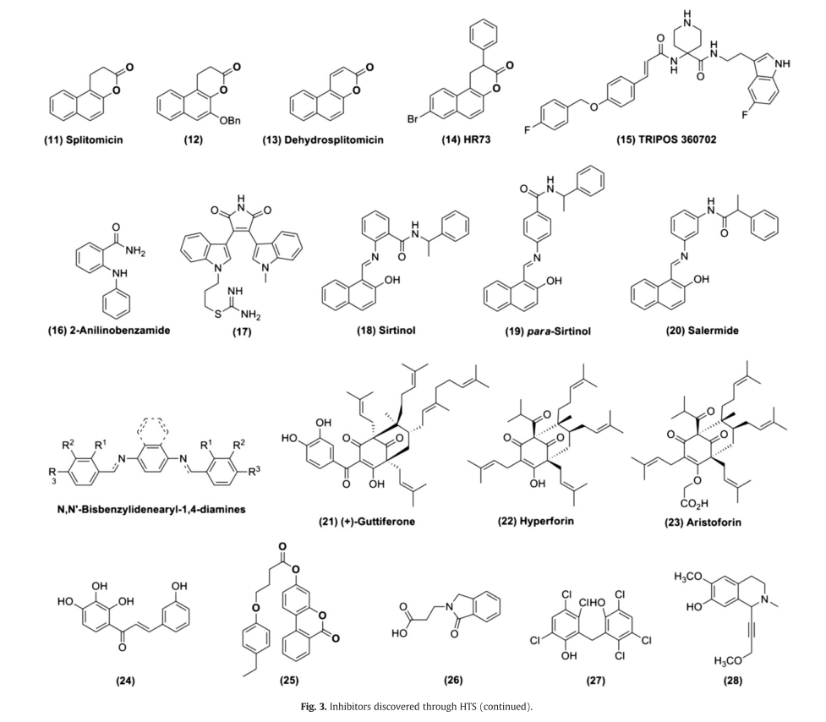
Sirtuins inhibitors discovered through HTS (cont.)

Slide 7
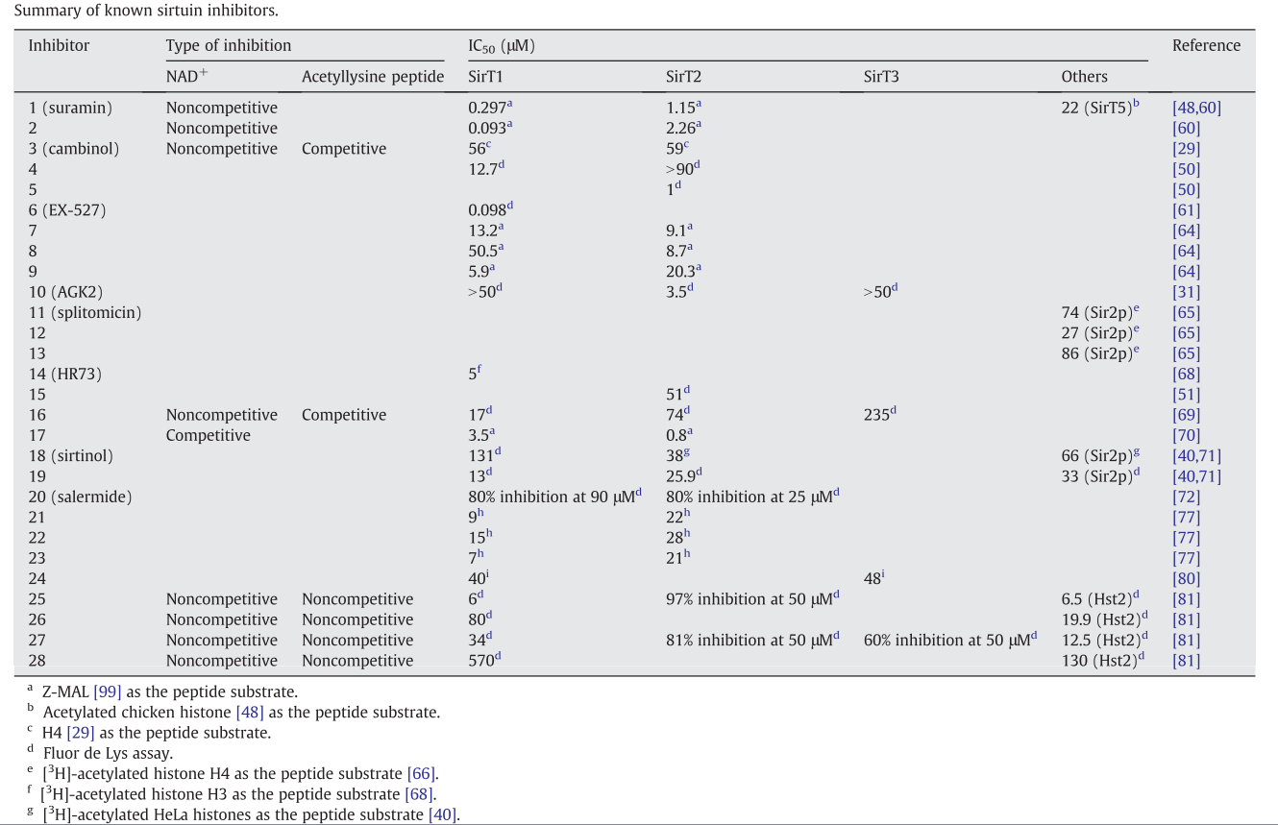
Different inhibition mechanism

Slide 8
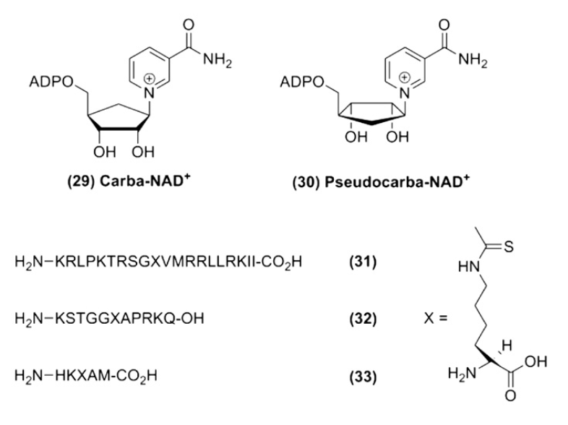
Mechanism-based sirtuin inhibitors

Slide 9
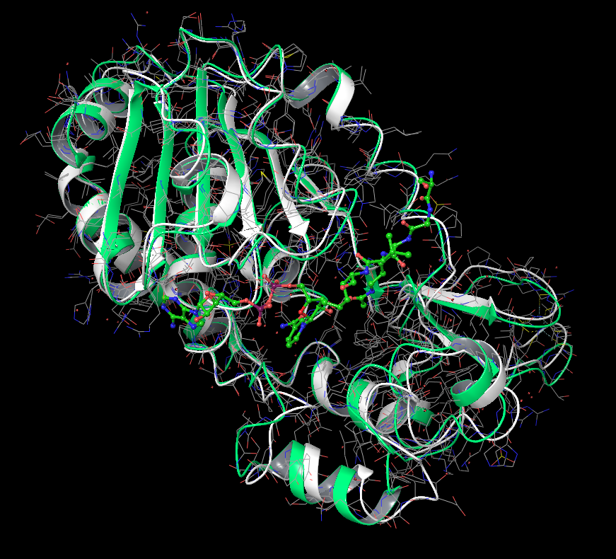
Structural changes upon substrate binding
Acetyl-Lysine Pepetide
Apo-enzyme (White)
Carba-NAD+
Enzyme: Substrate: Co-factor
(Green)
Jin, L. et al. Crystal structures of human SIRT3 displaying substrate-induced conformational changes. J. Biol. Chem. 284, 24394–405 (2009)
Szczepankiewicz, B. G. et al. Synthesis of carba-NAD and the structures of its ternary complexes with SIRT3 and SIRT5. J. Org. Chem. 77, 7319–29 (2012)

Slide 10
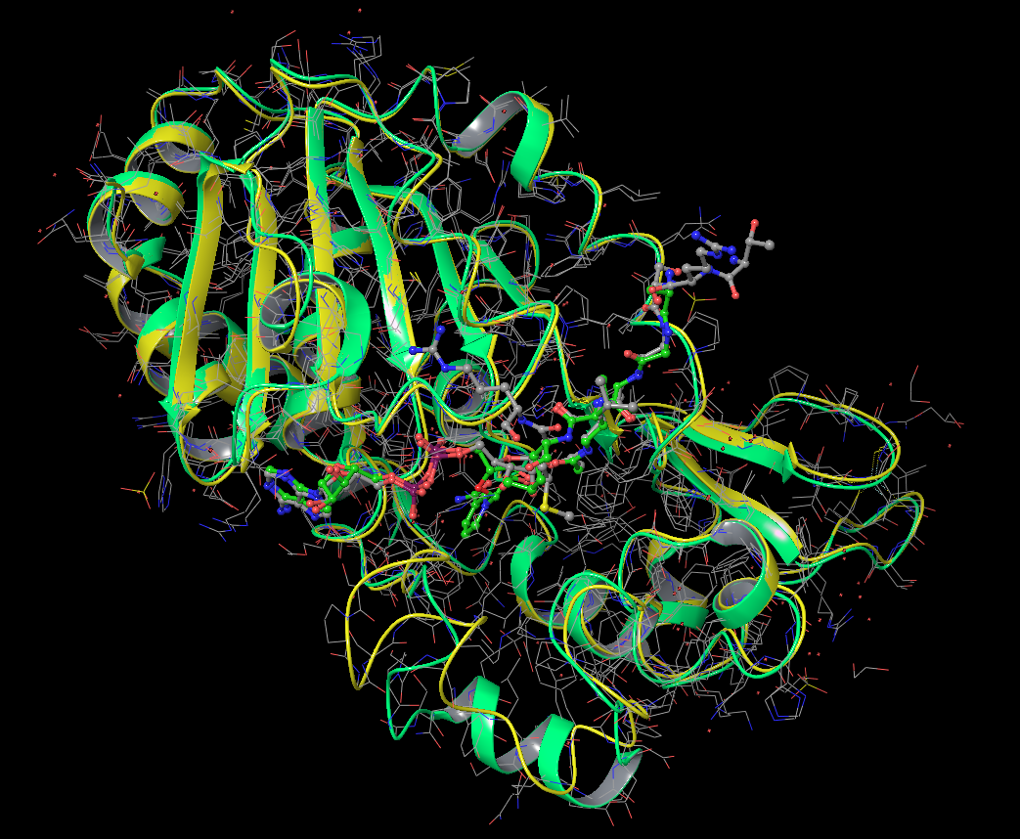
Structural change upon formation of intermediate
Enzyme: Intermediate
(Yellow)
Alkylimidate intermediate
Enzyme: Substrate: Co-factor
(Green)
Gertz, M. & Fischer, F. Ex-527 inhibits Sirtuins by exploiting their unique NAD+-dependent deacetylation mechanism. Proc. Natl. Acad. Sci. U. S. A. 110, E2772–81 (2013)

Slide 11
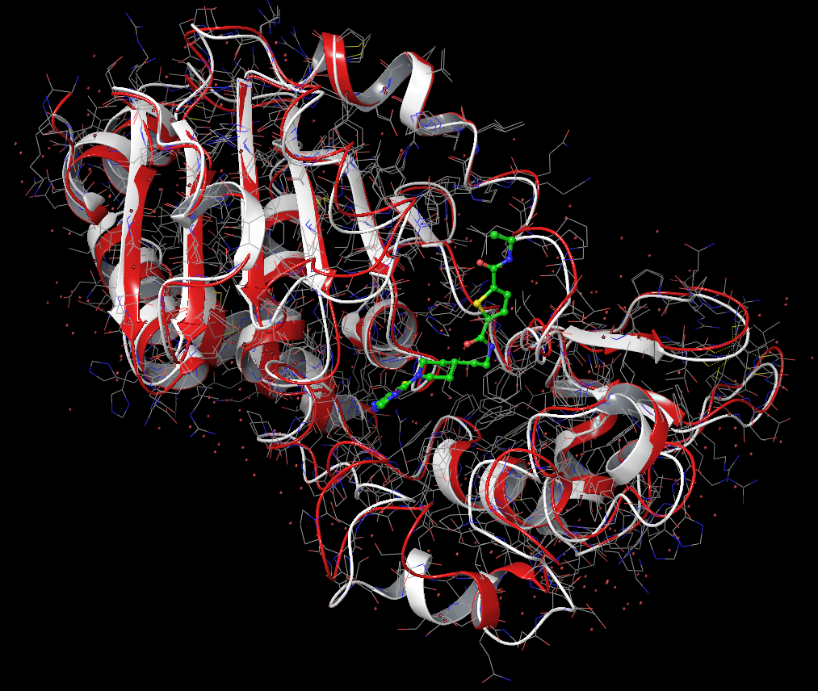
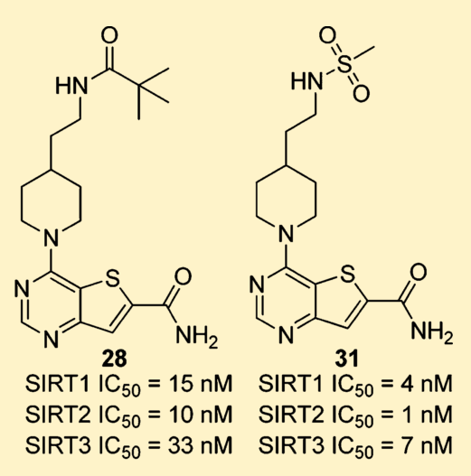
Structural change upon inhibitor binding (Case 1)
Apo-enzyme (White)
ELT Inhibitor
Enzyme: Inhibitor
(Red)
Disch, J. S. et al. Discovery of thieno[3,2-d]pyrimidine-6-carboxamides as potent inhibitors of SIRT1, SIRT2, and SIRT3. J. Med. Chem. 56, 3666–79 (2013).

Slide 12
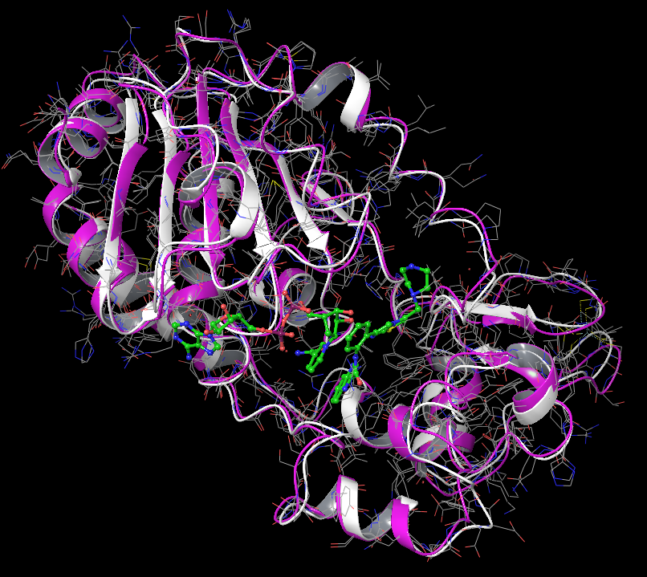
Structural change upon inhibitor binding (Case 2)
Apo-enzyme (White)
SRT1720 Inhibitor
NAD+
Enzyme: NAD+: Inhibitor
(Purple)
Nguyen, G. & Schaefer, S. Structures of human sirtuin 3 complexes with ADP-ribose and with carba-NAD+ and SRT1720: binding details and inhibition mechanism. Acta Crystallogr. Sect. D Biol. Crystallogr. 69, 1423–32 (2013)

Slide 13
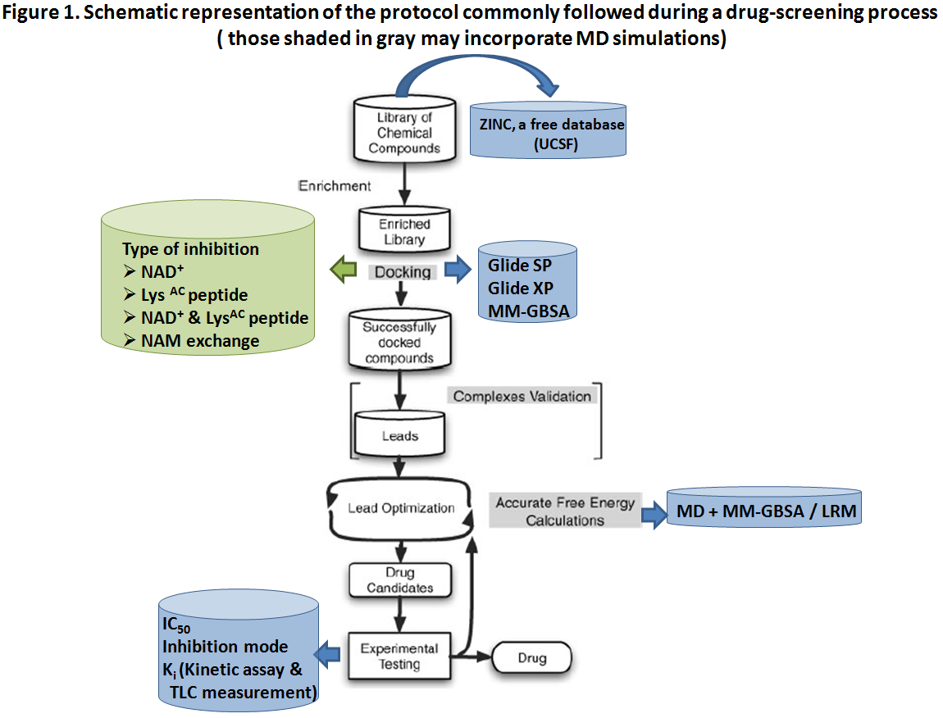
General approach to Drug Discovery
Alonso, H., Bliznyuk, A. a & Gready, J. E. Combining docking and molecular dynamic simulations in drug design. Med. Res. Rev. 26, 531–68 (2006).

Slide 14
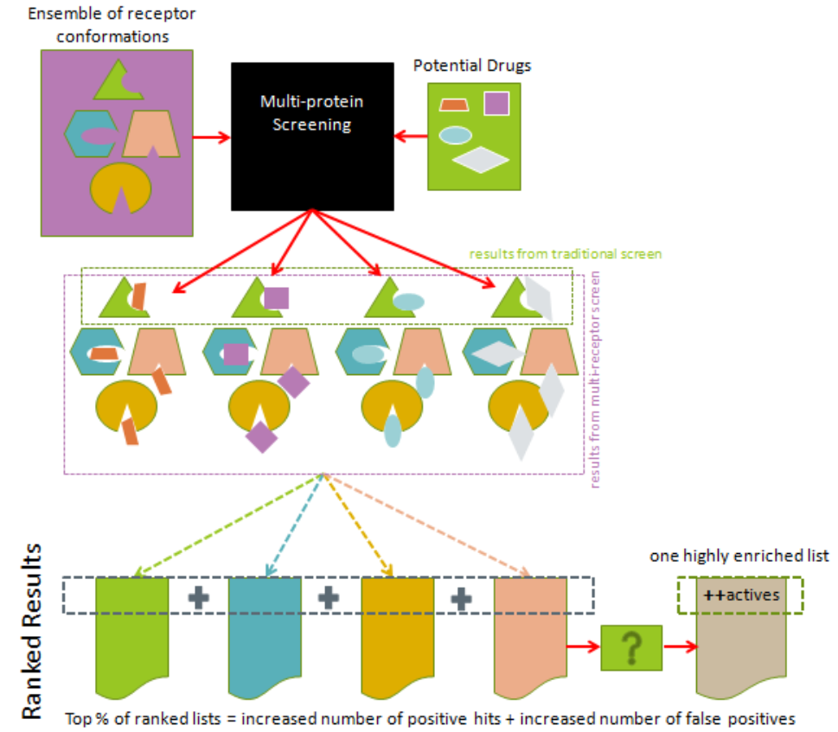
Ensemble docking
Korb, O. et al. Potential and limitations of ensemble docking. J. Chem. Inf. Model. 52, 1262–74 (2012)

Slide 15
Docking strategies/practices
Starting structures;
Structure optimization;
Protonation states;
Water selections;
Ions inclusions;
Substrate inclusions;
Scaling of vdw radius;
Definition of active site;
Scoring functions;
Flexibility;
Ligand preparations;
Constraints;
Post-docking minimization;
Output criteria;
Score re-evaluation.
Recent assessment on protein sampling vs docking performance
Elokely, K. M. & Doerksen, R. J. Docking Challenge: Protein Sampling and Molecular Docking Performance. J. Chem. Inf. Model. 53, 1934–1945 (2013)

Slide 16
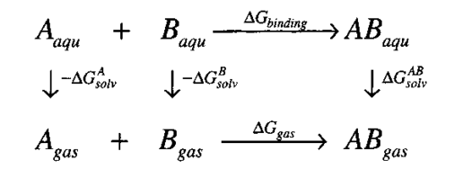
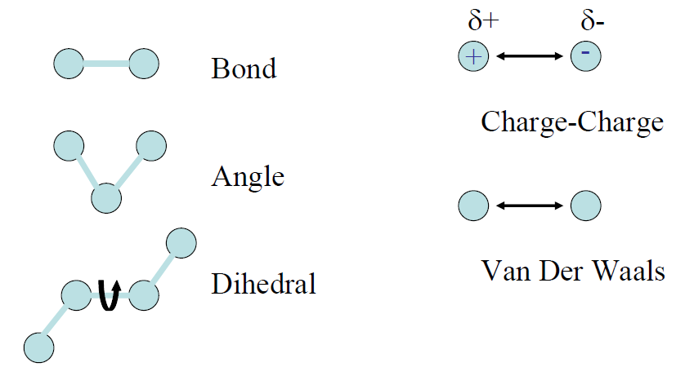
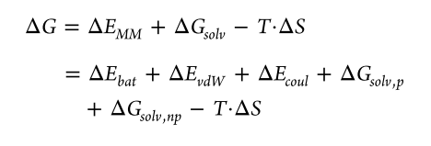
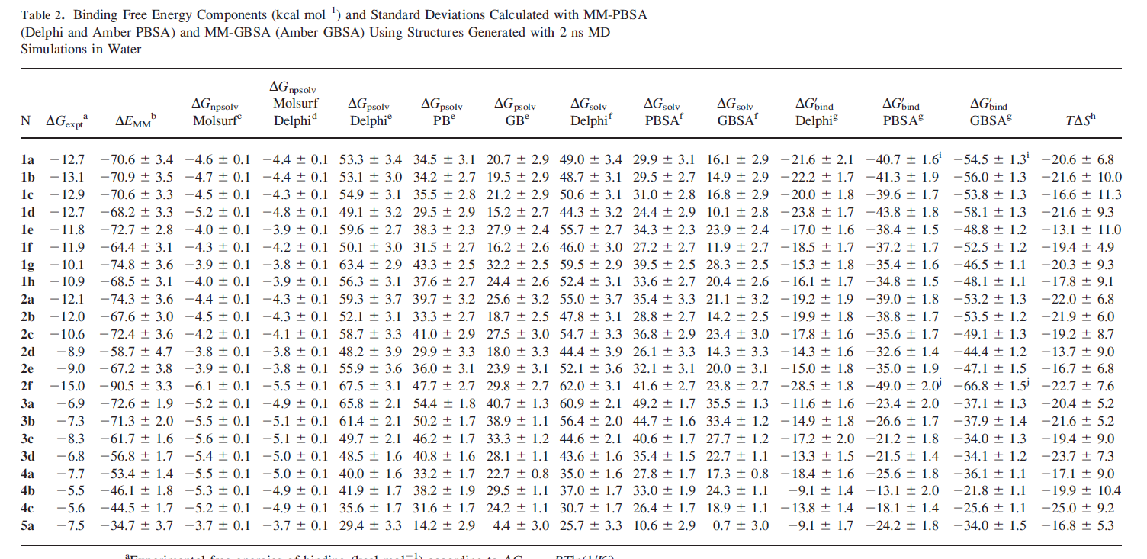
Binding free energy using MM-PB(GB)SA method
Molecular Mechanics (MM)
Solving Poisson-Boltzmann (PB) equation (or Generalized Born (GB) method) for electrostatic contribution to solvation energies:
MM-PBSA (Delphi) MM-PBSA(Amber) MM-GBSA(Amber)
* Known binding mode, manual docking
Change in solvent accessible surface area (SASA) for nonpolar contribution to solvation energies:
Entropy contribution (TΔS):
Normal Mode Analysis
Quasi-harmonic approximation
Kollman, P. a et al. Calculating structures and free energies of complex molecules: combining molecular mechanics and continuum models. Acc. Chem. Res. 33, 889–97 (2000)
Rastelli, G., Rio, A., Degliesposti, G. & Sgobba, M. Fast and accurate predictions of binding free energies using MM‐PBSA and MM‐GBSA. Int. J. Comput. Chem. 31, 797–810 (2010)
Notes:
deltaH = deltaE + delta(PV)

Slide 17
MM-PB(GB)SA
Molecular Mechanics (MM)
Solving Poisson-Boltzmann (PB) equation (or Generalized Born (GB) method) for electrostatic contribution to solvation energies:
MM-PBSA (Delphi) MM-PBSA(Amber) MM-GBSA(Amber)
* Known binding mode, manual docking
Change in solvent accessible surface area (SASA) for nonpolar contribution to solvation energies:
Entropy contribution (TΔS):
Normal Mode Analysis
Quasi-harmonic approximation
Kollman, P. a et al. Calculating structures and free energies of complex molecules: combining molecular mechanics and continuum models. Acc. Chem. Res. 33, 889–97 (2000)
Rastelli, G., Rio, A., Degliesposti, G. & Sgobba, M. Fast and accurate predictions of binding free energies using MM‐PBSA and MM‐GBSA. Int. J. Comput. Chem. 31, 797–810 (2010)
Notes:
deltaH = deltaE + delta(PV)
Manual dock

Slide 18
MM-PB(GB)SA
Molecular Mechanics (MM)
Solving Poisson-Boltzmann (PB) equation (or Generalized Born (GB) method) for electrostatic contribution to solvation energies:
MM-PBSA (Delphi) MM-PBSA(Amber) MM-GBSA(Amber)
* Known binding mode, manual docking
Change in solvent accessible surface area (SASA) for nonpolar contribution to solvation energies:
Entropy contribution (TΔS):
Normal Mode Analysis
Quasi-harmonic approximation
Kollman, P. a et al. Calculating structures and free energies of complex molecules: combining molecular mechanics and continuum models. Acc. Chem. Res. 33, 889–97 (2000)
Rastelli, G., Rio, A., Degliesposti, G. & Sgobba, M. Fast and accurate predictions of binding free energies using MM‐PBSA and MM‐GBSA. Int. J. Comput. Chem. 31, 797–810 (2010)
Notes:
deltaH = deltaE + delta(PV)

Slide 19
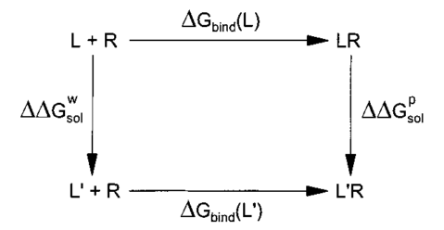
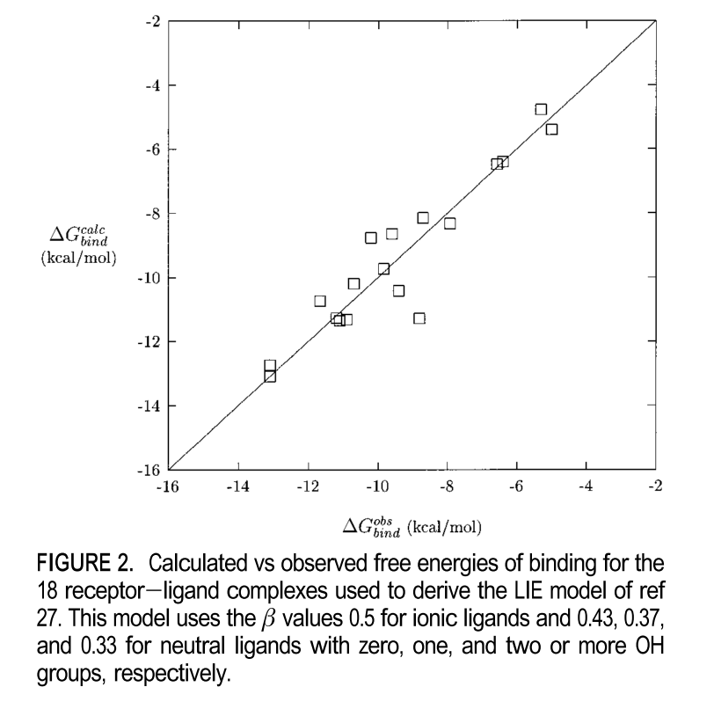
Linear Interaction Energy (LIE)
Applying linear response approximation:
1) for electrostatic contributions to solvation/binding free energies
where i = p or w; l-s: ligand and the surrounding;
2) for nonpolar contributions,
$${∆G}_{np}∝SASA∝ \left\langle {V_{l−s}^{}}_{}^{vdw}\right\rangle$$
Aqvist, J., Luzhkov, V. B. & Brandsdal, B. O. Ligand binding affinities from MD simulations. Acc. Chem. Res. 35, 358–65 (2002)
Notes:
deltaG_np =>SASA=><V_vdw>, typical value of beta is between 0.3 and 0.5. alpha is often around 0.18, ionic and polar

Slide 20
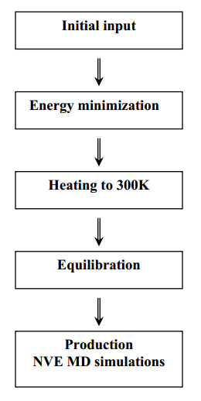
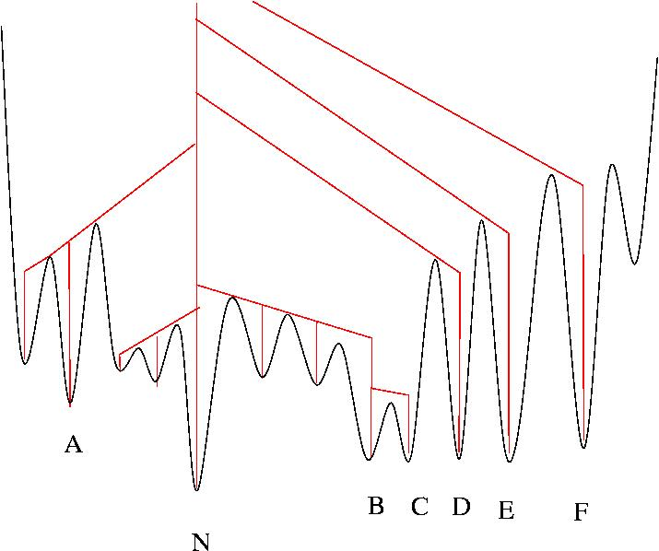
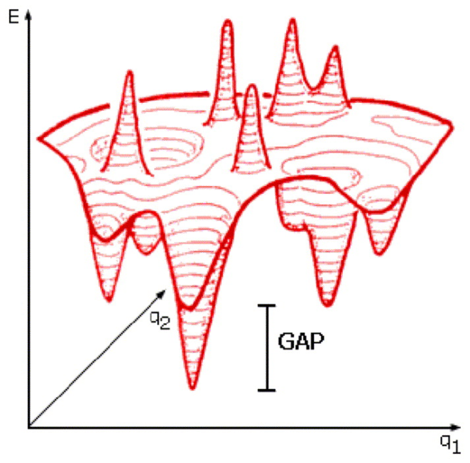
Molecular dynamics simulation for refinement and sampling
Why do we need MD?
How long the simulation is required?
Before docking: To create ensemble of conformation for better representation;
During docking: To take into account the protein flexibility and conformation change upon binding to ligand;
After docking: To optimize and carry out ensemble average for accurate free energy estimation.

Slide 21
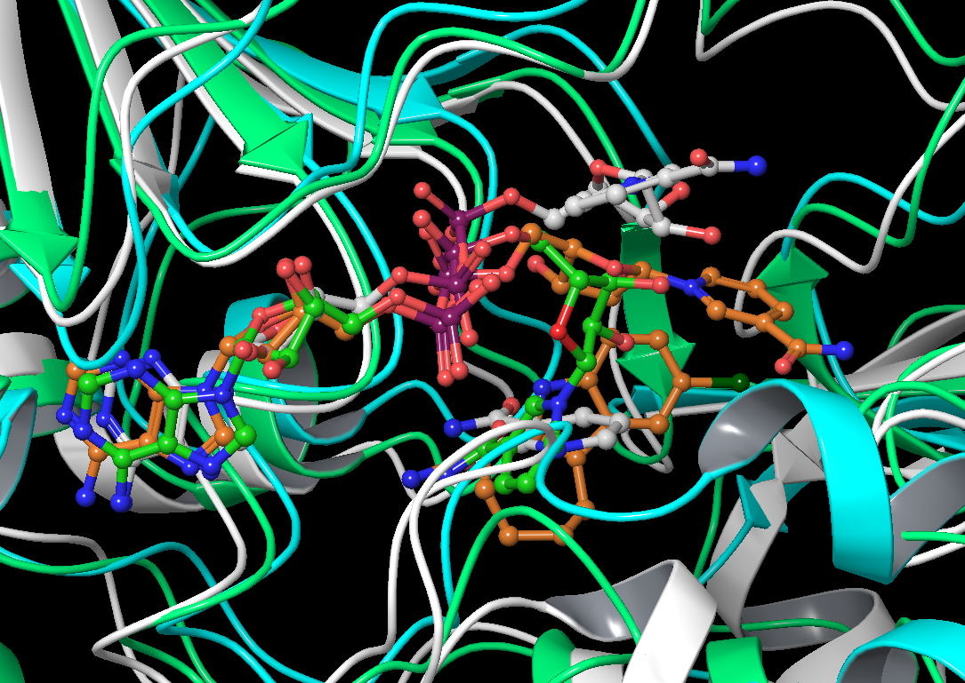
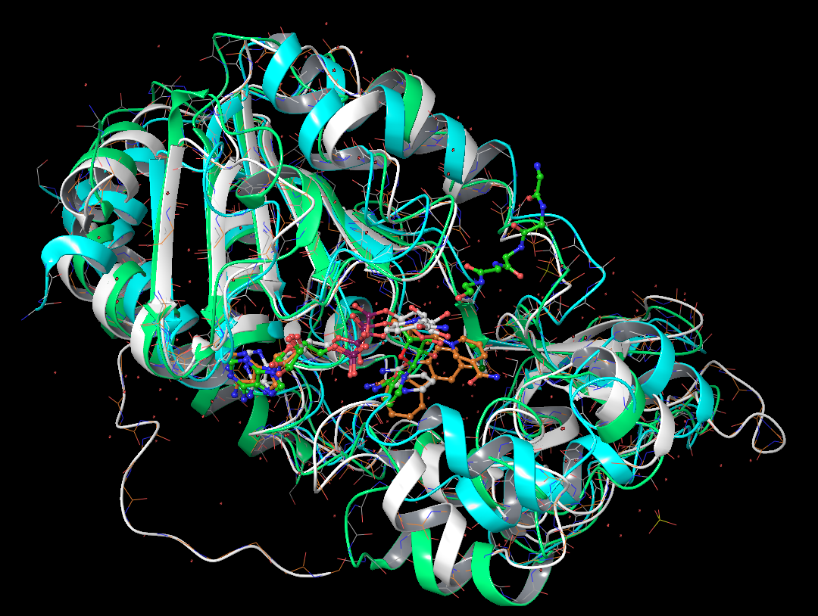
NAD⁺ binding revisited
Sir2Af2 with NAD+(AB) and NAM (C)
(Cran)
B
SIRT1 with NAD+(AD) and Ex527 (C)
(White)
SIRT3 with NAD+(AC) and
Acetyl-Lysine Peptide
(Green)
D
C
Avalos, J. L., Bever, K. M. & Wolberger, C. Mechanism of sirtuin inhibition by nicotinamide: altering the NAD(+) cosubstrate specificity of a Sir2 enzyme. Mol. Cell 17, 855–68 (2005)
Napper, A. & Hixon, J. Discovery of indoles as potent and selective inhibitors of the deacetylase SIRT1. J. Med. Chem. 48, 8045–8054 (2005)
Szczepankiewicz, B. G. et al. Synthesis of carba-NAD and the structures of its ternary complexes with SIRT3 and SIRT5. J. Org. Chem. 77, 7319–29 (2012)

Slide 22
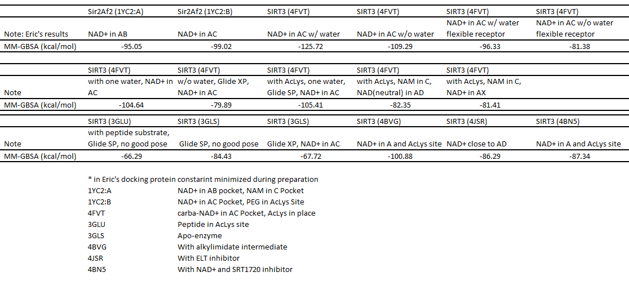
NAD⁺ Docking results using multiple receptor structures
Notes:
No protein flexibility

Slide 23
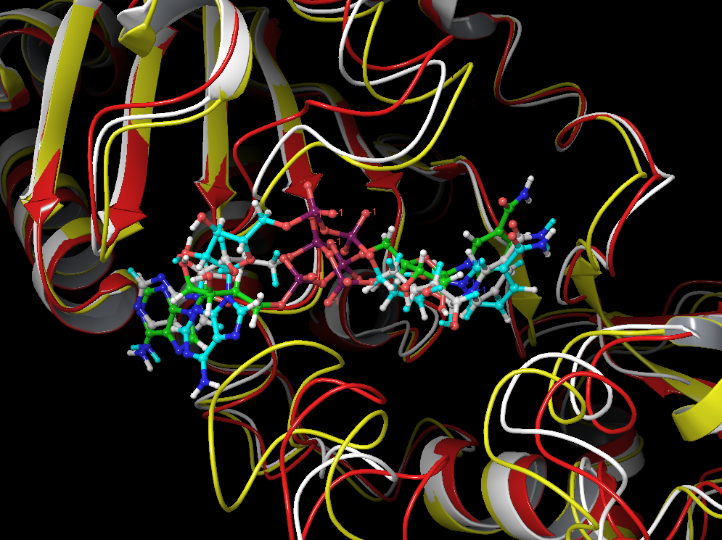
Top binding mode using three different receptor structures (4JSR, 4BVG, 4BN5)
4JSR (Red)
∆G = -86.29
(Carbon in cyan)
4BN5 (White)
∆G = -87.34
(Carbon in white)
4BVG (Yellow)
∆G = -100.88
(Carbon in green)

Slide 24
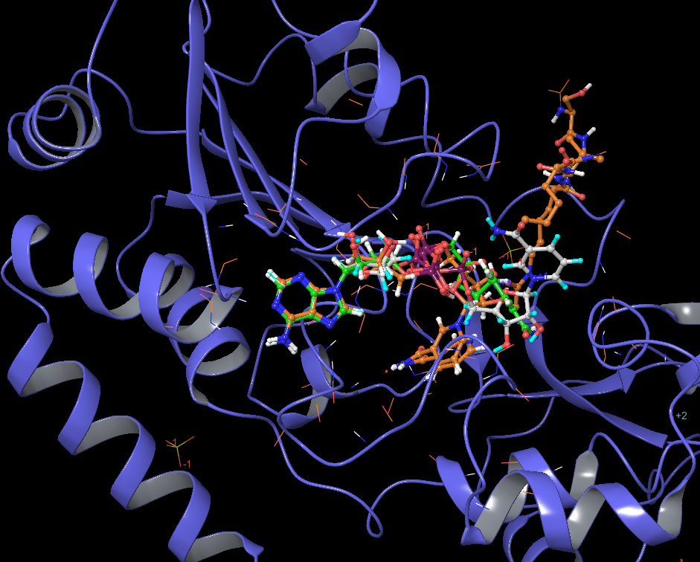
Bound structure (4FVT) as receptor (with Acetyl-Lysine Peptide) and inhibitor effect
∆G = -81.41
With NAM
(Carbon in grey)
∆G = -82.35
With NAM (Carbon in green)
∆G = -105.41 (Carbon in brown)

Slide 25
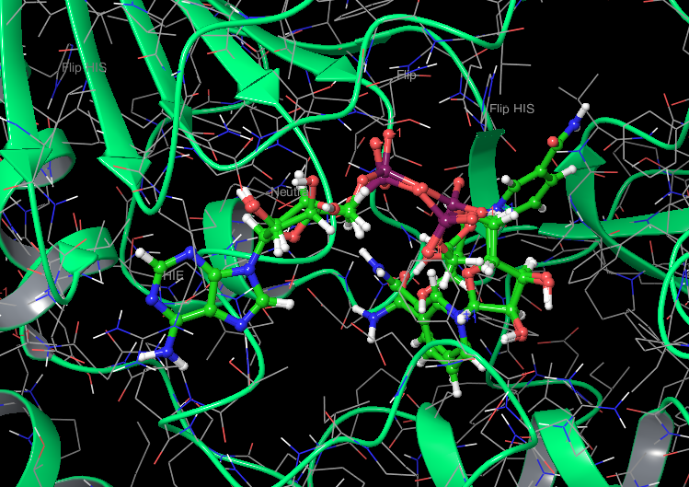
Top three poses using bound structure (4FVT) as receptor (without Acetyl-Lysine Peptide)
∆G = -78.42
∆G = -79.20
∆G = -79.89
Notes:
Binding affinity changes

Slide 26
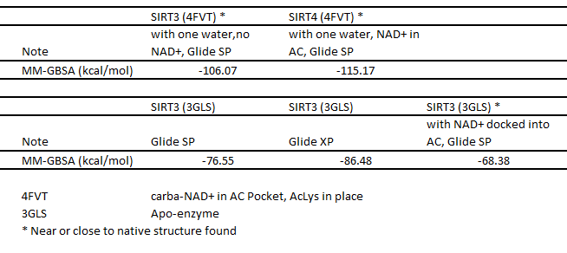
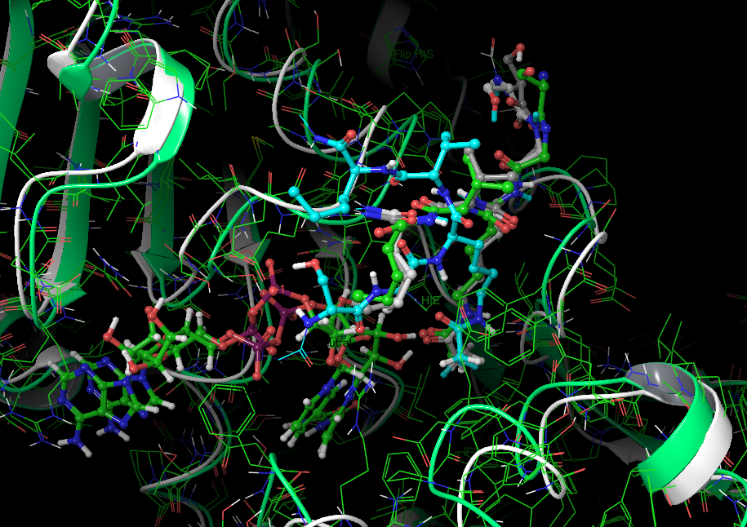
Binding of Acetyl-Lysine Peptide
Original acetyl peptide from 4FVT
(Carbon in green)
Acetyl peptide docked into 4FVT with DAN+ in place
(Carbon in silver)
Acetyl peptide docked into 4FVT without DAN+ in place
(Carbon in white)
Acetyl peptide docked into apo-enzyme (3GLS) with DAN+ pre-docked
(Carbon in blue)
4FVT (Ribbon in green)
3GLS (Ribbon in white)
Notes:
Why is it interesting? It affects other substrate binding, i.e. NAD+, and it may be competing with other inhibitors.

Slide 27
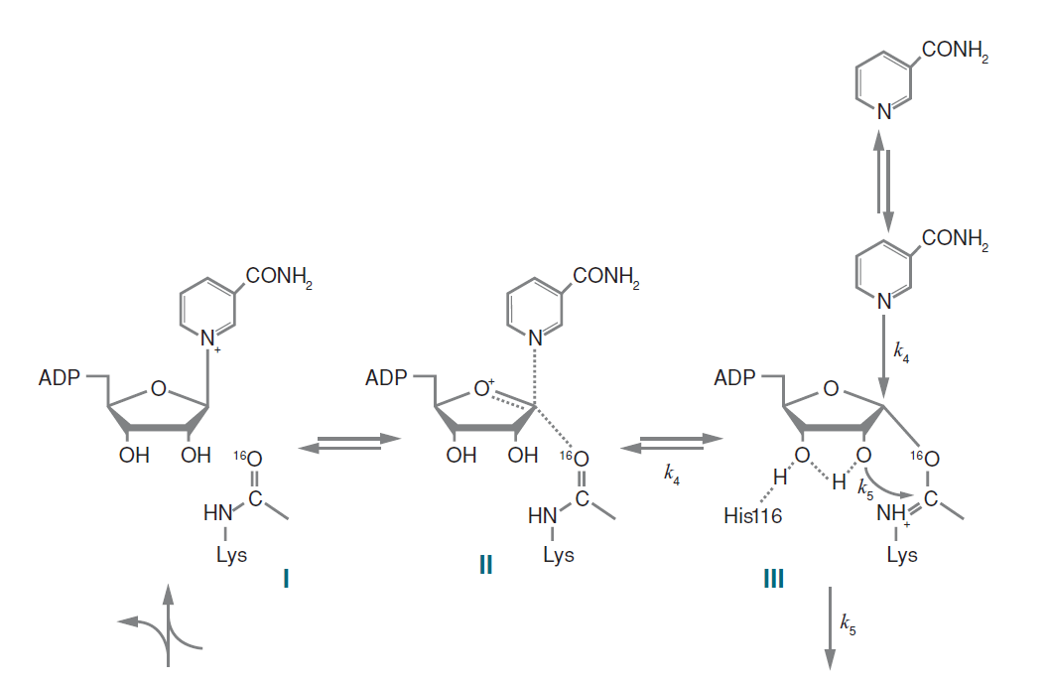
Inhibition mechanism revisited
Activate by displacing NAM
Target NAD+ only
Base exchange
Displace both
Target acetylated peptide only
Target peptidyl-imidate

Slide 28
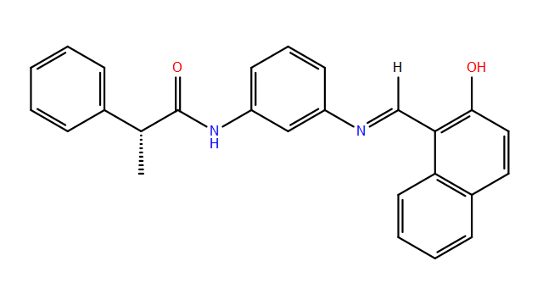
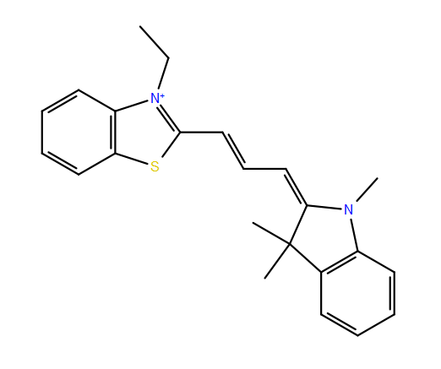
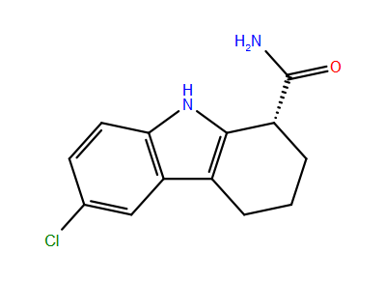
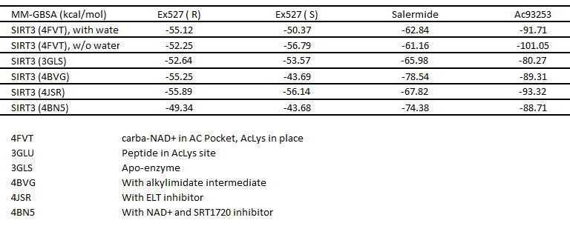
Binding of Known Ligands
Ex527
IC50 (SIRT3): 174.9 μM *
IC50 (SIRT1): 0.098 μM
Salermide
IC50 (SIRT3): 27.2 μM *
80% Inhibition (SIRT1): 90 μM
80% Inhibition (SIRT2): 25 μM
Ac93253
IC50 (SIRT3): 18.2 μM *
IC50 (SIRT1): 45.3 μM
IC50 (SIRT2): 6.0 μM
IC50 (SIRT3): 24.6 μM
Zhang, Y. et al. Identification of a small molecule SIRT2 inhibitor with selective tumor cytotoxicity. Biochem. Biophys. Res. Commun. 386, 729–33 (2009)

Slide 29
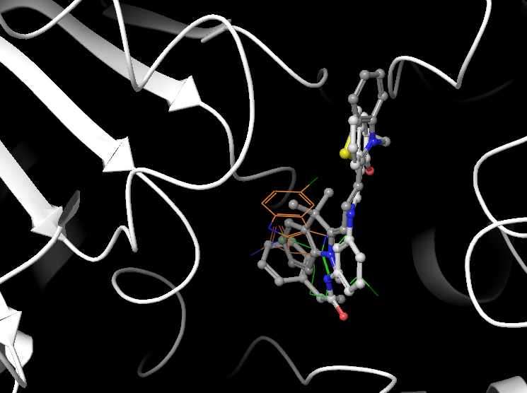
Binding mode for known ligands on 4BN5
Ac93253
(Carbon in grey)
Ex527 ( S)
(Carbon in green)
Salermide
(Carbon in white)
Ex527 ( R)
(Carbon in green)

Slide 30
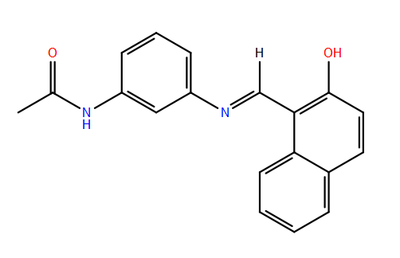
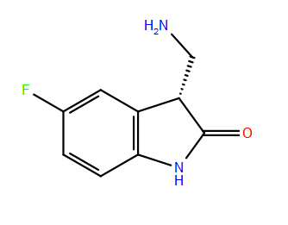
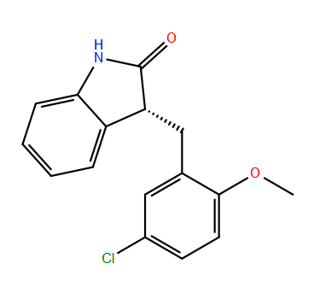
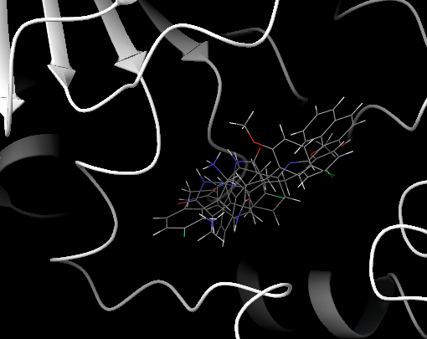
Binding of Selected Ligands

Slide 31
Activators design targeting base exchange reaction

Slide 32
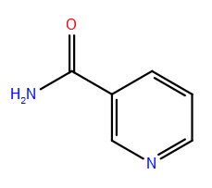
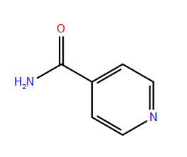
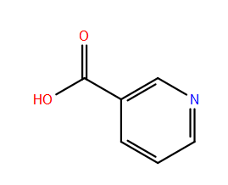
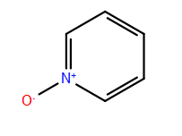
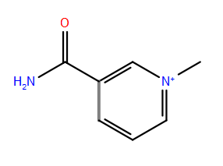
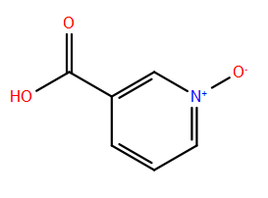
Small ligands experimentally tested for inhibition
Nicotinamide (NAM)
IC50 (SIRT3): 36.7 μM *
Iso-Nicotinamide (IsoNAM)
IC50 (SIRT3): 13.8 mM*
Nicotinic Acid
IC50 (SIRT3): 14.5 mM*
Pyridine, 1-oxide
IC50 (SIRT3): 24.1 mM*
N(1)-methylnicotinamide
IC50 (SIRT3): 9.2 mM *
Nicotinic Acid, 1-oxide
IC50 (SIRT3): 13.0 mM *

Slide 33
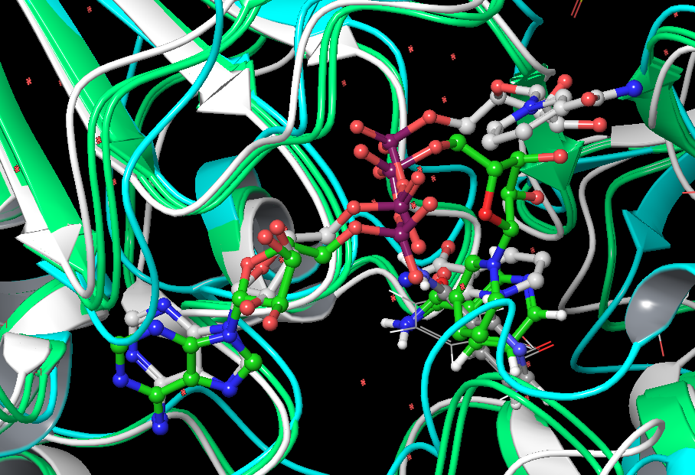
Binding of Nicotinamide (two potential orientations)
NAM in Sirt2 with NAD+ in AB
(Carbon in grey)
NAM docked to 4FVT w/ water
(Carbon in green)
NAM docked to apo-enzyme (3GLS)
(Carbon in dark grey)
NAM docked to 4FVT w/o water
(Carbon in wireframe)

Slide 34
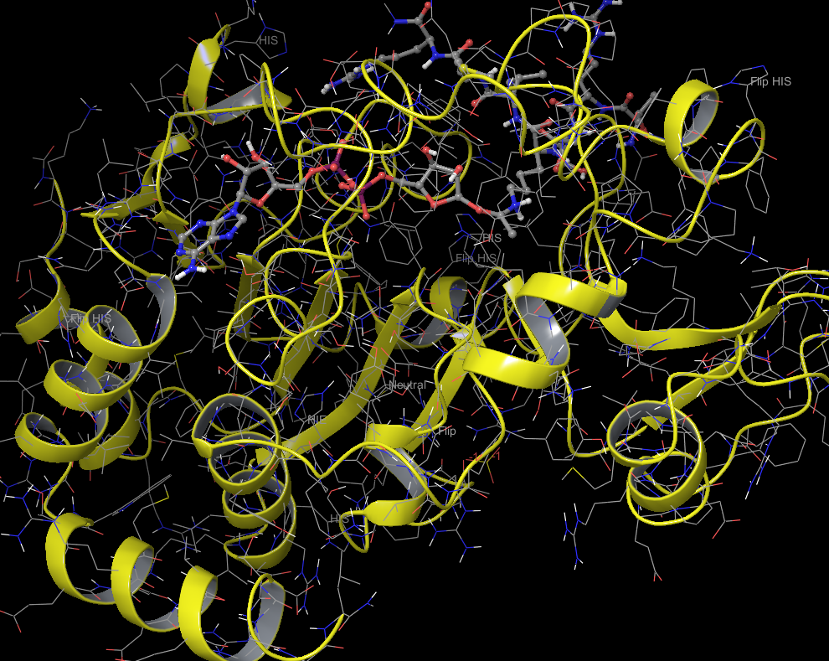
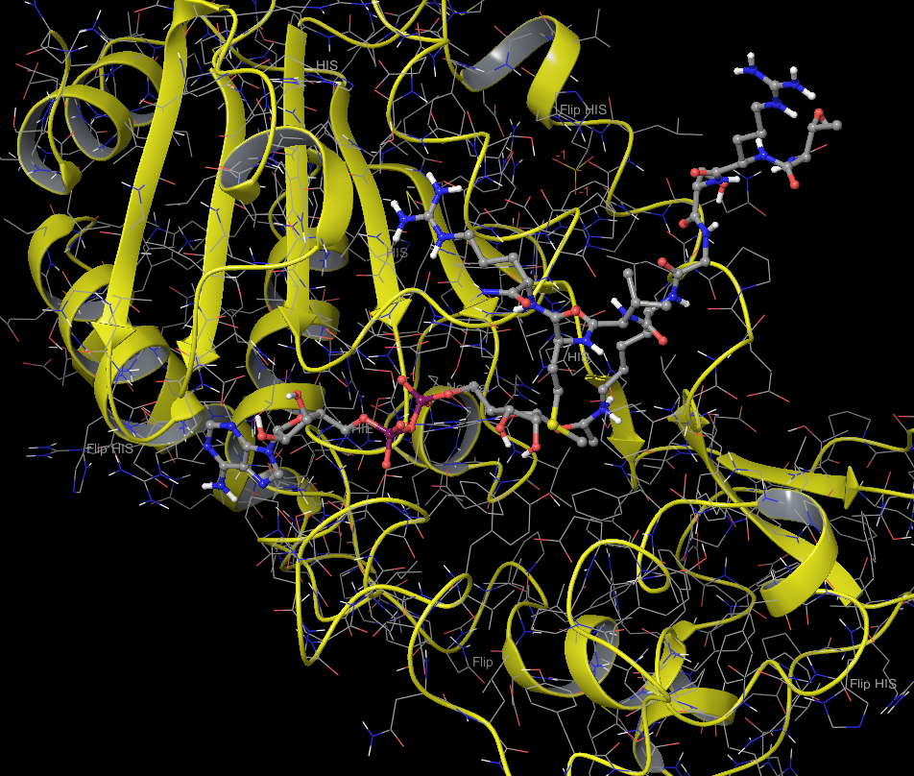
Include intermediate in the receptor

Slide 35
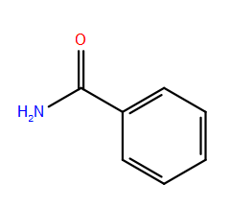
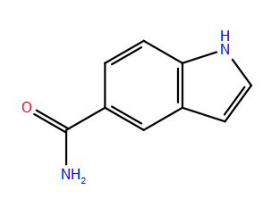
Docking small ligands with Intermediate in receptor
Ligand 1
Ligand 2
Ligand 3
Ligand 4
Ligand 5
Ligand 6

Slide 36
Two NAM binding modes and NAM release

Slide 37
Proposed research
The drug design protocol
The ensemble docking approach
The correlation between IC50 and MM-GBSA/LIE with single structure after docking
The correlation between IC50 and inhibition mechanism
The application of MD in structural refinement and binding free energy calculation
Activator discovery
Application of pharmacophore model in library enrichment
Application of protocol to obtain accurate binding affinity
Application of MD to study the kinetics of ligand exchange
Inhibitor discovery with specificity (SIRT3)
High throughput screening
Kinetics model for inhibition

Slide 38
Virtual high throughput screening

