Slide 1
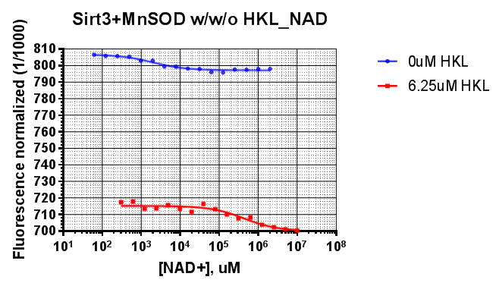
Sirt3 + Saturating MnSOD
w/w/o HKL
 | 0uM HKL | 6.25uM HKL
K_{d_NAD+}, uM | 1.98 | 43.8

Slide 2
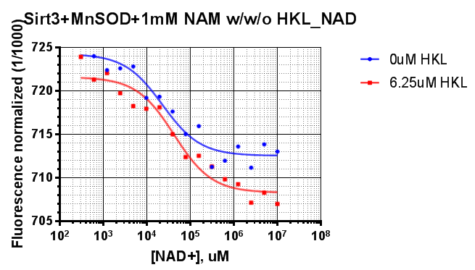
Sirt3 + Saturating MnSOD +1mM NAM
w/ w/o HKL
 | 0uM HKL | 6.25uM HKL
K_{d_NAD+}, uM | 22.9 | 42.6

Slide 3
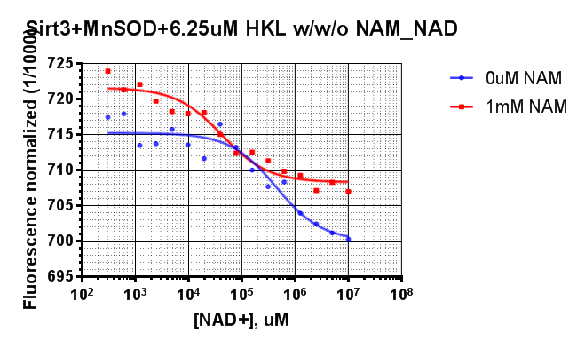
Sirt3 + Saturating MnSOD + 6.25uM HKL
w/ w/o NAM
 | 0uM NAM | 1mM NAM
K_{d_NAD+}, uM | 43.8 | 42.6

