Slide 1
OAADPr Expt.
[MnSOD K122] = 600 uM
[NAD+] = 100 uM
[HKL] = 0, 200 uM
[NAM] = 0, 100 uM
[OAADPr] = 0, 2.5 uM
Time points = 0, 10, 30, 40, 80, 120 min
AE-Sirt3 = 5 U (XG Batch I)
No repeat
Raw Data
100uM NAD+, 600uM K122, 100uM NAM, 200uM HKL
Time (min) | 0uM OAADPr | 2.5uM OAADPr
0 | 0.0000 | 0.0000
10 | 1.5380 | 1.6534
30 | 1.8368 | 1.8480
40 | 2.1450 | 2.3841
80 | 2.5750 | 2.4839
120 | 3.4582 | 3.6415
Raw Data
100uM NAD+, 600uM K122, 0uM NAM, 0uM HKL
Time (min) | 0uM OAADPr | 2.5uM OAADPr
0 | 0.0000 | 0.0000
10 | 4.3226 | 3.9237
30 | 8.2098 | 7.7033
Initial rate, uM/min
 | 0uM NAM/0uM HKL |  | 100uM NAM/200uM HKL
 | 0uM OAADPr | 2.5uM OAADPr | 0uM OAADPr | 2.5uM OAADPr
Single exp | 0.5057 | 0.453 | 0.09843 | 0.109
2nd poly | 0.4801 | 0.4333 | 0.04413 | 0.04308
3rd poly | Too few points | Too few points | 0.08682 | 0.09834

Slide 2
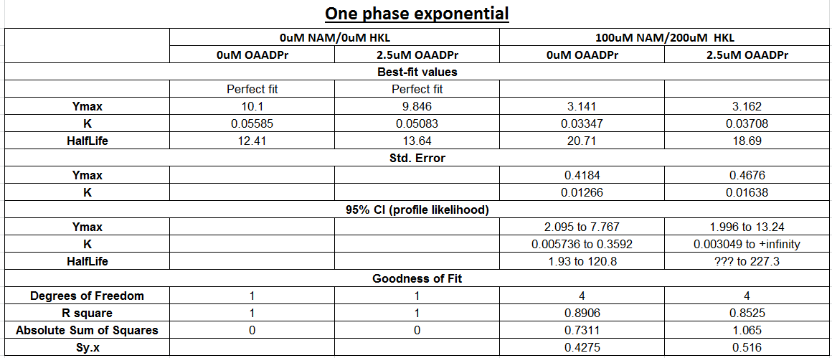
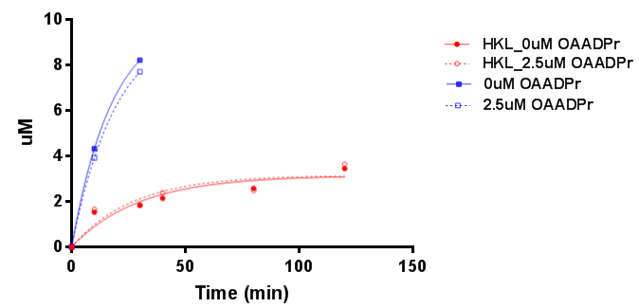

Slide 3
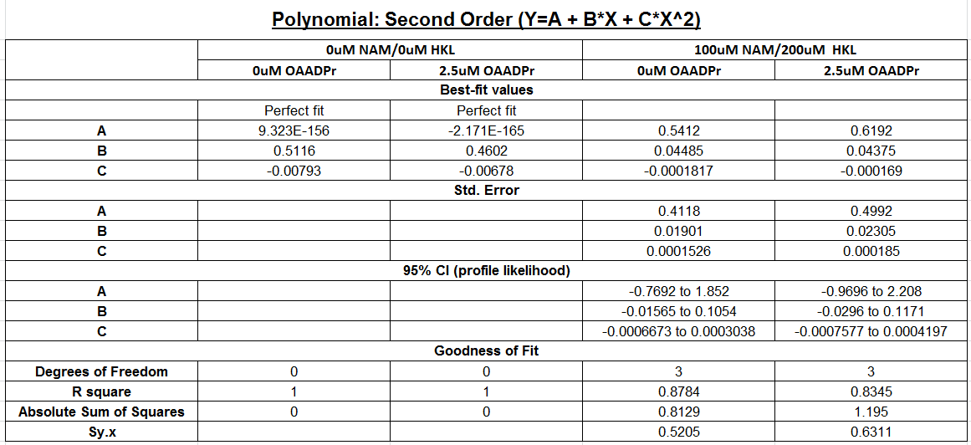
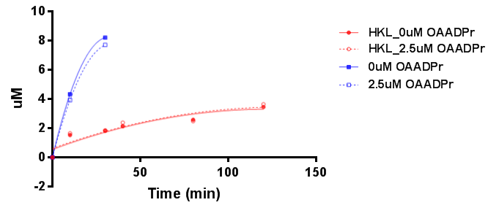

Slide 4
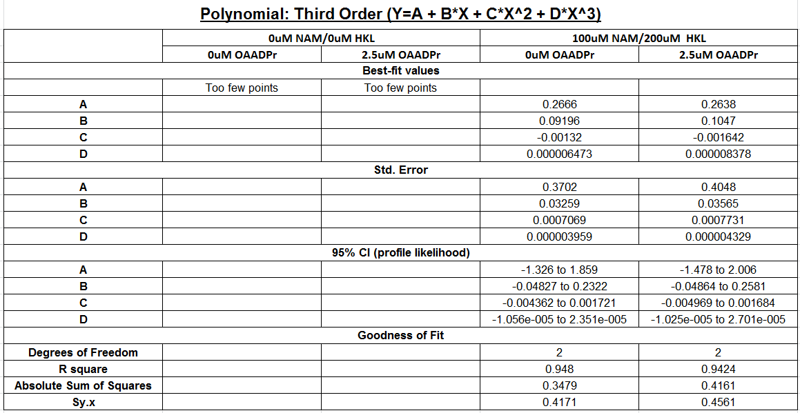
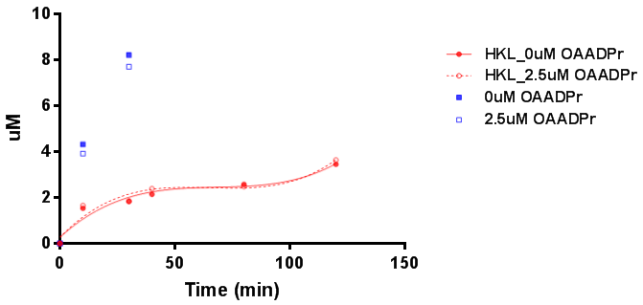

Slide 5
Remarks
At 0µM NAM and 0µM HKL , in the presence of 2.5 µM OAADPr, the initial rate decreased from 0.5057 to 0.453 µM/min ( 10.4%)—Single Exponential; 0.4801 to 0.4333 (9.7%)- 3nd Polynomial, which indicated that OAADPr does has inhibition effects.
At 100µM NAM and 200µM HKL. in the presence of 2.5 µM OAADPr, the initial rate increased from 0.09843 to 0.109 (10.7%) – Single Exponential; decreased from 0.04413-0.04308 (2.4%) –2nd polynomial; and increased from 0.08682 to 0.09834 (13.3%)---3rd polynomial.
By using different functions to fit the time series data, the initial rates obtained varies. As notices before, 10 min time point did not fit will all the current functions (slides 2-4).
For 0NAM/0HKL, we have saved sample for longer time point. Please advise if it’s necessary to run them. Total 6 samples for one day.

Slide 6
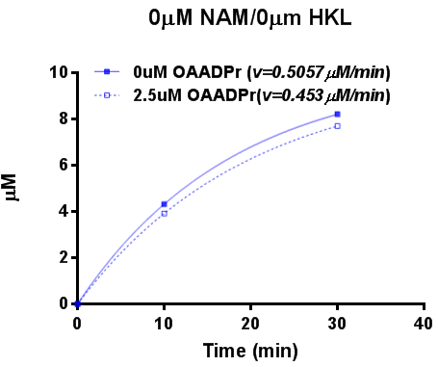
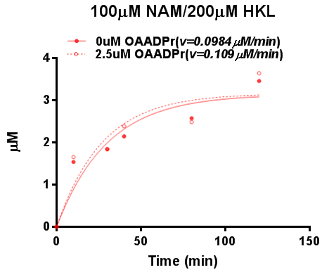
(a) (b)
Figure X. Investigation of OAADPr product inhibition. The deaceylation reactions were performed at [NAD⁺]=100µM, [MnSOD K122]=600µM in the presence of 2.5 µM OAADPr (a) 0µM NAM and 0µM HKL (b) 100µM NAM and 200µM HKL. The product formation was monitored by HPLC at desired time points (0, 10, 30, 40, 80, 120min). The time series were fitted in single exponential function in Prism.

