Slide 1
PMC-AT Group meeting
Ping Lin
08/22/2014

Slide 2
Inhibitor discovery for SIRT3
Docking of DHP series to SIRT3 structures and MM-GBSA calculations
Docking of DHP series to SIRT2 structures and MM-GBSA calculations

Slide 3
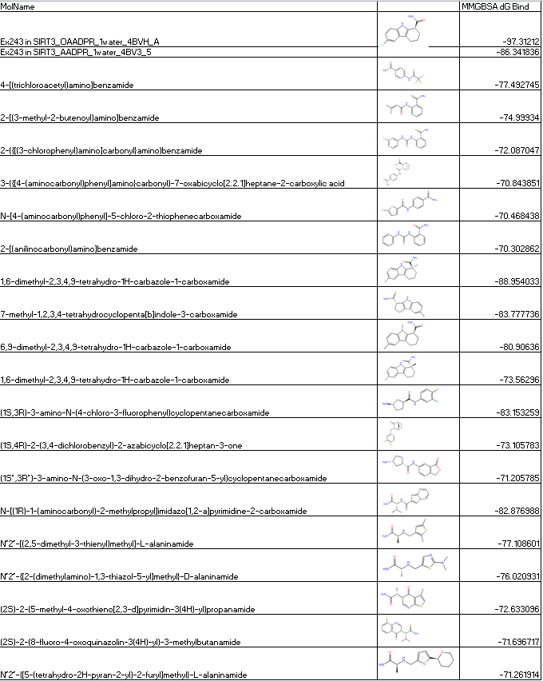
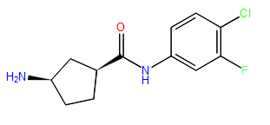
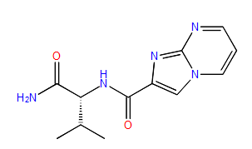

Slide 4
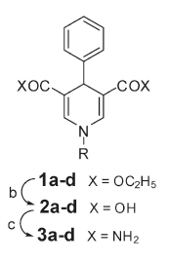
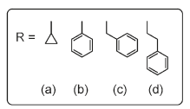
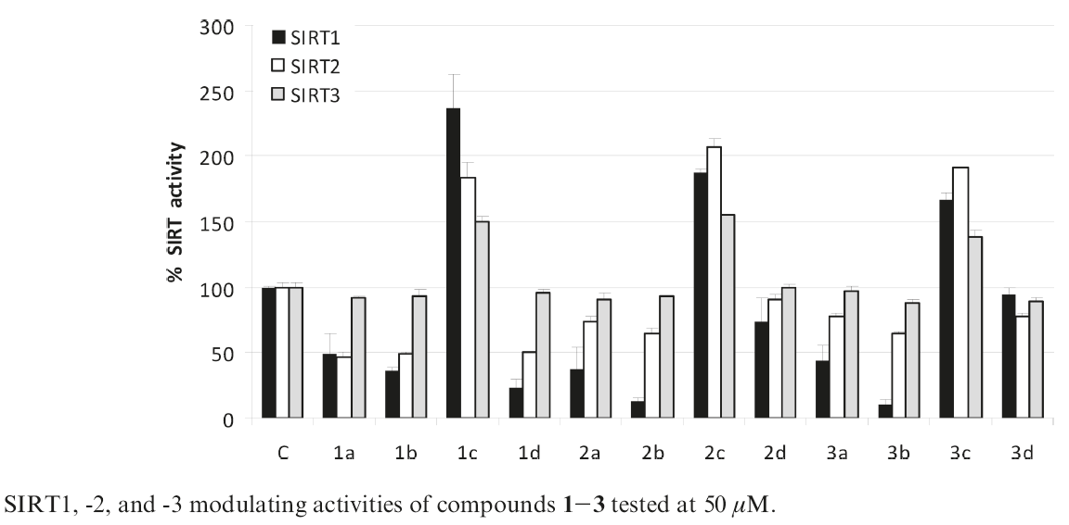
1,4-dihydropyridine (DHP) compounds derivatives
Antonello Mai, et al, J. Med. Chem. 2009, 52, 5496–5504

Slide 5
Ligand | Receptor | MM-GBSA scores | Glide Score (XP)
DHP-1c | SIRT3:ac-Peptide(from 4FVT) | -79.054743 | -5.288631
DHP-1d | SIRT3:ac-Peptide(from 4FVT) | -67.262835 | -4.613234
DHP-1b | SIRT3:ac-Peptide(from 4FVT) | -76.015906 | -2.117807
DHP-1a | SIRT3:ac-Peptide(from 4FVT) | -76.104804 | -1.390832
DHP-1c | SIRT3(from 4BVH) | -49.761182 | -8.060841
DHP-1b | SIRT3(from 4BVH) | -57.11277 | -7.756798
DHP-1d | SIRT3(from 4BVH) | -52.199778 | -6.983156
DHP-1a | SIRT3(from 4BVH) | -44.563101 | -6.276144
DHP-1b | SIRT3(from 4BN5) | -73.321258 | -9.291359
DHP-1c | SIRT3(from 4BN5) | -69.275284 | -8.134838
DHP-1a | SIRT3(from 4BN5) | -68.652436 | -7.854865
DHP-1d | SIRT3(from 4BN5) | -82.207429 | -7.826902
DHP-1a | SIRT3(from 4JSR) | -76.373909 | -8.369315
DHP-1d | SIRT3(from 4JSR) | -64.798252 | -7.631151
DHP-1c | SIRT3(from 4JSR) | -70.454133 | -7.45589
DHP-1b | SIRT3(from 4JSR) | -80.388479 | -6.967164
DHP-1c | SIRT3(from 4FVT) | -88.97926 | -7.451651
DHP-1b | SIRT3(from 4FVT) | -77.625507 | -7.38527
DHP-1a | SIRT3(from 4FVT) | -80.881088 | -6.741127
DHP-1d | SIRT3(from 4FVT) | -59.410078 | -5.907016
DHP-1d | SIRT3(from 4FVT) Induced Fit |  | -10.712468
DHP-1b | SIRT3(from 4FVT) Induced Fit |  | -10.342806
DHP-1c | SIRT3(from 4FVT) Induced Fit |  | -9.890372
DHP-1a | SIRT3(from 4FVT) Induced Fit |  | -9.192057
DHP-1c | SIRT3:ac-Peptide(from 4FVT) Induced Fit |  | -10.985114
DHP-1b | SIRT3:ac-Peptide(from 4FVT) Induced Fit |  | -10.489428
DHP-1d | SIRT3:ac-Peptide(from 4FVT) Induced Fit |  | -10.332505
DHP-1a | SIRT3:ac-Peptide(from 4FVT) Induced Fit |  | -9.009854

Slide 6
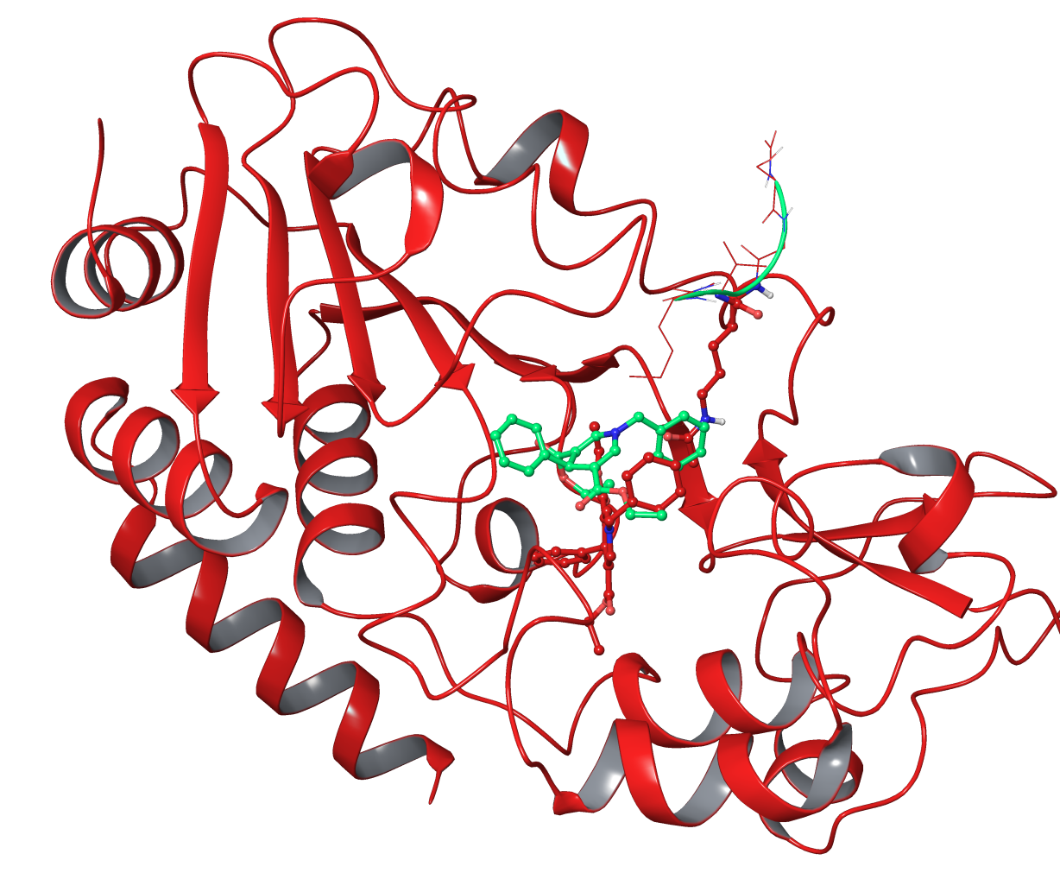
DHP-1c in SIRT3 (in green) and SIRT3:ac-peptide (in red) (both taken from 4FVT)

Slide 7
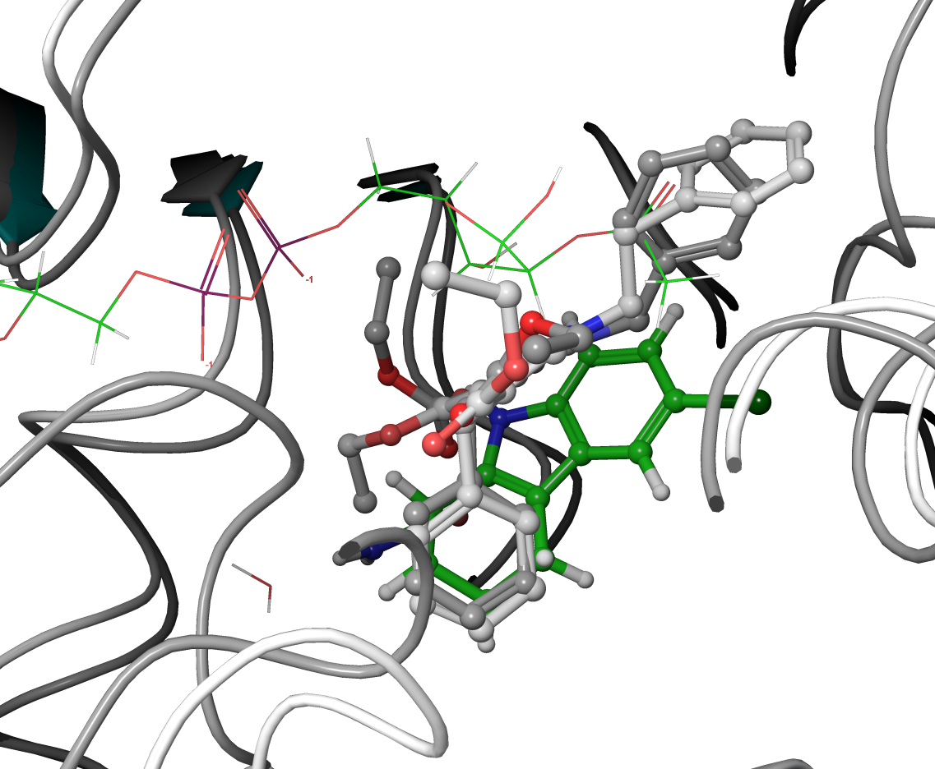
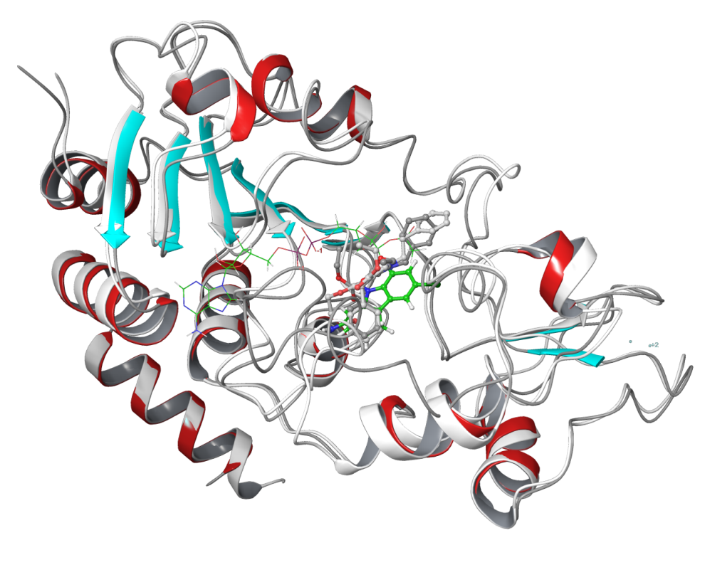
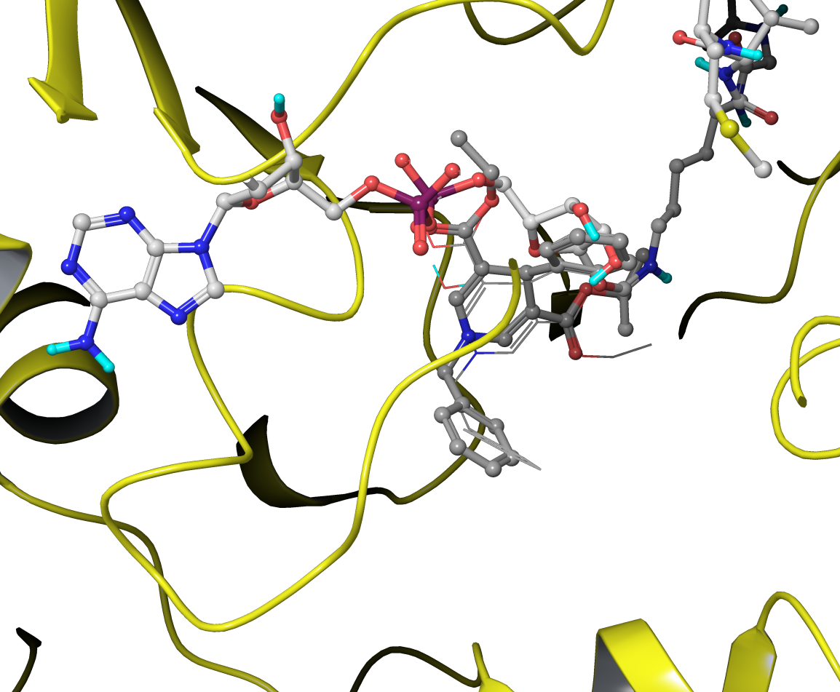
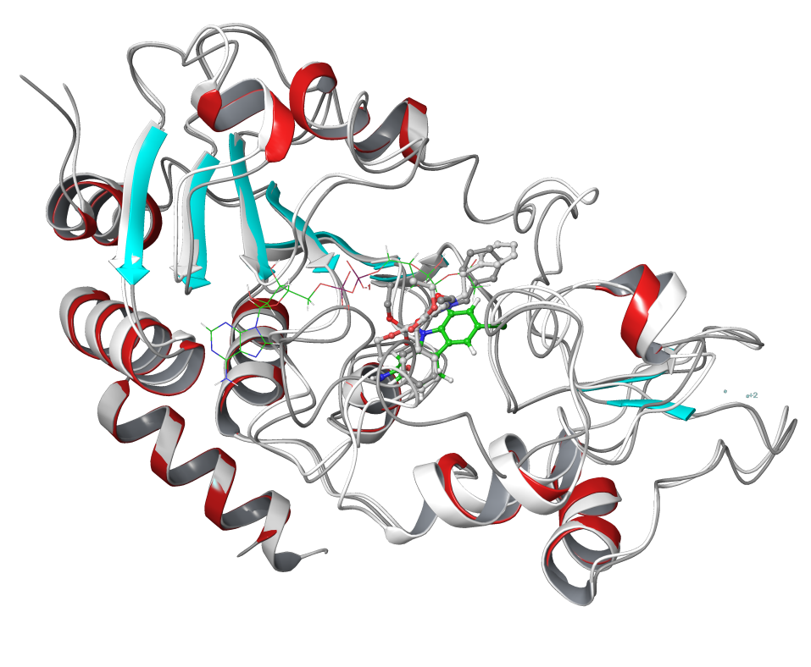
Docking of DHP-1c (C atom in grey) and DHP-1d (C atom in white) in SIRT3 (taken from 4BN5, NAD+ and inhibitor removed, enzyme only) compared with 4BVH structure (SIRT3:ac-ADPR:Ex-243, C atom in green)
Docking of DHP-1c (C atom in grey, ball-and-stick) and DHP-1d (C atom in grey, line) in SIRT3 (taken from 4BVG, Intermediate removed, enzyme only) compared with 4BVG structure (SIRT3:Intermediate, C atom in white)

Slide 8
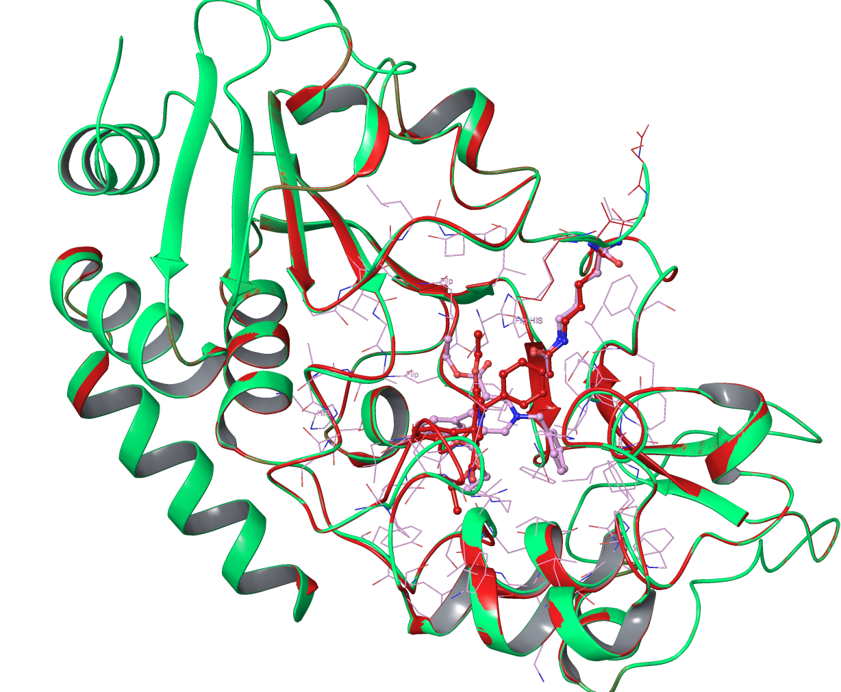
Comparison of DHP-1c in SIRT3:ac-peptide with induced Fit (pink, SIRT3 in green) and with Glide XP (red, SIRT3 in red)

Slide 9
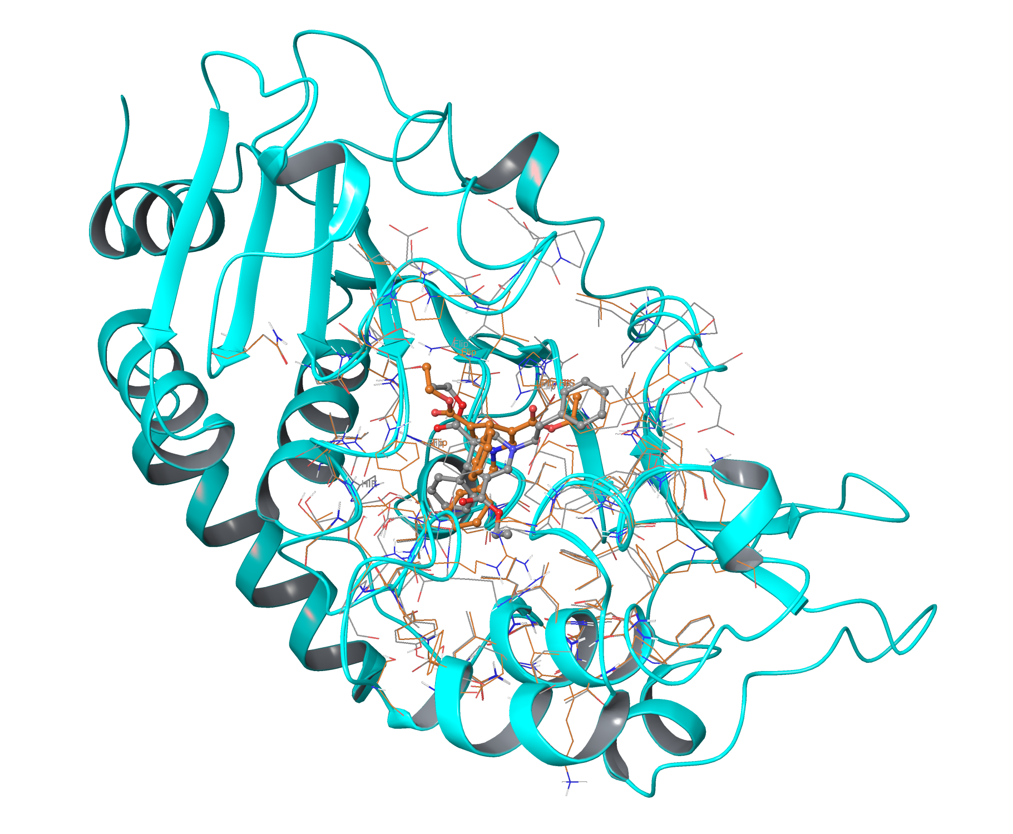
Induced Fit produce more poses,
192 using SIRT3 as receptor
Induced Fit of Docking of DHP-1d (C in grey) and 1c (C atom in orange) in SIRT3 (taken from 4FVT, NAD+ and ac-peptide removed, enzyme only)

Slide 10
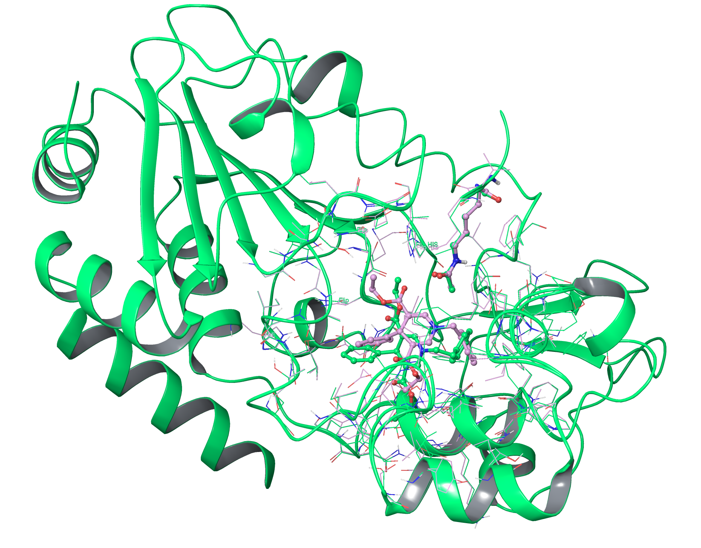
Induced Fit produce more poses,
172 using SIRT3:ac-Peptide as receptor
Induced Fit of Docking of DHP-1d (C in pink) and 1c (C atom in green) in SIRT3:Ac-peptide (taken from 4FVT, NAD+ removed)

Slide 11
Docking of DHP series to SIRT2 structures and MM-GBSA calculations
4L3O_AE_prep4 | Glide XP | MM-GBSA
DHP-1a | -4.72152 | -36.929736
DHP-1a | -3.72582 | -47.940468
DHP-1a | -3.31948 | -48.577835
DHP-1c | -2.92864 | -15.683576
DHP-1c | -0.66281 | -39.215692
DHP-1c | -0.50429 | -37.97968
3ZGV_A_prep4_no_ADP
DHP-1c | -9.93043 | -80.029694
DHP-1d | -8.28082 | -78.061052
DHP-1b | -8.27005 | -64.332552
DHP-1a | -6.70977 | -81.982955
3ZGO_A_prep3
DHP-1d | -7.09279 | -45.885888
DHP-1c | -6.78584 | -63.688691
DHP-1b | -6.06666 | -53.754607
DHP-1a | -6.00105 | -51.038207

Slide 12
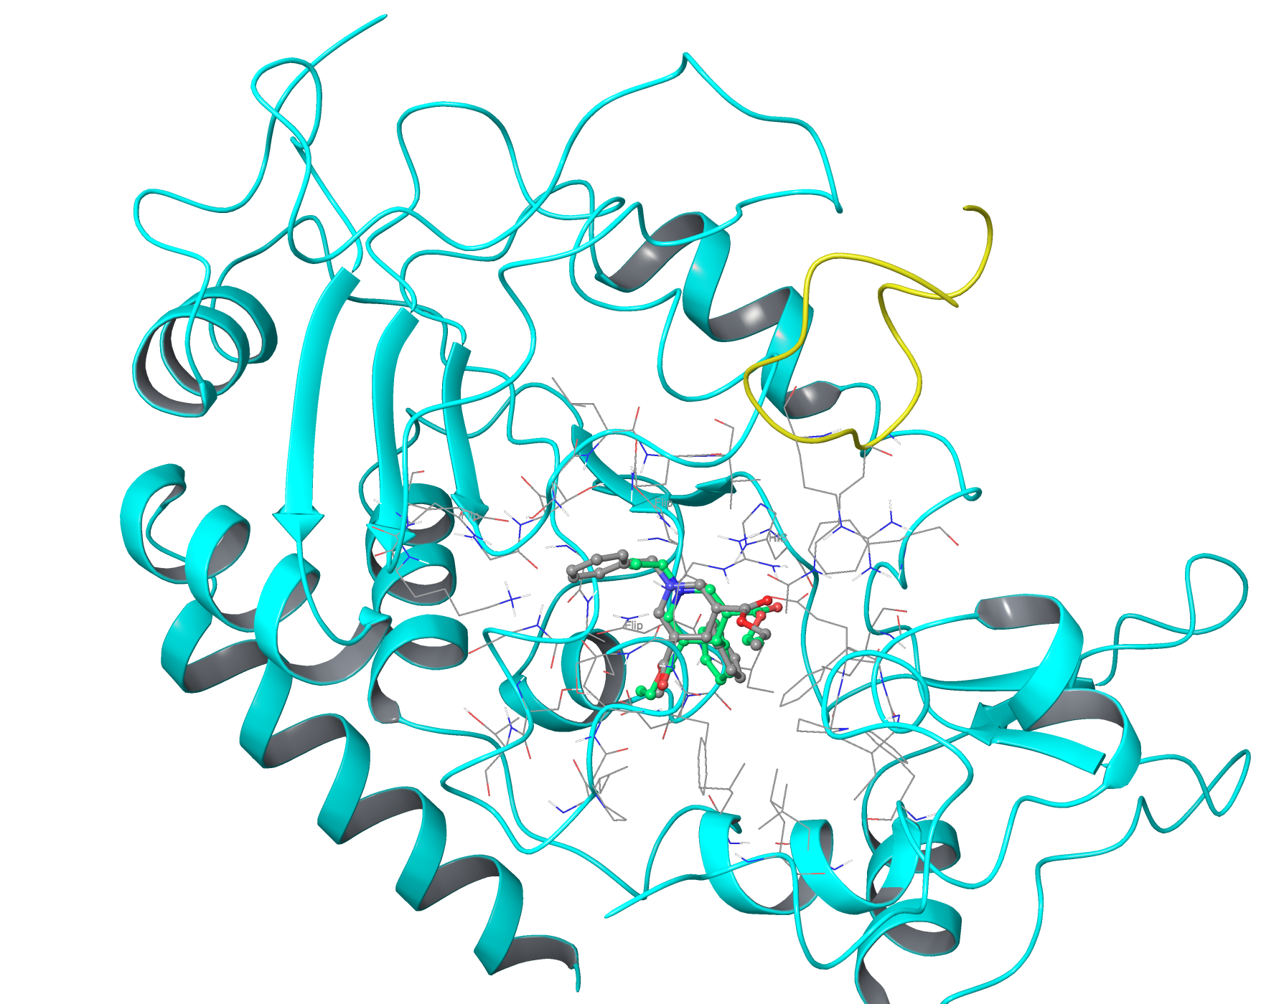
Docking of DHP-1c (C atom in grey) and DHP-1a (C atom in green) in SIRT2:ac-peptide (taken from 4L3O)

Slide 13
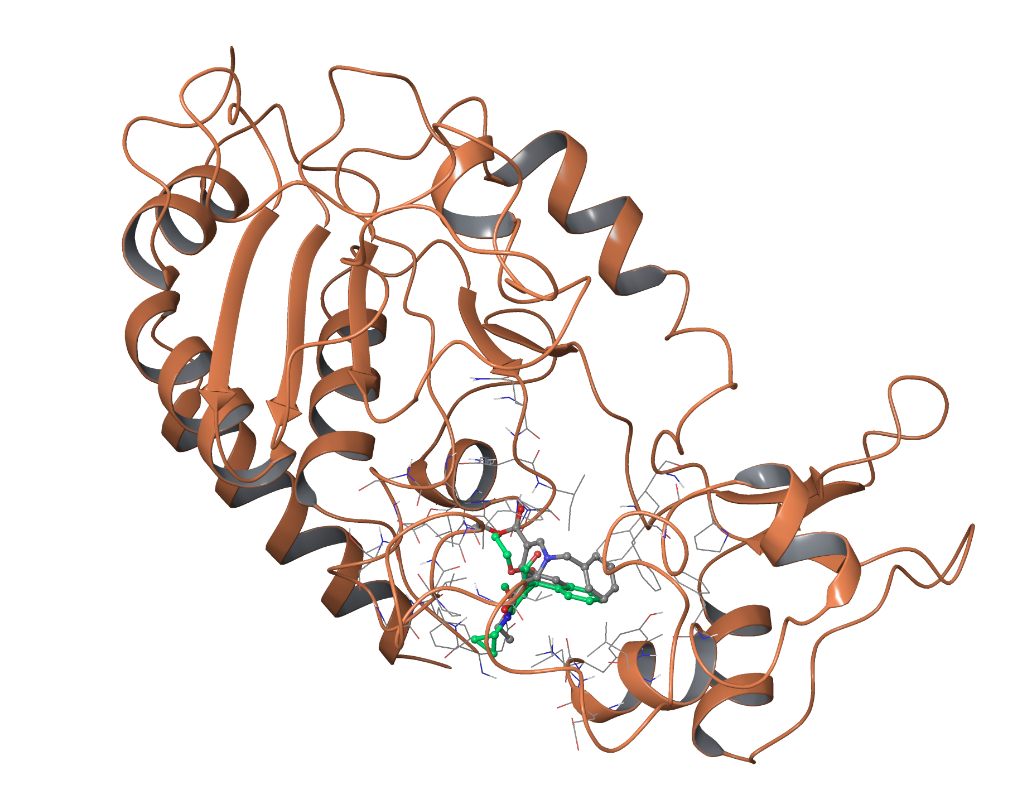
Docking of DHP-1c (C atom in grey) and DHP-1a (C atom in green) in SIRT2 (taken from 3ZGV, ADP removed, enzyme only)

Slide 14
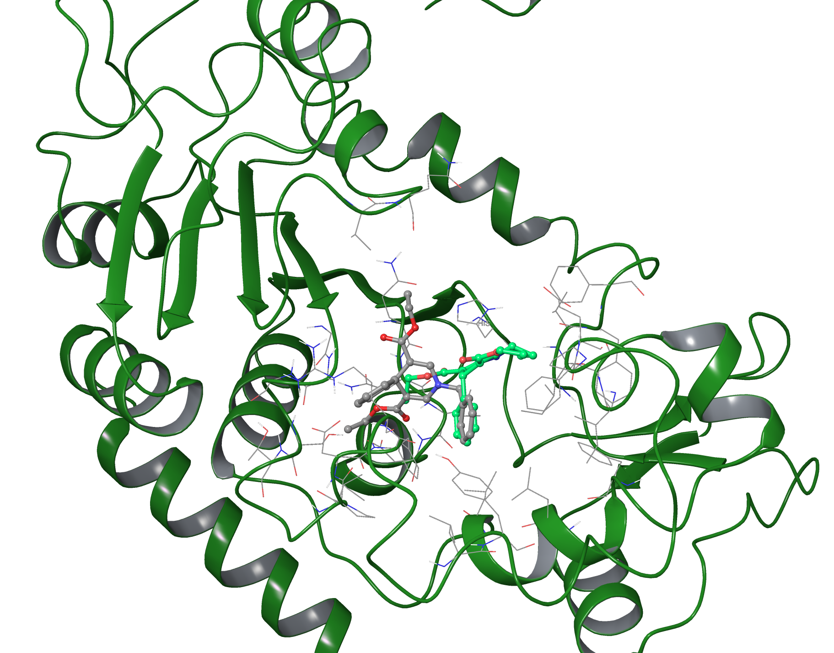
Docking of DHP-1c (C atom in grey) and DHP-1a (C atom in green) in SIRT2 (taken from 3ZGO, apo-enzyme)

