Slide 1
Summary for Similarity Search
07.18.2014

Slide 2
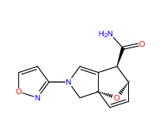
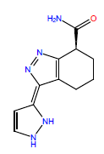
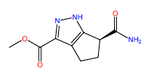
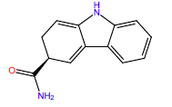
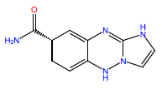
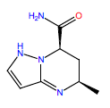
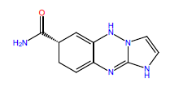
100 molecules from MOE CoreHopping results (Top100_MOE_SIRT3_aADPR_add group01.pdf)
Degree of similarity was set as 75%
CHEM BRIDGE database/Hit2Lead/Structure Search
Some commercially available compounds were found pertaining similar structures with molecules Pmcat #7, 15, 27, 29, 45, and 54.
No. 7 No.15 No.27 No.29
No.45 No. 54 No. 64

Slide 3
No. 7

Slide 4
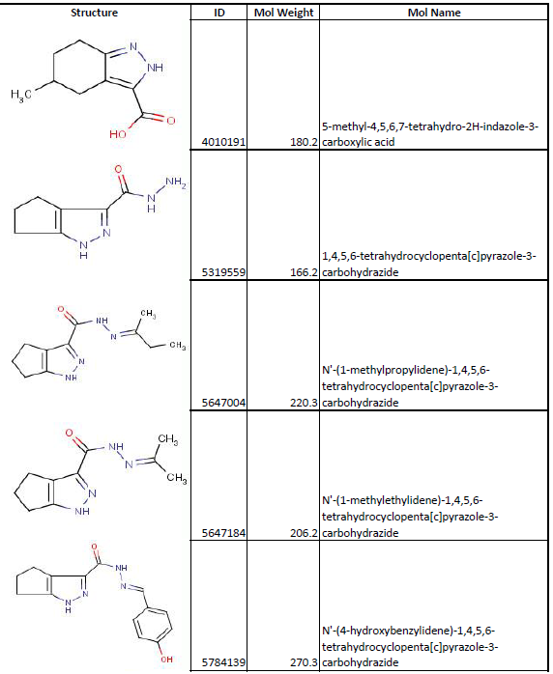
No. 15

Slide 5
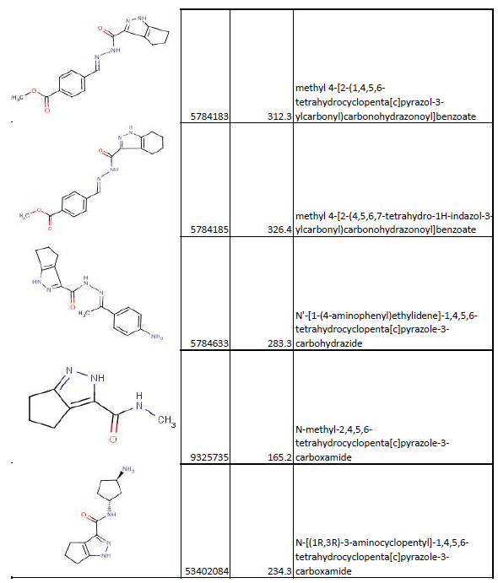
No. 15

Slide 6
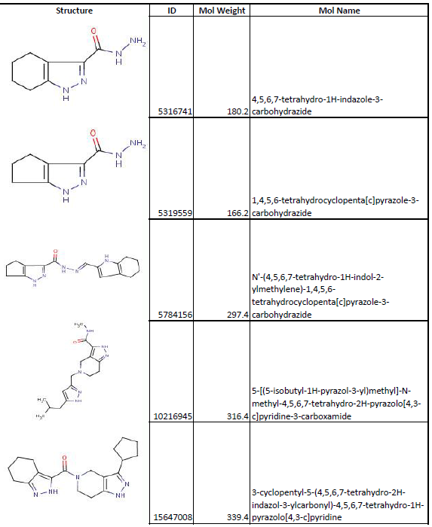
No. 27

Slide 7
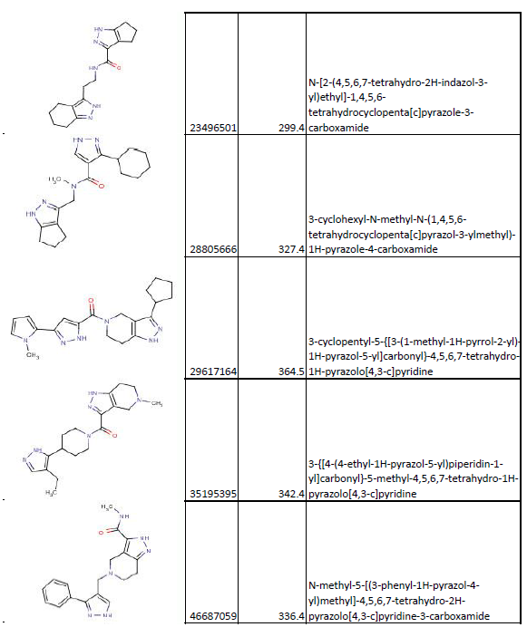
No. 27

Slide 8
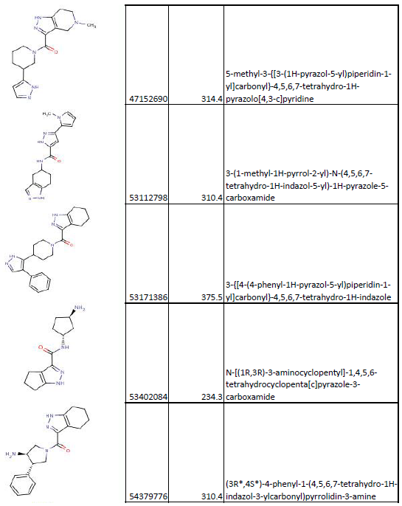
No. 27

Slide 9
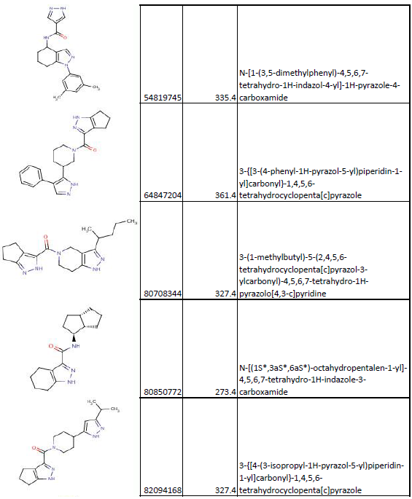
No. 27

Slide 10
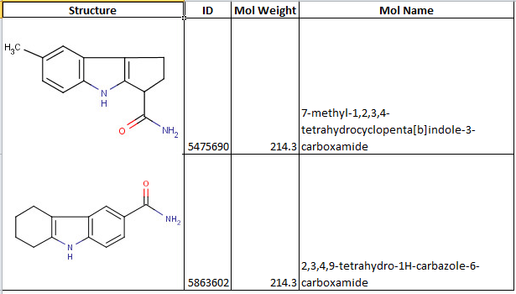
No. 29

Slide 11
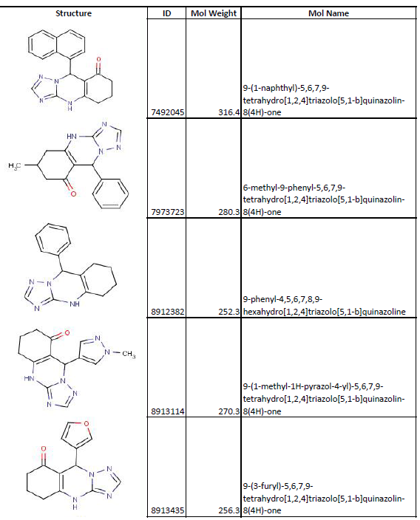
No. 45

Slide 12
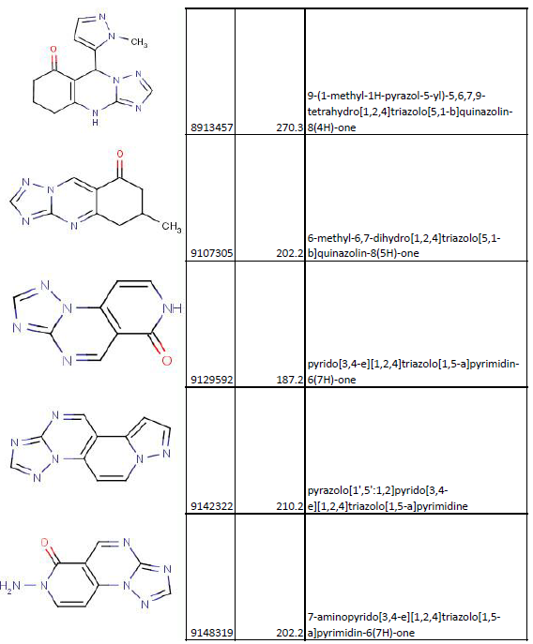
No. 45

Slide 13
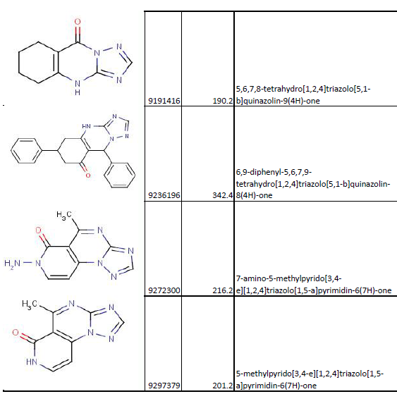
No. 45

Slide 14
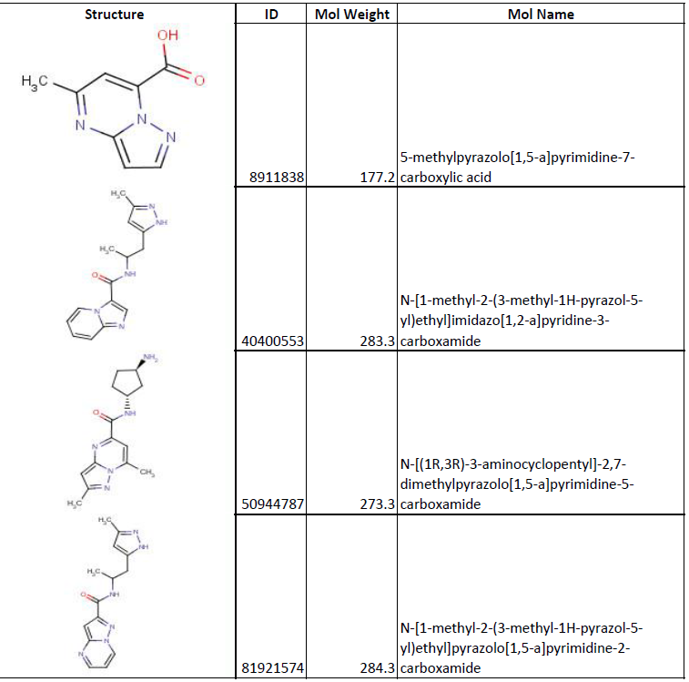
No. 54

Slide 15
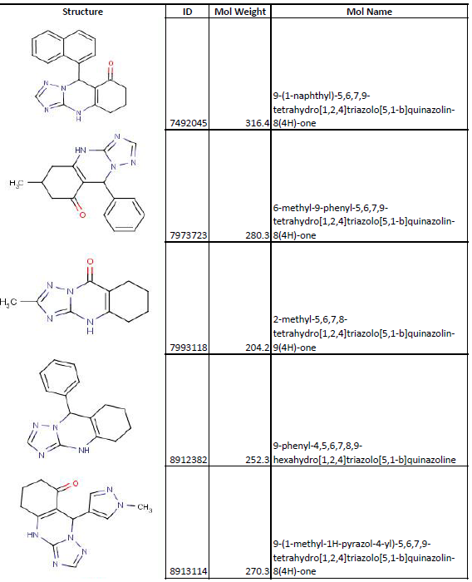
No. 64

Slide 16
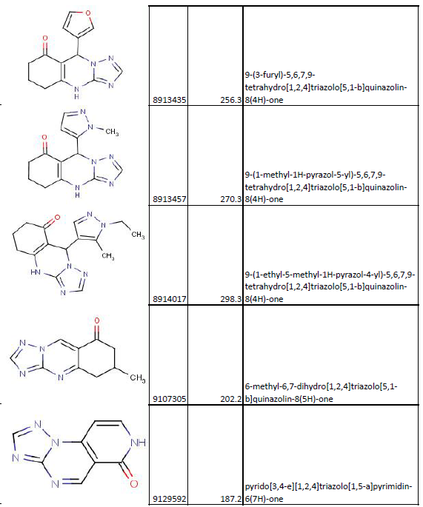
No. 64

Slide 17
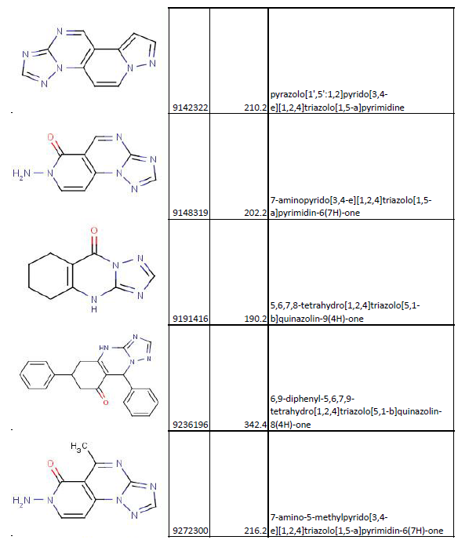
No. 64

Slide 18
No. 64

Slide 19
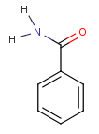
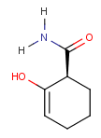
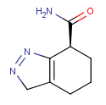
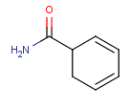
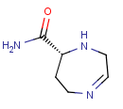
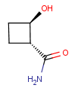
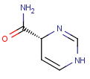
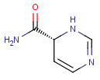
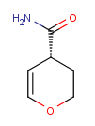
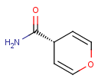
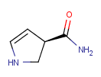
100 molecules from MOE CoreHopping results (Top100_MOE_SIRT3_aADPR_add group01.pdf)
Substructure search (all the parameter settings are based on Lipinski’s rule of five)
Molecular weight, from 180 to 500 daltons
LogP( octanol-water partition coefficient, not greater than 5
Rotatable bonds, no more than 3
hDon (hydrogen bond donors), no more than 5
hAcc (hydrogen bond acceptors), no more than 5
CHEM BRIDGE database/Hit2Lead/Substructure search
The substructure used for searching are listed as following

Slide 20
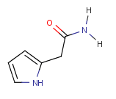
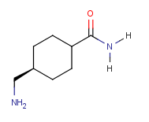
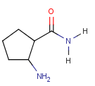
100 molecules from MOE CoreHopping results (Top100_MOE_SIRT3_aADPR_add group01.pdf)
Substructure search (all the parameter settings are based on Lipinski’s rule of five)
Molecular weight, from 180 to 500 daltons
LogP( octanol-water partition coefficient, not greater than 7
Rotatable bonds, no more than 5
hDon (hydrogen bond donors), no more than 5
hAcc (hydrogen bond acceptors), no more than 10
CHEM BRIDGE database/Hit2Lead/Substructure search
The substructure used for searching are listed as following
sss_A_1 sss_A_2 sss_A_3 sss_A_4 sss_A_5
sss_A_6 sss_A_7 sss_A_8

Slide 21
SSS_A_1
Total 3239 molecules were found.

Slide 22
SSS_A_2
Total 7 molecules were found.

Slide 23
SSS_A_3
Total 557 molecules were found.

Slide 24
SSS_A_4
Total 8 molecules were found.

Slide 25
SSS_A_5
Total 18 molecules were found.

Slide 26
SSS_A_6
Total 407 molecules were found.

Slide 27
SSS_A_7
Total 407 molecules were found.

Slide 28
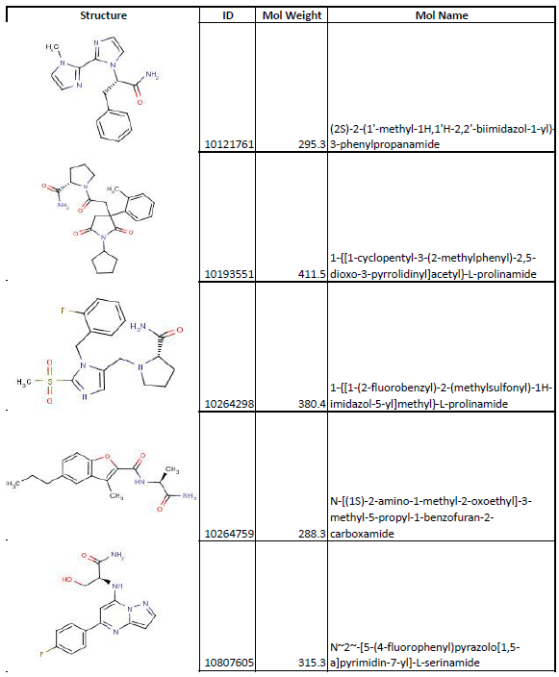
SSS_A_8
Total 407 molecules were found.

