Slide 1
Truncated SIRT3 Characterization
V_{max}, K_{m}, K_{cat} Measurement
SIRTainty assay

Slide 2
SIRTainty Stazndard Curve
[NAM], uM | Raw | ΔAFU
25 | 989 | 668
12.5 | 641 | 320
6.25 | 526 | 205
3.125 | 373 | 52
1.5625 | 367 | 46
0.78125 | 345 | 24
0.390625 | 335 | 14
0 | 321 | 0
[NAM] = 0 – 25 uM
[Nicotinamidase]= 0.1ug/ul
30min incubation
Room temperature

Slide 3
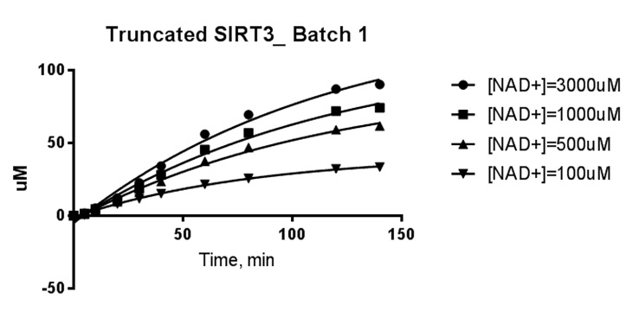
Initial Rate experiment
Time, min | [NAD⁺], uM
 | 100 | 500 | 1000 | 3000
0 | 0.0 | 0.0 | 0.0 | 0.0
10 | 3.7 | 4.3 | 4.6 | 5.1
20 | 8.2 | 9.6 | 10.5 | 12.1
30 | 11.7 | 16.0 | 18.7 | 22.5
60 | 21.5 | 37.4 | 45.4 | 56.0
120 | 32.2 | 59.1 | 72.0 | 87.0
[MnSOD K122] = 600uM
[NAD+] = 100, 500, 1000, 3000 uM
[Nicotinamidase] = 0.5 ug/reaction
[Truncated SIRT3] = 5 U/reaction
Time points = 0, 10, 20, 30, 60, 120, 140 min
Temp. = 37ºC

Slide 4
MM Fitting
 | Truncated SIRT3 (118-399) |  | 2M Urea SIRT3 (102-399)
 | [NAD+] = 100 - 3000uM [MnSOD] = 600uM | [NAD+] = 8, 24 mM [MnSOD]=600uM | [NAD+] = 50 – 3000uM [MnSOD] = 600uM
Vmax | 1.179 | 3.3 | 0.8739
Km | 176.5 |  | 242.8
Std. Error
Vmax | 0.09613 |  | 0.009129
Km | 65.81 |  | 9.671
R square | 0.9304 |  | 0.9997
Absolute Sum of Squares | 0.01747 |  | 0.00005167
[E]₀, uM | 4.999 | 10 | 2.04
Kcat, 1/s | 0.003931 | 0.0055 | 0.007143
MW _ Truncated SIRT3 (118-399): 31435.33 Daltons
[Truncated SIRT3], ug/ul: 5.5
Activity Truncated SIRT3, U/ul: 7
MW _ AE 2M urea SIRT3 (102-399): 32.7 KD
[SIRT3_102-399], ug/ul: 1
Activity SIRT3_102-399, U/ul: 1.5

