Slide 1
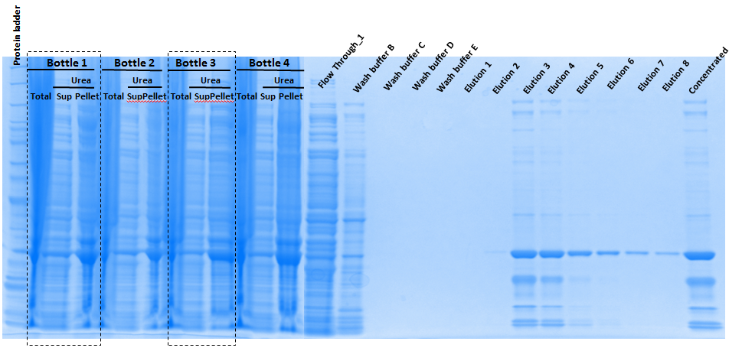
10.23.2015
Large scale _ Batch I
1mM IPTG induction (4X200mL)
8M Urea

Slide 2
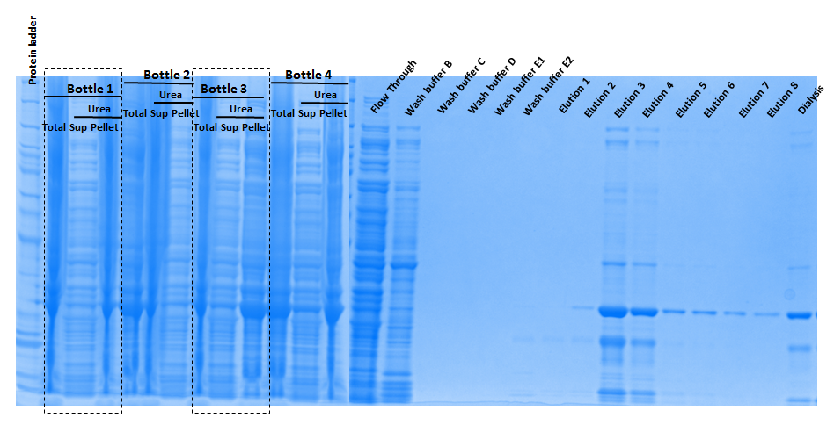
10.23.2015
Large scale _ Batch II
1mM IPTG induction (4x200mL)
8M Urea

Slide 3
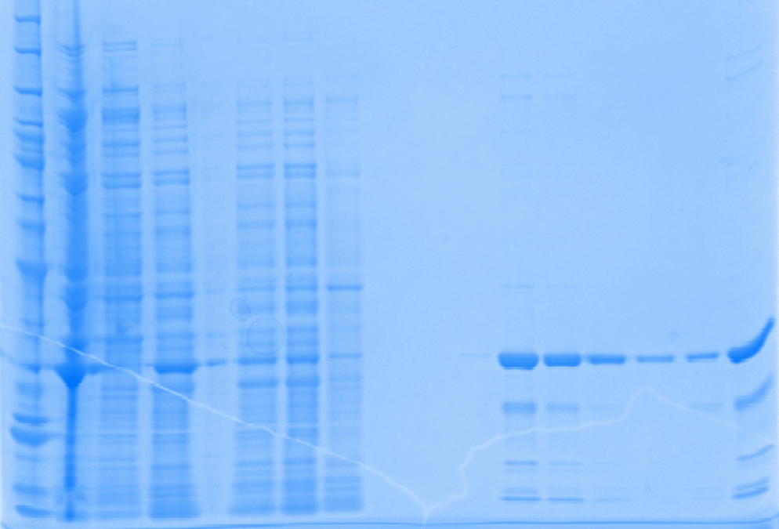
10.16.2015
1mM IPTG induction _ 200mL
8M Urea
Flow Through_1
Protein ladder
Supernatant
Urea (Pellet)
Flow Through_2
Wash buffer B
Urea (sup)
Wash buffer E
Concentrated
Total
Elution 1
Elution 2
Elution 3
Elution 4
Elution 5
Elution 6
Dialysis

Slide 4
1mM IPTG induction at 30 ºC 8M Urea treatment | 200mL | Batch I_800mL | Batch II_800mL
[Purified Protein], ug/ul | 0.5196 | 0.7657 | 0.7441
V_{Total}, ul | 2500 | 2500 | 2500
Total protein, ug | 1299.0 | 1914.3 | 1860.3
Specific activity, U/ug | 0.4052 | 0.2821 | 0.2426
Total Reactions | 211 | 216 | 181
Purity | 95% | 80-85% | 80-85%
How many batches required for one series of initial rate Exp. | 1.4 | 1.4 | 1.7
Conclusion:
Large scale purification
Purified protein concentration was increased
Total amount protein was increased
Purity was decreased
Specific activity was decreased
Total reactions can be done for one batch stay the same.
Possible reasons
For each 200mL culture, it takes quite a while to suspend and proceed for Urea treatment. Proceeding time was too long for 4-fold of cell (800ml) in one day. Homogenizer is needed for speed up these particular steps.
Loading 4X samples on 1 single column does not provide 4x amount of protein
Some loss from FlowThrough indicated the binding was not sufficient
Purity was decreased which indicated extra wash is needed
Possible solutions
Purify the protein as 200mL per unit
Load them into different column separately
Pool them together for dialysis

