Slide 1
Competitive inhibition
of deacetylation
EAc-PrI₂
k_{cat}
EADPR-Pr-ImI₂
k₃[I₂]
k₋₃
AADPR+Pr
k₃[I₂]
k₋₃
Competitive
inhibition
of Base Exchange
EAc-Pr
k_{cat}
EADPR-Pr-Im
AADPR+Pr
k₋₂
k₋₁
k₁[NAD⁺]
k₋₂
EAc-PrNAM
k₂[NAM]
Base Exchange
AADPR+Pr
k_{cat}
k_{-ex}
EAc-PrNAD⁺
EADPR-Pr-ImNAM
k_{ex}
ADPR-Pr-Im: ADPR peptidyl-Imidate

Slide 2
EAc-Pr
k_{cat,app}
EADPR-Pr-Im
AADPR+Pr
k_{-2,app}
k_{-1,app}
k_{1,app}[NAD⁺]
k_{-2,app}
EAc-PrNAM
k_{2,app}[NAM]
k_{cat,app}
AADPR+Pr
k_{-ex,app}
EAc-PrNAD⁺
EADPR-Pr-ImNAM
k_{ex,app}

Slide 3
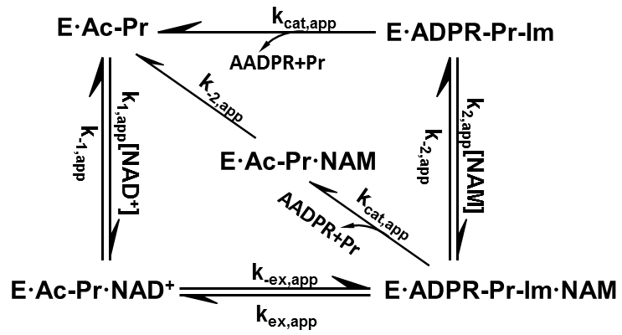
EAc-Pr I₂
Implied K
EADPR-Pr-ImI₂
K₃
K₃
EAc-Pr
k_{cat}
EADPR-Pr-Im
EAc-PrNAMI₂
k₋₂
Mixed
Noncompetitive
inhibition of
Base Exchange
K₃
k₋₁
k₁[NAD⁺]
k₋₂
k₂[NAM]
EAc-Pr NAM
EAc-PrNAD⁺I₂
EADPR-Pr-ImNAMI₂
k_{cat}
K₃
Noncompetitive inhibition
of Base
Exchange
k_{ex}
EAc-PrNAD⁺
EADPR-Pr-ImNAM
k_{-ex}

Slide 4
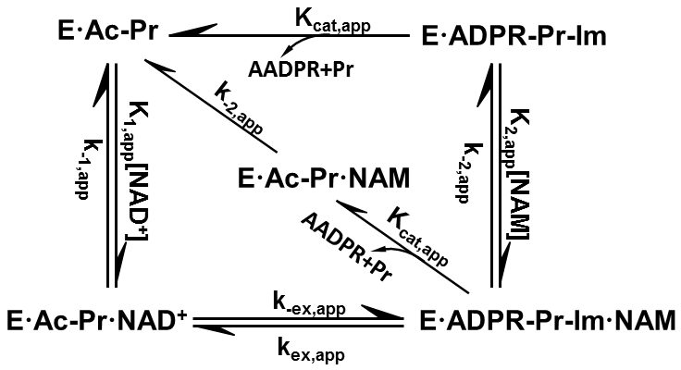
EAc-Pr I₂
k_{cat}
EADPR-Pr-ImI₂
K₃
K₃
EAc-Pr
k_{cat}
EADPR-Pr-Im
EAc-PrNAMI₂
k₋₂
K₃
Noncompetitive inhibition
of
Base Exchange
k₋₁
k₁[NAD⁺]
k₋₂
k₂[NAM]
EAc-Pr NAM
EAc-PrNAD⁺I₂
EADPR-Pr-ImNAMI₂
k_{cat}
K₃
k_{-ex}
EAc-PrNAD⁺
EADPR-Pr-ImNAM
k_{ex}

Slide 5
EAc-Pr A
K_{d1,A}
EAc-Pr
k_{-1’}
Bold or preferably color code the left and right sides;
color coding could match the two MST traces overlaid in pt b
k_{1’}[NAD⁺]
k₋₁
k₁[NAD⁺]
EAc-PrNAD⁺A
K_{d2,A}
EAc-PrNAD⁺

Slide 6
Slide 5 is pt a; this slide for titrated c-NAD with
and without sat HKL
w red and blue side by side on same axes
is pt b. Same format at slide 8 after revisions
Also make a caption

Slide 7
EAc-Pr A
K_{d1,A}
k_{-2’}
EAc-Pr
k_{2’}[NAM]
EAc-PrNAMA
k₋₂
K_{d5,A}
k₂[NAM]
EAc-Pr NAM
Bold or color code the two Kd,A sides; color coding could
match the two MST traces overlaid in pt b

Slide 8
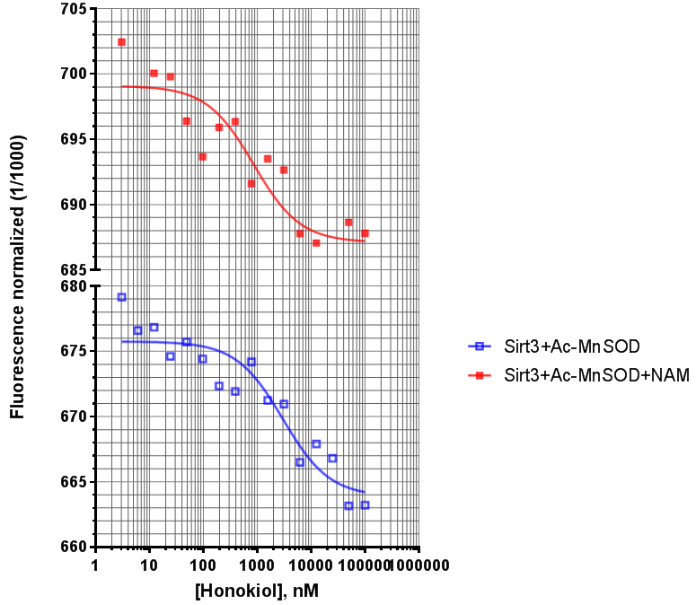
Slide 7 is pt a; this slide w red and
Blue side by side on same axes
is pt b. Also make a caption
 | K_{d_HKL}, uM
Ac-MnSOD | 2.99
Ac-MnSOD + NAM | 0.85

