Slide 1
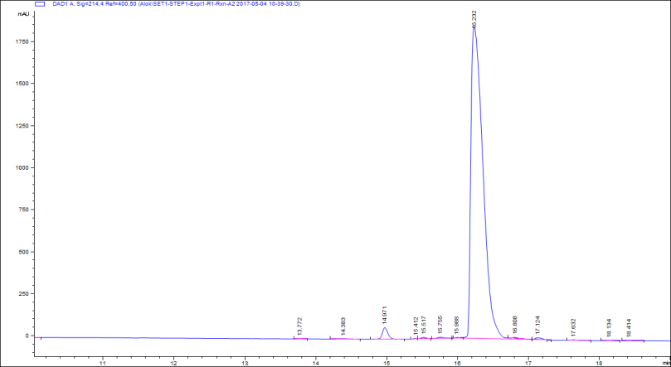
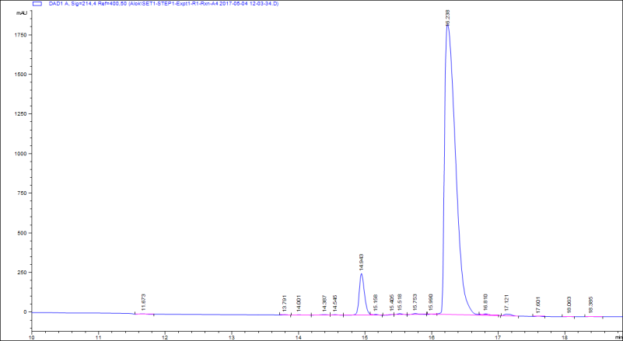
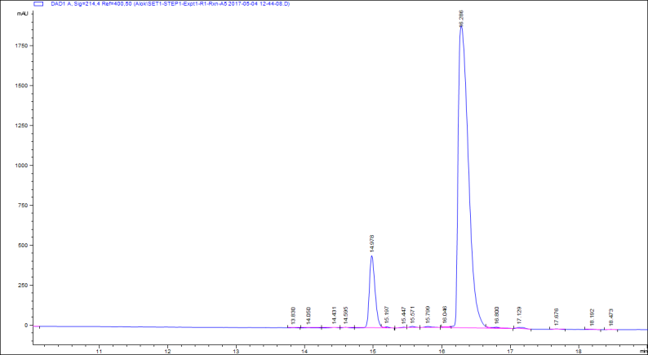
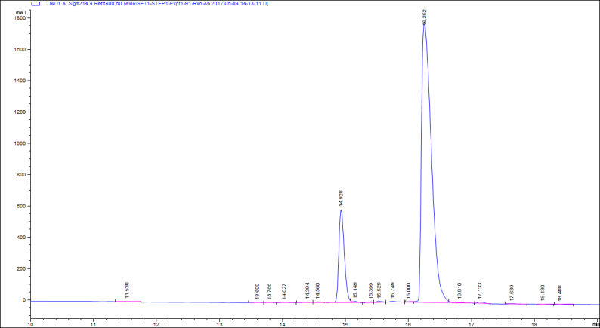
XG-EB-1
A2-10 min
A4-40 min
A5-80 min
A3-30 min
A6-120 min

Slide 2
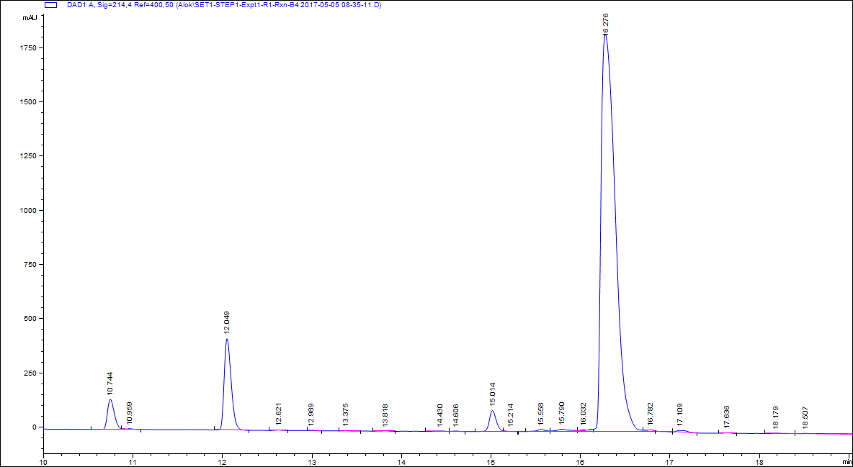
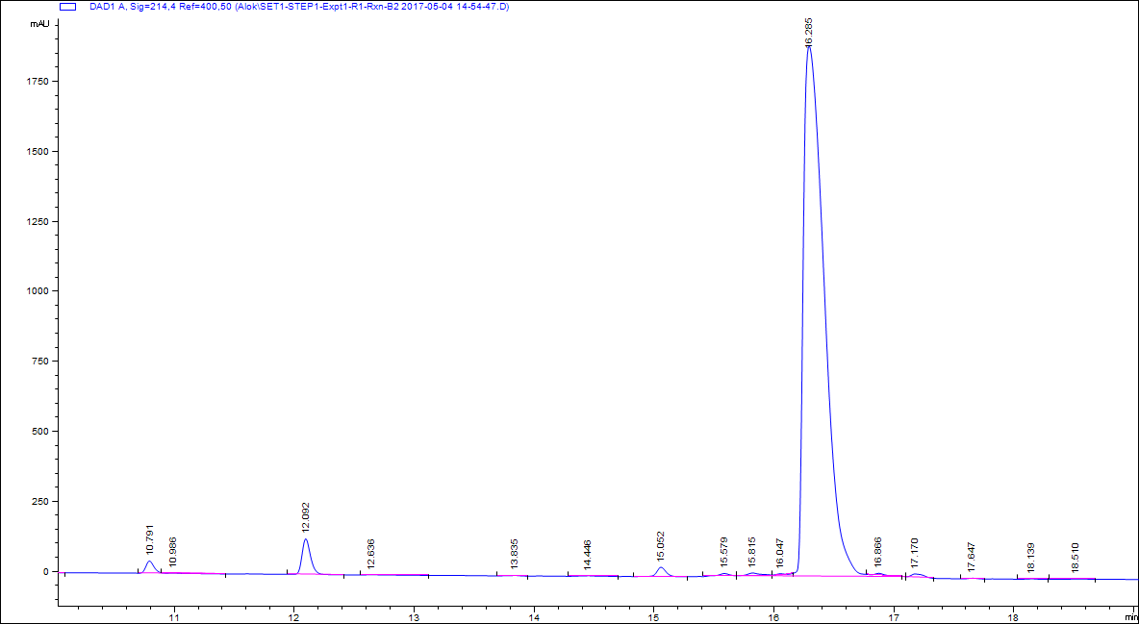
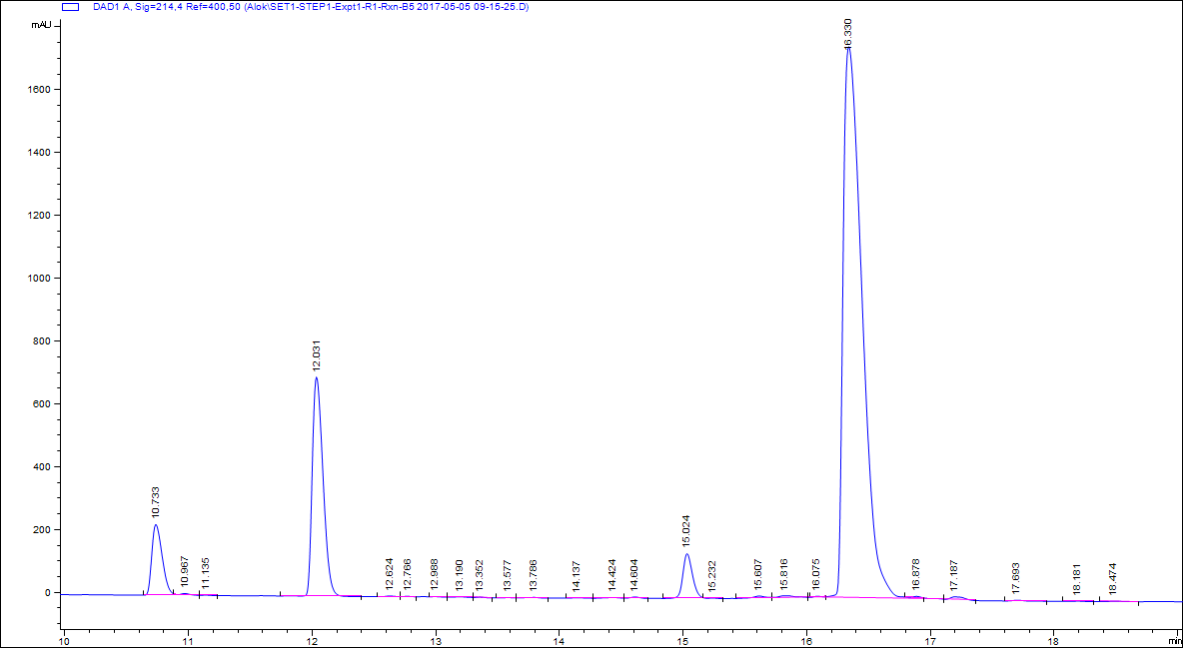
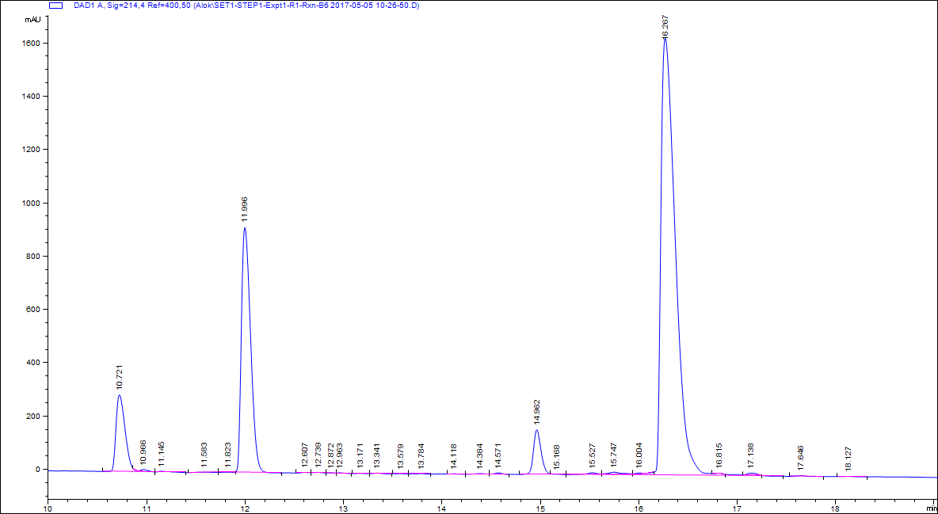
XG-EB-2
B4-40 min
B2-10 min
S
S
Peak 2
Peak 1
Peak 2
P
Peak 1
P
B5-80 min
Peak 2
S
B3-30 min
Peak 1
Peak 2
S
P
Peak 1
P
B6-120 min
Peak 2
S
Peak 1
S = Substrate peak
P = product peak
Red arrow = extra peak
P

Slide 3
Retention time and peak area
Extra Peaks /XG-EB2 | [NAD] = 3000 uM, [K122] = 600 uM; Sirt3-XG-EB2
Time (min) | 10 | 30 | 40 | 80 | 120
Reactions | B2 | B3 | B4 | B5 | B6
Peak 1 Rt (Min) | 10.791 | 10.715 | 10.744 | 10.733 | 10.721
Peak 2 Rt (Min) | 12.092 | 12.016 | 12.049 | 12.031 | 11.996
Peak 1 Area | 207.2263 | 587.9065 | 739.1135 | 1314.251 | 1844.23
Peak 2 Area | 625.8806 | 1800.679 | 2282.354 | 4207.718 | 5989.596
Actual Product/Subs area | [NAD] = 3000 uM, [K122] = 600 uM; Sirt3-XG-EB2
Time (min) | 10 | 30 | 40 | 80 | 120
Reactions | B2 | B3 | B4 | B5 | B6
Product Rt (Min) | 15.052 | 14.981 | 15.014 | 15.024 | 14.962
Substrate Rt (Min) | 16.285 | 16.245 | 16.276 | 16.33 | 16.267
Product Area | 179.2593 | 444.1325 | 529.6533 | 772.5719 | 902.0437
Substrate Area | 22800.3 | 21417.4 | 20334.6 | 18638.3 | 16900.2
Total Area | 22979.56 | 21861.53 | 20864.25 | 19410.87 | 17802.24

