Slide 1
PMC-AT Group Meeting
(Experimental section)
Ping LIN
Xiangying Guan
Oct. 18, 2013

Slide 2
Outline
Overview of current methods used and developing in the lab
Enzyme coupled continuous assay
importance
progress status
Comparison on the cost/time by using different assays
Experimental approaches for inhibitor discovery
IC50
Inhibition mode
Binding affinity
Activator discovery
Proposed research

Slide 3
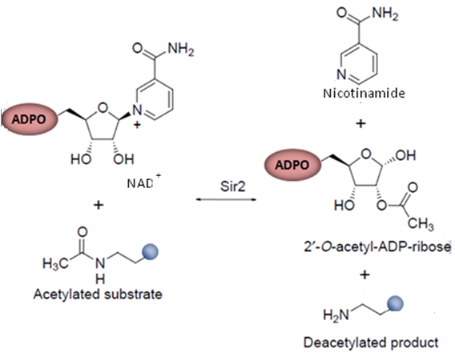
Methods current used and developing at the lab
Developer

Slide 4
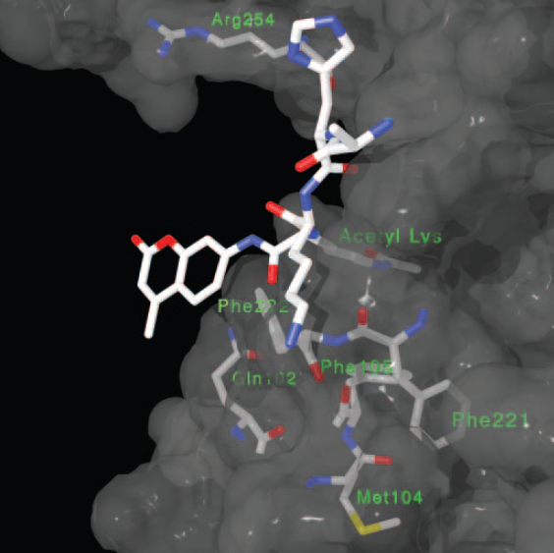
The fluorescence-based assays have been shown to be very efficient approaches for screening a large number of compounds. However, it was found that resveratrol failed to activate the deacetylase activity of SIRT1 by using an unlabeled substrate. Therefore, SIRT1 activation was dependent on the presence of a fluorescent label. Competition studies demonstrated that the attachment of a fluorophore decreased the binding affinity of the corresponding peptide, but in the presence of resveratrol, the tagged substrate bound more tightly (M. T. Borra, B. C. Smith, J. M. Denu, J. Biol. Chem. 2005, 280, 17: 187.)
To directly monitor deacetylation,
MS (Pacholec, Bleasdale et al. 2010)
HPLC (Borra and Denu, 2003)
Microfluidic mobility shift assays (Liu, Gerber et al, 2008)
To measure nicotinamide formation,
A continuous microplate assay (Smith, Hallows 2009)
[¹⁴C]nicotinamide release assay (Kaeberlein, McDonagh et al, 2005; McDonagh, Hixon et al. 2005)
Nicotinamide exchange assay (Landry, slama et al. 2000; Landry, Sutton et al. 2000)
TLC methods (Borra and Denu 2003; Landry, Sutton et al. 2000; Tanny and Moazed 2001)
To monitor the production of OAADPr,
Charcoal binding (Borra and Denu 2003)
TLC (Landry, Sutton et al. 2000; Tanny and Moazed 2001)
HPLC assays (Borra and Denu, 2003)
Putative binding site of the p53-AMC peptide. The p53-AMC peptide substrate modeled from the crystal structure of an 18-mer p53 peptide bound to Sir2-Af2 is shown bound to SIRT1 built from homology modeling. The SIRT1 residues Gln102, Met104, Phe105, Phe221, Phe222, and Arg254 are shown as possible new contacts to the coumarin of p53-AMC upon loop rearrangement resulting from resveratrol binding. These residues were chosen from the built model because of their close proximity to the coumarin ring (<10 Å).

Slide 5
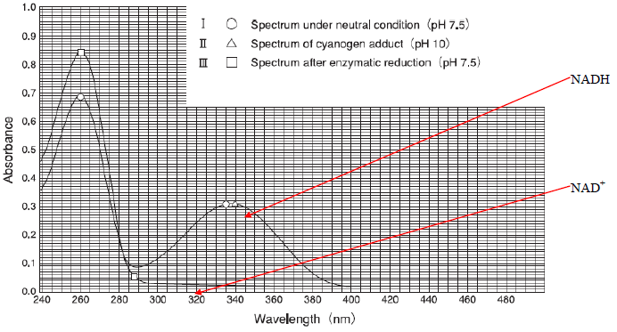
Methods current used and developing at the lab Coun’t
GDH
Glutamate
+
NAD⁺
PNC1
Ammonia
+
Nicotinic acid
α-ketoglutarat
+
NADH

Slide 6
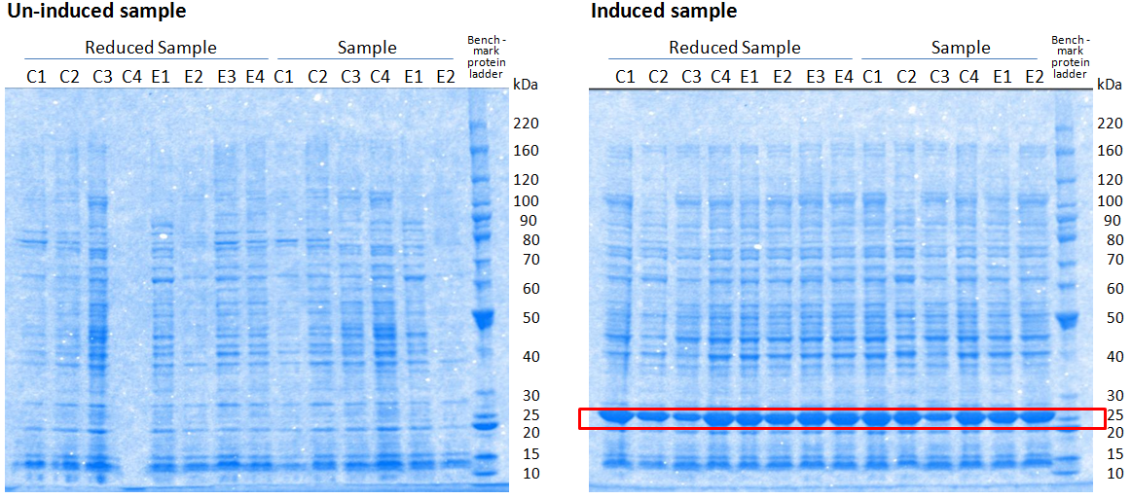
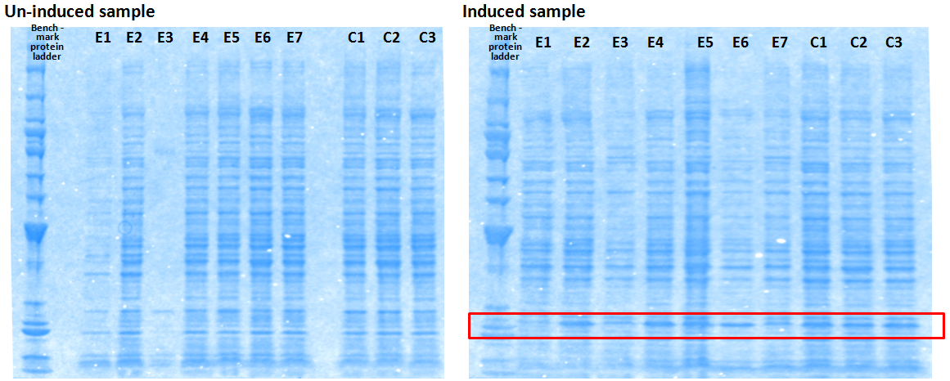
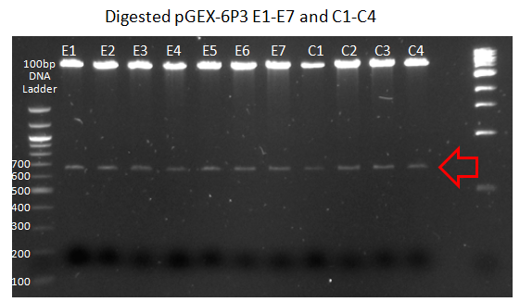
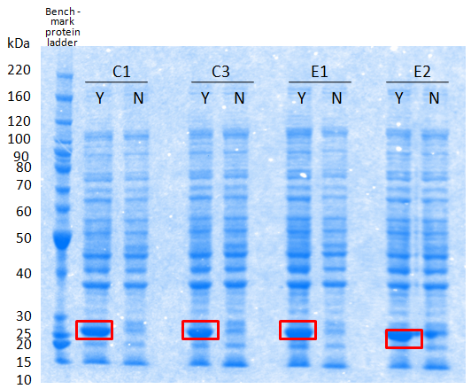
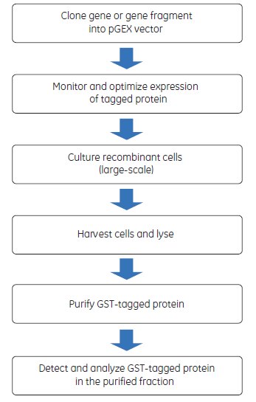
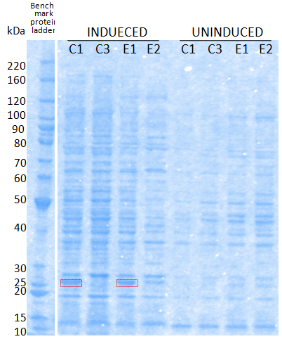
Continuous enzyme coupled assay
PCR amplification of PNCA from Samonella genomic DNA (Primer design, PCR condition optimization, …)
Subcloning into appropriate expression vector-pGEX6P3. (TOPO cloning, transformation of TOP10 chemical competent cell, identification of positive clones, Mini and Midiprep for sequencing, Digestion, Alkaline phosphatase, Calf Intestinal_CIP for Ligation, …)
Plasmid maxi preparation
Linearism the constructs
Transformation the linear construct into the appropriate host strain BL21(DE3)
Confirmation of positive transformants
Expression optimization and confirmation. (Screening of transformants, media formulation and inducer concentrations, induction temperature and length, culture lysate conditions, SDS-PAGE gel, …)
Large-scale expression.
Purification and confirmation.
Activity measurements

Slide 7
Standard work flow [Study of the potency of inhibition and inhibition mode of candidates inhibitors_Ex-527, AC93253, salermide, ChemBridge 5281077, 4102009, 9147724 are currently available in the lab….]
Week 1: Inhibitor physiochemical properties
Solubility in H2O, assay buffer
If not soluble or have very poor solubility in assay buffer, selection of organic solvent
Concentration range, pH range
If has color, background minimization
Week 2: Standardization of working assay systems (Fluor-de-Lys and Continuous Enzyme Coupled Assay)
Standard calibration curve
Titration of developer signal stabilization
Measurement of Km(NAD+) and Km(substrate peptide)
Week3 and 4: Inhibition mode of target inhibitors (Duplication is applied.)
IC50 (may try 10 different [inhibitor] then narrow down for specific range.)
Ki ( [NAD+]=0, 62.5, 125, 250, 500, 1000, 1500, 3000 uM with different [inhibitor].)

Slide 8
Comparison on the cost/time by using different assays
 | Fluor-de-Lys SIRT3 drug discovery kit |  | Continuous enzyme coupled assay
 | Time | Cost | Time | Cost
For inhibitor screening | 1 month for 5 inhibitors | 2 kits ~$1200 | 1 month for 10 inhibitors | Costs of the chemical reagents used in assay, like buffer solutions, chemicals, 96-well plates et al
For inhibition mode study | 4 weeks for testing 1 inhibitor | 2 kits ~$1800 | 3 weeks for testing 1 inhibitor

Slide 9
Our interests
Inhibitor Screening
Activator Design
Inhibitor Screening
IC50_ the potency of inhibitor
Ex-527 0.175
AC93253 0.018
Salermide 0.027
Cambridge_5281087
Cambridge_4102009
Cambridge_9147724
Inhibition mode _ inhibition mechanism

Slide 10
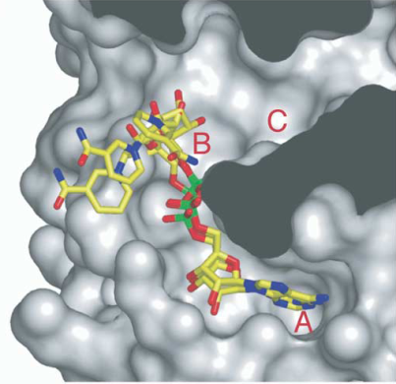
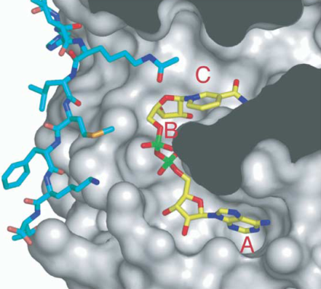
Proposed mechanism of SIRT3 deacetlyation
Substrate Binding and Base Exchange may coexist.
Substrate Binding
Are AB or AC pockets the only poses for NAD⁺ ?
In the absence of substrate peptide, NAD⁺ can bind in the A and B pockets of sirtuins in alternative, non-productive conformations (Fig.B). In the presence of a substrate peptide (Fig.C.), NAD⁺ binds in a precise productive conformation that buries its nicotinamide moiety in the highly conserved C pocket of sirtuins.
Avalos JL, Bever KM, Wolberger C (2005) Molecular Cell, 17, 859-868.
Denu, J.M. (2003). Trends Biochem. Sci. 28, 41–48.
Notes:
In our first paper, we emphasized the importance of substrate binding. We have focused on NAD+ binding site, which include AB pocket for productive mode, and AB pockets for nonproductive mode. According to inhibition mode, therefore our assumption was for noncompetitive inhibition, inhibitor occupied C pocket while NAD+ was in AB pose. For competitive inhibition, inhibitor compete with NAD+ for C pocket binding since NAD+ can not be docked into B pocket. However, in our model, we did not include some possibilities that NAD+ can be docked into other place other than B pocket.

Slide 11
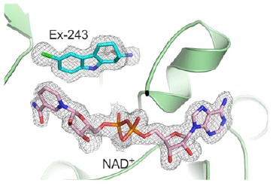
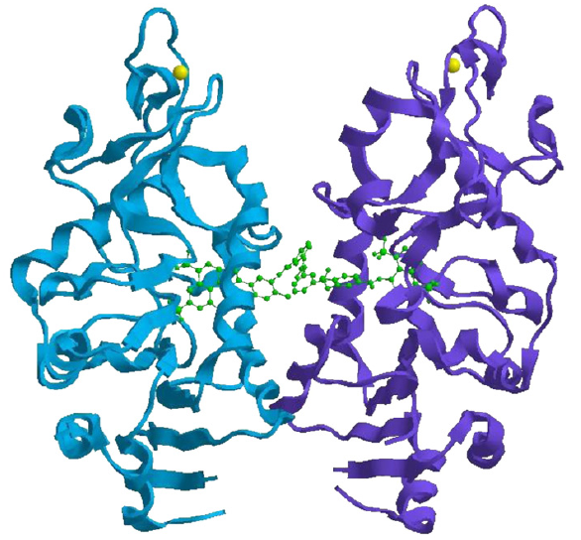
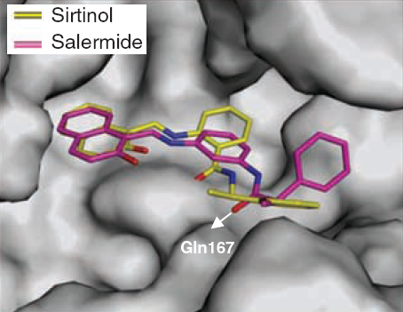
Other Inhibition Mechanisms
Ex-527 occupies the nicotinamide site and a neighboring pocket and binds to intermediate, which stabilizes the closed enzyme conformation preventing product release.
For inhibitor design
Only target C pocket binding ?
or
Expand the target area to emphasize potency of inhibition?
SirT5 binds to suramin. The two SirT5 monomers, suramin and zinc atoms are colored in blue, purple, green and yellow, respectively.
Structures of the complexes sirtinol/Salermide with human Sirt2 histone deacetylase modelled by docking these two ligands onto the C-pocket of Sirt2 structure after minimization. The white arrow shows the polar interaction between the carbonyl group of the amide of Salermide and Gln167 of Sirt1, which is absent in the case of sirtinol.

Slide 12
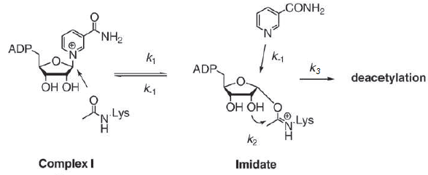
Base Exchange
Nicotinamide bond cleavage step is usually faster than the downstream chemistry of the imidate intermediate (Jackson, Schmidt et al, 2003; Sauve, Schramm, 2003; Borra, Langer et al, 2004).
The nicotinamide bond cleavage step is not rate limiting and the nicotinamide base-exchange rate proceeds faster than the deacetylation reaction rate (Jackson, Schmidt et al, 2003; Sauve, Schramm, 2003).
When nicotinamide base-exchange rate greatly exceeds the deacetylation rate (k₋₁ >k₂), NAM inhibition is efficient.
If the base-exchange rate is slower than the deacetylation rate (k₋₁<k₂), inhibition of deacetylation by nicotinamide will not complete, such as the inhibition of Af2Sir2 deacetylase reaction by NAM does not exceed 50% (Sauve, Schramm, 2003). This type of inhibition is called hyperbolic or non-linear inhibition. This causes nicotinamide to be slower in reacting with the intermediate, relative to forward chemistry and results in hyperbolic inhibition.

Slide 13
Radioactive labeled reagents are involved in all of the current published methods for detection of NAM exchange rate.
Microplate filtration assay for NAM release from NAD using a boronic acid resin. McDonagh T et al. Methods 36 (2005) 346.
Sir2 Regulation by NAM results from switching between base exchange and deacetylation chemistry.
Sauve AA and schramm VL. Biochemistry 42(2003)9249-9256.

Slide 14
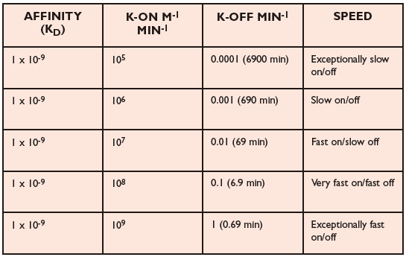
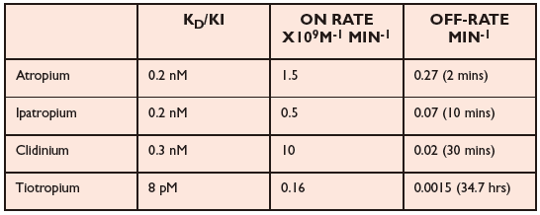
The need for kinetics study early in the drug discovery process
The majority of drug discovery projects rely upon estimates of compound affinity to a target protein to guide lead seeking medicinal chemistry in early stages when high compound numbers are being screened.
Affinity (K_{D}) for a target protein, derived from IC50, is used regularly to rank compound performance. K_{D} is dependent on both the association (on) and dissociation (off) rates of the compound and it is not possible to predict these from the K_{D} as shown in Table below.
Increased residence time gives better duration of action
Improved selectivity due to differential off-rates

Slide 15
Our interests
Inhibitor Screening
IC50_ the potency of inhibitor
Inhibition mode _ inhibition mechanism
Binding affinity _ direct comparison to simulation work
Methods
Radio-labeled ligand_binding-site competition between a hot ligand and a cold ligand (untagged ligand).
Non labeled methods
Surface plasmon resonance
Dual polarisation interferometry , can also quantify the affinity from concentration based assays but also from the kinetics of association and dissociation, and, in the later case, the conformational change induced upon binding.
Microscale Thermophoresis (MST), an immobilization-free method was developed. This method allows the determination of the binding affinity without any limitation to the ligand's molecular weight.

Slide 16
Our interests
Inhibitor Screening
Activator Design

Slide 17
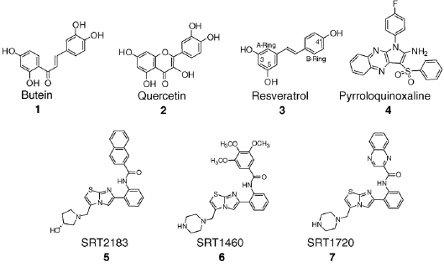
Small-molecule activators
Across the Sirtuin family, only activators of SIRT1 have been described. The first small molecule activators of SIRT1 identified were polyphenolic plant metabolites (STACs) elonging to three structural classes — chalcones (butein 1), flavones (quercetin 2), stilbenes (resveratrol 3), and novel small-molecule activators of SIRT1 (SRT2183 5, SRT1460 6, and SRT1720 7) .
Notes:
The most potent natural product activator identified was resveratrol 3 in terms of its ability to activate the enzyme in vitro and to extend lifespan in S. cerevisiae in a Sir2-dependent manner. Additional polyphenolic plant metabolites were also identified as activators of SIRT1 enzyme activity, but not more potent than resveratrol. The structure–activity relationship (SAR) surrounding resveratrol has been explored for SIRT1 activation and the hydroxyl substituents at the 3 and 5 positions of the A ring were identified as crucial for activity, while modification at the 40 position of the B ring could be tolerated. Nayagam and Wang describe the identification and in vitro characterization of non-polyphenolic SIRT1 activators based on imidazoquinoxaline and pyrroloquinoxaline scaffolds. These compounds exhibit micromolar potency and the ability to activate
SIRT1 by approximately twofold in vitro, and are functionally active in cellular assays.
Novel small-molecule activators of SIRT1 (SRT2183 5, SRT1460 6, and SRT1720 7) compounds are structurally unrelated to any of the previously identified SIRT1 activators, significantly more potent, orally bioavailable, and active in vivo. From initial hits identified by high-throughput
screening, these compounds were derived from SAR studies conducted using a high-throughput mass spectrometry assay to optimize the potency and maximal activation of SIRT1.

Slide 18
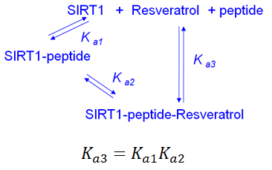
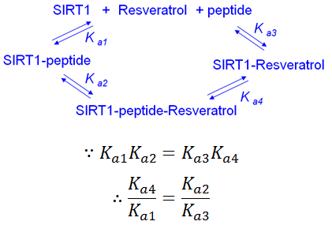
Mechanism 2
However, Miline et al. pointed out that resveratrol only bind to SIRT1 in the presence of fluorophore peptide (Milne, Lambert et al. 2007).
The net affinity for peptide binding to the resveratrol-bound complex is the multiplied association constants of peptide and resveratrol. Resveratrol that bind with similar affinity, but does not provide the same extent of activation (peptide-binding stabilization).
Mechanism 1
In Sinclair’s 2003 nature paper, resveratrol was termed an allosteric effector of SIRT1 (as well as yeast Sir2). Previous results indicated that a conformational change in SIRT1 was induced by resveratrol binding, which stabilized fluorophore peptide binding (Borra, Smith et al. 2005).
The enhanced binding of peptide to the activator-substrate complex is determined by the relative affinity of resveratrol for the peptide complex versus free SIRT1.
Conclusion: Since it is required to involve protein conformational change connecting two binding, the mechanism for the biochemical effect of resveratrol is heterotropic substrate-driven allostery. Accordingly, substrate binding opens a distinct site for activator-ligand binding, which stabilizes substrate binding by a thermodynamic component associated with substrate driven activator binding (Gunasekaran, Ma et al. 2004).

Slide 19
3rd mechanism : IsoNAM like small molecules activate SIRT3 by reliving NAM inhibition. (Sauve, Moir et al. 2005)
Nicotinamide bond cleavage step is usually faster than the downstream chemistry of the imidate intermediate (Jackson, Schmidt et al, 2003; Sauve, Schramm, 2003; Borra, Langer et al, 2004).
The nicotinamide bond cleavage step is not rate limiting and the nicotinamide base-exchange rate proceeds faster than the deacetylation reaction rate (Jackson, Schmidt et al, 2003; Sauve, Schramm, 2003).
When nicotinamide base-exchange rate greatly exceeds the deacetylation rate (k₋₁ >k₂), NAM inhibition is efficient.
If the base-exchange rate is slower than the deacetylation rate (k₋₁<k₂), inhibition of deacetylation by nicotinamide will not complete, such as the inhibition of Af2Sir2 deacetylase reaction by NAM does not exceed 50% (Sauve, Schramm, 2003). This type of inhibition is called hyperbolic or non-linear inhibition. This causes nicotinamide to be slower in reacting with the intermediate, relative to forward chemistry and results in hyperbolic inhibition.
Computational prediction is needed .

Slide 20
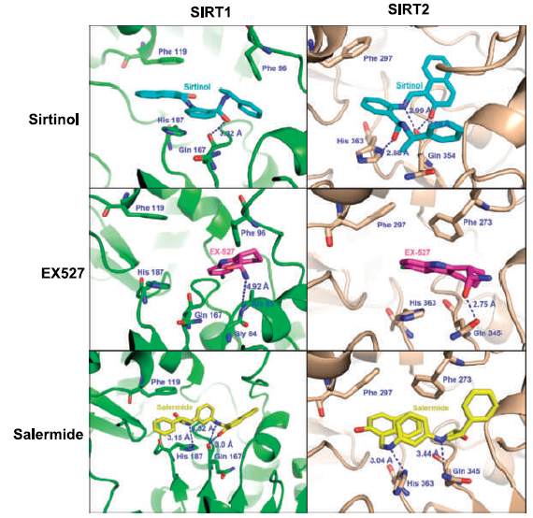
Proposed research
Predict selectivity of target enzyme
Inhibitor screening with specificity (SIRT3)
High throughput screening
Kinetics model for inhibition
Activator discovery
NAM-exchange Assay Development
In terms of SIRT1 binding, both Sirtinol and Salermide show significant hydrogen bonding interactions with Gln 345 and His 363. EX527 also displays hydrogen bonding to Gln 345, with additional π-π interactions with His 363 and Phe 273.
In terms of SIRT2 binding, Sirtinol and Salermide show comparable hydrogen bonding interactions with Gln 167 . Sirtinol also displays π-π interactions with His 187 and Phe 119, whereas Salermide has a hydrogen bond with His 187 and no
interaction with Phe 119. For EX527, no significant interactions was found with SIRT2, the closest interaction identified being a Van derWaals force between EX527 and Ala 85.
Salermide have high degrees of selectivity for SIRT1/2, whereas EX527 has a high specificity for SIRT1 but not SIRT2.

Slide 22
Inhibition Mode

Slide 24
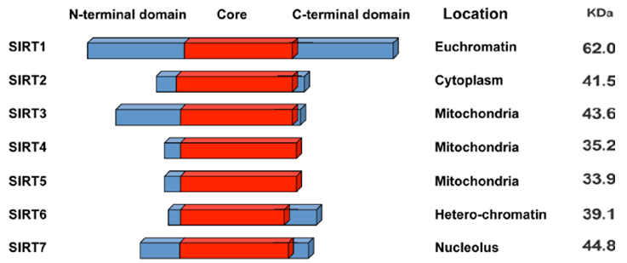
The Mammalian Sirtuins: SIRT 1-7
Mammals contain seven sirtuins, SIRT1–7, which are categorized by their highly conserved central NAD+-binding and catalytic domain, termed the sirtuin core domain. Although these sirtuins are relatively conserved, their N and C termini differ, and they are likely to have highly divergent biological functions owing to (a) different enzymatic activities, (b) unique binding partners and substrates, and (c) distinct subcellular localization and expression pattern.
Frye, R.A. (2000) Biochemical and Biophysical Research Communications, 273, 793–798.
Alhazzazi TY et al. (2011) Biochim Biophy Acta. 1816, 80-88.

